Slide 1
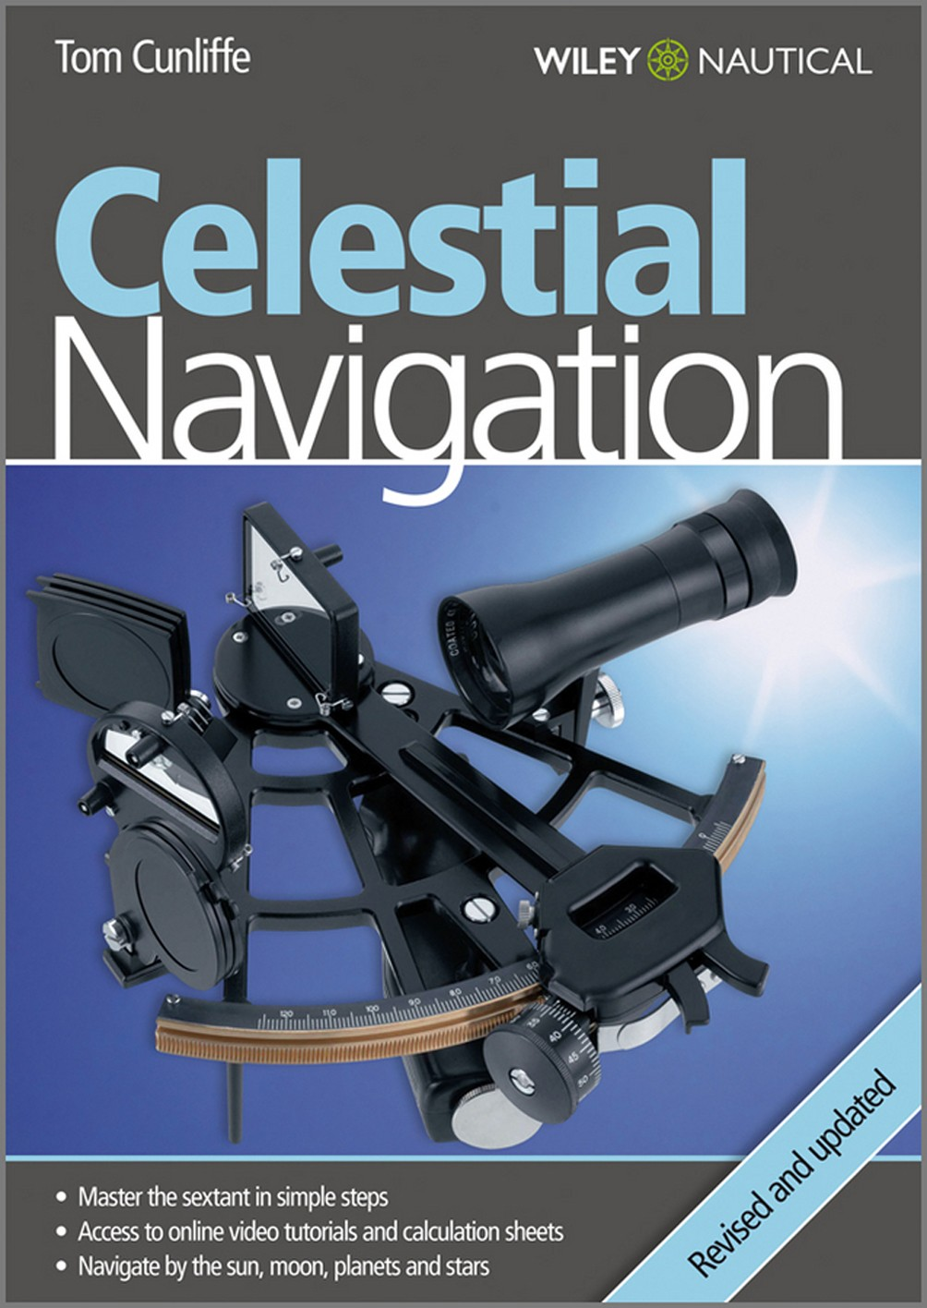

Slide 3
Celestial Navigation
Tom Cunliffe

Slide 5

Celestial Navigation
Revised and Updated
Tom Cunliffe

Slide 6
This edition first published 2010
© 2010 Tom Cunliffe
Registered office
John Wiley & Sons Ltd, The Atrium, Southern Gate, Chichester, West Sussex, PO19 8SQ, United Kingdom
For details of our global editorial offices, for customer services and for information about how to apply for permission to reuse the copyright material in this book please see our website at www.wiley.com.
The right of the author to be identified as the author of this work has been asserted in accordance with the Copyright, Designs and Patents Act 1988.
All rights reserved. No part of this publication may be reproduced, stored in a retrieval system, or transmitted, in any form or by any means, electronic, mechanical, photocopying, recording or otherwise, except as permitted by the UK Copyright, Designs and Patents Act 1988, without the prior permission of the publisher.
Wiley also publishes its books in a variety of electronic formats. Some content that appears in print may not be available in electronic books.
Designations used by companies to distinguish their products are often claimed as trademarks. All brand names and product names used in this book are trade names, service marks, trademarks or registered trademarks of their respective owners. The publisher is not associated with any product or vendor mentioned in this book. This publication is designed to provide accurate and
authoritative information in regard to the subject matter covered. It is sold on the understanding that the publisher is not engaged in rendering professional services. If professional advice or other expert assistance is required, the services of a competent professional should be sought.
Photo credits pages 10, 11, 12, 14, 15 and 16:
© Lester McCarthy/Yachting Monthly/IPC+ Syndication
Thanks to charter and events specialists, Lymington Yacht Charters, for the provision of a yacht for the filming of the video tutorials. Tel: 01590 676470; www.lyc.co.uk
Library of Congress Cataloging-in-Publication Data
Cunliffe, Tom.
Celestial navigation / Tom Cunliffe. – Rev. and updated, 3rd ed.
p. cm.
ISBN 978-0-470-66633-3 (pbk. : alk. paper)
1. Yachting. 2. Nautical astronomy.
3. Navigation. I. Title. GV813.C785 2010 797.124′6–dc22
2010013938
A catalogue record for this book is available from the British Library.
Artwork by Creative Byte
Set in 9/9.8pt Humanist 777 BT Light by Toppan Best-set Premedia Limited
Printed in Great Britain by Bell and Bain, Glasgow
Wiley Nautical – sharing your passion.
At Wiley Nautical we’re passionate about anything that happens in, on or around the water. Wiley Nautical used to be called Fernhurst Books and was founded by a national and European sailing champion. Our authors are the leading names in their fields with Olympic gold medals around their necks and thousands of sea miles in their wake. Wiley Nautical is still run by people with a love of sailing, motorboating, surfing, diving, kitesurfing, canal boating and all things aquatic.
Visit us online at www.wileynautical.com for offers, videos, podcasts and more.

Slide 7
Contents
Introduction vi
1 | The Earth and the Heavens 1
2 | The Sextant 10
3 | The Noon Sight for Latitude 17
4 | Time 22
5 | Position Lines and Plotting 25 Tables 28
6 | Sun Sights 38
7 | The Planets 44
8 | The Moon 47
9 | The Stars 50
10 | Polaris – the Pole Star 57
11 | Compass Checking on the Ocean | 60
12 | The Shortest Way 62

Slide 8
Introduction
NAVIGATION is that art which instructs the mariner in what manner to conduct a ship through the wide and trackless ocean, from one part to another, with the greatest safety, and in the shortest time possible.
JW Norie
Norie’s Practical Navigation (mid-nineteenth century)
the foreseeable future, therefore, mainstream navigators will use satellite systems as their primary fixing tool. Celestial navigation is deposed from its hitherto unassailable situation at the summit of the navigator’s achievement. Overnight, the skills of the ages were degraded to mere back-up against the ultimate catastrophe, loss of volts. For many sailors, however, the change is to be lamented as well as welcomed.
Until a few years ago, students plunged into the “Celestial Navigation” section of the Yachtmaster Ocean syllabus in earnest. Without it, they would have been truly lost while off soundings. Except in an emergency, this is no longer the case, but it does not mean that when things are going smoothly on the electronic front the old ways should be consigned to an unvisited corner of the mind.
Daily connection with the heavens used to serve as a constant reminder of our own ultimate insignificance which did wonders for any skipper tempted by megalomania. Together with this metaphysical aspect to astro navigation came an inevitable degree of uncertainty about one’s exact position which bred seamanlike caution.
When finally dispelled by a good landfall, this gave rise to an elation that no longer has a parallel. All this is potentially lost to the electronic navigator.
Of greater concern to some, however, will be that sextant work, like all arts, requires continuous practice to achieve any real proficiency. It just isn’t sufficient to take a couple of sun sights on a short passage and send them to an examiner who may then declare you an Ocean Yachtmaster. The traditional daily round of morning or evening stars and the forenoon sight of the sun followed by a noon latitude not only gave rhythm to the watch system, it also bred a facility with the tools that today’s navigator will still need if the electronics ever go down. And one thing at least is certain: the firmament will continue to blaze long after the last navigational satellite has escaped into deep space, or burned up in the final truth of its
re-entry.
For all these reasons, any skipper of a yacht on the ocean should make the effort to master celestial navigation. The methods and techniques
For a thousand years, celestial navigation in one form or another has guided mariners across the trackless oceans. Since the days of Captain Cook, a seaman with a clear horizon and a glimpse of the heavens has needed only a sextant and a chronometer to ascertain his position to within a mile or two.
Only the most cynical of navigators has not at some time looked at the fix on his chart in awe, remembering that the position lines have been derived from stars and galaxies marching at unimaginable distances through space. Whilst the electronics of the new era can only stand to increase man’s pride in his own works, the celestial navigation of the ages encourages a deep humility which, at sea in a small vessel, is no bad thing.
Ocean navigation has changed utterly in the 35 years between my first venture across the Atlantic as skipper and my most recent crossing of the same stretch of water. From celestial navigation as the only option, we have stumbled through a dawn period of transit satellites into the full daylight of universal GPS, Galileo and GLONASS. If the bulkhead GPS fails for any reason out on the wide ocean, the skipper simply reaches into his kitbag for the back-up unit he bought at the boat show for the price of his night’s lodging. Those whose experience of technology has presented a catalogue of disappointments may even have invested in more than two such wonders.
From the beginnings of seafaring, mankind navigated under the inescapable reality that for much of the time his position was seen through a frosted window. All at once, in the early 1990s, technology leapt ahead. An exact fix became available whenever it was desired. For

Slide 9
INTRODUCTION
vii
have been set out here in a form that will get you navigating by the sky as soon as possible – long before you have finished the book – but do not for one moment suppose that because the Sun makes its appearance in these pages before the stars that it is more important. You have to start somewhere and the Sun is pretty hard to miss, so it’s the best thing on which to practise using your sextant. It won’t help you much though, if you are expecting a dawn landfall on an unlit coast and you are wondering where you are. It won’t be around to be observed until after breakfast, and then it will only offer a single position line. Morning stars and a planet thrown in for good measure will, if the sky is clear, fix your position to within a mile or so.
As you will see, stars are surprisingly easy to operate with; the planets are our neighbours under the Sun, and simple to reduce; the Moon is so close that its movements are a challenge but, given proper respect, it will smile wryly down on our efforts and provide a useful signpost.
I am not an astronomer. I am by no stretch of the imagination either a physicist or a mathematician. I am, before everything, a practical seaman. I learned my celestial
navigation by spending long periods of time on the ocean in the days before GPS. One by one I have forced myself over the hurdles presented in my mind by planets, Moon and stars. On each occasion, what I imagined to be a problem soluble only by the academic or hard-line professional turned out to be yet another piece of cake. The whole business, if tackled in the right order, is amazingly simple. In the following chapters I have set out from my own experience what you need to know. Very little more, and no less. You’ll notice that Chapter 1 is all about concepts, conventions and definitions. As Saint John noted, “In the beginning was the Word”. Skip it, and you’re in trouble. Read it, understand it and be ready to refer back to it because it is the rock on which the rest is built.
Apologies to any women offended by my use of the masculine personal pronoun. Absolutely no disrespect is intended and some of the best star navigators of my acquaintance have been ladies. However, continuously using the phrase ‘he or she’ is tiresome, and I categorically refuse to insult my readers by using the plural pronoun for a singular case. So, for convenience only, male it is. The Romans did it that way too. Fair winds to you on your voyage!

Slide 11


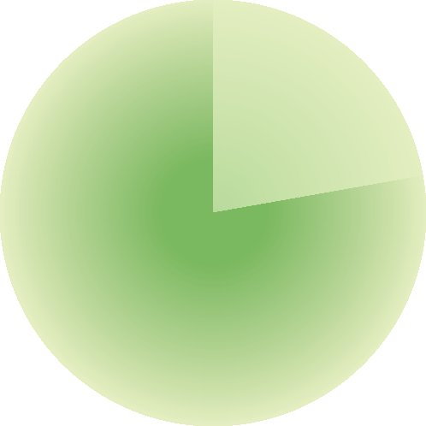
1 The Earth and the Heavens
We all learn as infants that the Earth revolves once a day and that the stars remain, to a greater or lesser extent, stationary. We also become aware that the Moon is in our own back yard, that the stars are plunging through space at various mind-boggling distances from us and that the Earth is travelling on an annual voyage around the Sun. Whether or not all this is true is of no relevance to the practical astro navigator.
For our purposes the Earth, otherwise known as the terrestrial sphere, may be taken to be a perfectly round ball swimming in a vacuum at the centre of the known universe. At the outside of the vacuum, an indeterminate but fortunately irrelevant distance away, is a further big ball which marks the perimeter of the universe. This ball is known as the celestial sphere. For our purposes all the heavenly bodies move in their courses on its inside surface, and its centre coincides exactly with the centre of the Earth.
Meridian of Longitude
0⁰ meridian (Greenwich)
THE TERRESTRIAL SPHERE
Any location on the Earth’s surface can be expressed in terms of latitude and longitude.
Meridians of longitude
To define our position on the globe in an east–west direction we make use of the meridians of longitude. These are great circles which converge at the poles of the Earth, a great circle being the line described on the Earth’s surface by a plane passing through the centre of the Earth. In the case of a meridian, it is best thought of as what you would see if you pulled a segment out of a perfectly round orange. The segment starts and ends at the opposite poles of the orange. Its curved surface is the shortest distance between them on the surface of the orange. This definition becomes more important when great circle sailing is discussed later. For
Parallel of Latitude
angular distance 80⁰
North Pole
small circle
80⁰ west longitude
Pole
great circle (equator)
terrestrial sphere
Looking down on the Earth’s axis from the Pole. An observer at 80°W longitude is at an angular distance of 80° west of the Greenwich Meridian.
South Pole
Great and small circles (Earth viewed from just north of the equator). The equator is a great circle – that is, on a plane that passes through the centre of the Earth – but all the other parallels of latitude are small circles.

Slide 12


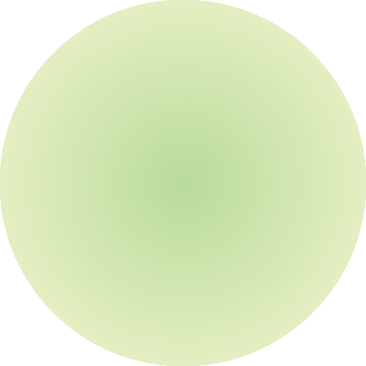
2
CELESTIAL NAVIGATION
now, it is enough that a meridian runs direct from pole to pole on the surface of the terrestrial sphere.
Position is measured in terms of angular distance (see below) east or west of the zero or datum meridian. This passes through the Greenwich Observatory in England, and is known as the Greenwich Meridian. Those in denial of Britain’s contribution to astronomy and longitude can choose to call this the International Reference Meridian, or the Prime Meridian.
Longitude is measured in degrees east or west of Greenwich until east and west meet somewhere in the remote Pacific Ocean.
Parallels of latitude
Having determined our angular distance east or west of Greenwich we need another set of co-ordinates to fix us in a north–south direction. These are the parallels of latitude, which define angular distance north or south of the equator, which is actually the great circle on a plane at right angles to the Earth’s axis, halfway between two poles.
The equator is the only parallel of latitude which fulfils the definition of a great circle. All the others are small circles (see diagram).
celestial pole
North Pole
terrestrial sphere
celestial equator
equator
South Pole
celestial sphere
celestial pole
40⁰N latitude
The celestial sphere is an imaginary sphere enclosing the Earth, with its own poles and equator. For the purposes of navigation, all celestial bodies such as the Sun and the stars
are positioned on the surface of this sphere regardless of their actual distance from the Earth.
0⁰ (equator)
40⁰
60⁰
Geographic position
Any point on the Earth’s surface fixed by its terrestrial co-ordinates (latitude and longitude), is known as a geographic position (GP).
Angular distance
For the non-specialist, distances between locations on Earth are generally expressed in miles or kilometres. This is convenient because we need to time our journeys. For the astro navigator, things are somewhat different. It would be impossible to try to handle the north–south distance between the stars Sirius
60⁰S latitude
Latitude – the Earth (the terrestrial sphere) viewed from the plane of the equator.
Latitude is expressed as an angular distance north or south of the equator, measured from the centre of the Earth.

Slide 13
THE EARTH AND THE HEAVENS
3
and Aldebaran in terms of miles, but to say that it is 33° measured from the centre of the Earth is comprehensible and very easy to work with.
When dealing with spheres, the most convenient unit of distance is one degree of a circle. The Earth turns through around 25,000 miles in a 24-hour day at the equator. Because the meridians come together at the pole, it won’t be anything like this far in Northern Norway. This inconvenience is done away with if we think of Earth as turning through 360 degrees in a day. This is angular distance. It’s the same in Norway, the Caribbean and even for a masochist camped out a few yards from the North Pole.
Subdivision of degrees
A degree subdivides into 60 minutes (60′), and each minute into 60 seconds (60″). One minute of latitude is equal, at all latitudes, to one nautical mile (1M). One second of latitude is equal to 101 feet, or a few boat lengths for the average yacht. Since this is clearly too small to be of any serious use, minutes of arc are now more conveniently subdivided into decimal points, thus: 36°14.1′N. A tenth of a mile is around 200 yards, the length of a unit of anchor rode in Nelson’s navy, hence the term ‘cable’ when used for distance.
One minute of longitude equals one mile at the equator, but diminishes to zero at the poles.
Working out what it represents in between in terms of miles would mean yet another calculation, so there, straight away, is a very
good reason for the concept of angular distance.
by Universal Time (UT). Modern almanacs and data in general refer nowadays to UT,
but Greenwich remains the centre of operations for the celestial navigator. As for time alone, there is no practical difference between the two.
The celestial zero meridian is the projection of the terrestrial zero (Greenwich) meridian. However, whereas terrestrial longitude is measured from the Greenwich Meridian in degrees east or west around the world to 180° on the opposite side, celestial longitude,
which is known as Greenwich Hour Angle (GHA), is measured to the westward only in degrees from 0° to 360°. When considering matters concerning the concept of Greenwich Hour Angle, never forget that it is merely a way of expressing celestial longitude.
You will see in the diagram on page 4 that 40°W longitude is the equivalent of a GHA of 40° on the celestial sphere, and that 120°E longitude marries up with GHA 240°. A second glance shows that if 120°E were expressed in
a 0° to 360° notation, beginning at Greenwich and working westward, it would represent a longitude of 240°. It is just a question of convention. For better or worse, longitude is expressed as 0° to 180° east or west, and GHA as 0° to 360°.
To convert east longitude to 360° notation and tie it in with the corresponding GHA, simply subtract the figure from 360°. Thus 120° east is equivalent to a GHA of 360 minus 120, or 240°.
To find the GHA of a body for a given time (and it changes by the second as the Earth turns) you need to consult The Nautical Almanac or one of the other available books containing the required data, known as the nautical ephemeris. By far the easiest of these to use, although not the cheapest, is the almanac itself, published jointly by HM Nautical Almanac Office, United Kingdom Hydrographic Office (NP 314) and, in the United States, by the United States Naval Observatory. These two books are one and the same. Illustrated on pages 28–29 are the pair of ‘daily pages’ from the almanac for 1st, 2nd and 3rd May of a given year. (The year for the examples in this book is actually 1986. In practice you would turn to the current year in your almanac.) The far left column of the right-hand page refers to hours of GMT and the next column gives the
GHA of the Sun for the hour exactly. To find the increment by which it varies for minutes and seconds of time, turn to the ‘increments’ tables in the back pages of the almanac, an example of which is illustrated on page 30. Read off the
THE CELESTIAL SPHERE
Just as it is possible to fix a position on the Earth’s surface using its terrestrial co-ordinates of
latitude and longitude, so the exact situation of a heavenly body on the surface of the celestial
sphere can be defined by its celestial co-ordinates.
All the main features of the terrestrial sphere are mirrored in its celestial counterpart.
The terrestrial poles, if projected outwards from the centre of the Earth onto the celestial sphere, form the celestial poles. The terrestrial equator is projected outwards to throw a great circle onto the celestial sphere equidistant at all points from the celestial poles. This is called the celestial equator.
Celestial longitude – or Greenwich Hour Angle (GHA)
Since the first edition of this book, the notion of Greenwich Mean Time (GMT) has been replaced

Slide 14


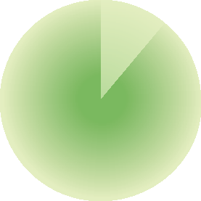

4
CELESTIAL NAVIGATION
GHA 40⁰
zero meridian
40⁰W longitude
pole
120⁰E longitude
GHA 240⁰
View of the earth and the celestial sphere from the north elevated pole. Greenwich Hour Angle (GHA) compared to longitude.
answer, making sure that you take it from the correct column.
Note that since the heavenly bodies are moving westward, their GHA goes on increasing until it reads 360°, when it starts again. This means the minutes and seconds increments
are always added to the hourly value of the GHA.
Example
What is the GHA of the Sun at 10 h 15 m 47 s GMT on 1st May?
this case, 43.5 + 56.8 = 100.3 minutes. At 60 minutes to the degree, that makes 1°40′.3.
Celestial latitude, or declination
The cross co-ordinate used on the celestial sphere to fix the position of a heavenly body north or south on its GHA co-ordinate is its declination. As you’ll by now be able to guess, it corresponds exactly to terrestrial latitude.
Declination is actually angular distance north or south of the celestial equator and, like terrestrial latitude, it is conveniently named north or south. A body with a declination of 42°N will, at some time in the 24-hour period, pass directly over the head of an observer in 42°N latitude.
Declination often changes with time. To calculate the declination of a body for a given moment consult the almanac. Look again at the daily pages illustration (pages 28–29) and notice
GHA 10 h 330° 43′ .5
+Increment for 15 m 47 s 3° 56′ .8
GHA Sun 334° 40′ .3
Notice that 43′.5 + 56′.8 equals 1°40′.3. Sixty minutes make one degree, not one hundred. In

Slide 15




THE EARTH AND THE HEAVENS
5
that each column gives not only the changing GHA of the body, but also its declination.
At the bottom of the column is a small letter ‘d’ with a numerical value beside it. This is the rate of change per hour. Inspection of the hours adjacent to the one you are interested in will show whether the change is to be added or subtracted, depending on whether declination is increasing or decreasing.
Now look at the illustration of the ‘increments’ page (page 30), and check the column for each minute headed ‘v’ or ‘d’ correction.
Suppose you are interested in a 14-minute increment and a ‘d’ value of +0.9. Go down the column for 14 minutes as far as ‘d’ 0.9 and read off the value, which is +0.2. This figure is now added to the hourly declination figure you’ve taken from the daily page. Notice that ‘v’ and ‘d’ corrections do not refer to seconds of time. The
figures in the column are for minutes only, which is invariably quite accurate enough.
In practice, many people can usually work out the declination for a given number of minutes after the hour by inspection and mental arithmetic, so recourse to the increment pages for changing declination is rare. In the case of the Moon, however, declination varies rapidly and hugely, so the mental arithmetic involved in bypassing the ‘d’ increment is way beyond me. Here, then, is an example of its use:
Example
What is the declination of the Moon at 2314 on 3rd May?
Dec 23 h S 8° 15′ .3
− d(14.4) 14 m 3′ .5
Dec 2314 S 8° 11′ .8
Earth and the celestial sphere from the equator. Latitude compared to declination.
declination 42⁰N
celestial sphere
42⁰N latitude
observer
42⁰
celestial equator

Slide 16

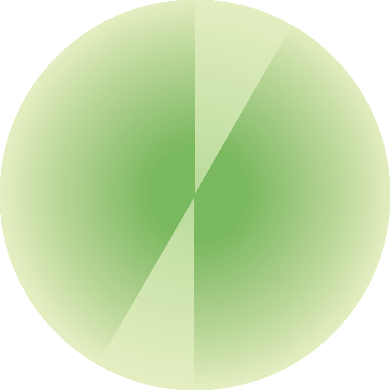
6
CELESTIAL NAVIGATION
Note that in this case ‘d’ is negative because declination is decreasing, and that the declination is always labelled N or S.
Zenith
An observer’s zenith is his terrestrial position projected from the centre of the Earth onto the celestial sphere. In other words, the point directly above his head. The declination of his zenith is the same as his latitude. The GHA of his zenith is the same as his longitude, although in east longitude it will be necessary to adjust the longitude figure to read 0° to 360° notation by subtracting it from 360°.
Opposite the observer’s zenith is the celestial position delightfully termed his nadir. Project a line from the zenith through the observer to the centre of the Earth, keep going until you hit the celestial sphere on the other side, and you have
it. As the name suggests, it’s about as low as you can get.
Local Hour Angle
In the majority of the calculations involved in celestial navigation, the data required will not be the Greenwich Hour Angle of the body concerned, but the Local Hour Angle (LHA).
Just as the GHA of the body at a given time is its angular distance west of the Greenwich Meridian, so the LHA of the same body is its angular distance to the west of the observer’s meridian.
Given the GHA of the body from the almanac (see page 3) and some idea of your longitude, working out the body’s approximate LHA is straightforward.
As always with angular questions, when in doubt draw a diagram. Below are four examples
zenith
pole
The nadir is the celestial position opposite the observer’s zenith.
nadir

Slide 17
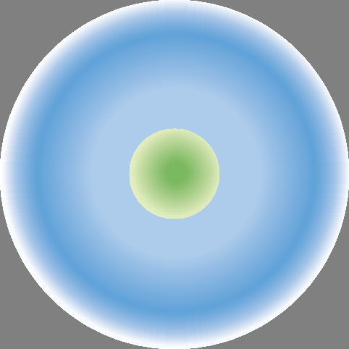
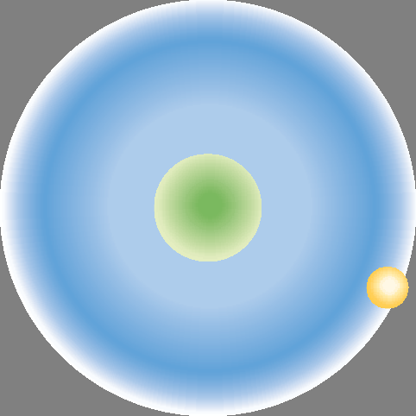



THE EARTH AND THE HEAVENS
7
to illustrate the four most likely calculations of LHA. They are quite simple and it is vital that they are understood. Without a grasp of the concept of Local Hour Angle, the rest of the book will simply not make sense.
Case 1
West longitude: GHA of Sun greater than observer’s longitude.
In this case
LHA = GHA minus longitude west.
GHA, then subtract it from 360 (the remainder of the full circle).
On the face of it, this looks a bit awkward. By far the easiest way to handle these numbers is to add the GHA to 360 and then subtract the west longitude. The answer comes out right every time.
₀0
₀0
GHA
GHA
longitude
west
longitude west
LHA
LHA
Example
What is the LHA of the Sun at 14 h 16 m 18 s GMT on 3rd May? Your longitude is 40°13′W.
Example
What is the LHA of the Sun at 16 h 15 m 27 s GMT on 1st May? Your longitude is 15°23′W.
GHA 14 h
+ Increment 16 m 18 s GHA Sun
30° 47′ .2
4° 04′ .5
34° 51′ .7
+ 360
360°
GHA 16 h | 60° 43′ .9 |  | GHA + 360 Longitude west | 394° 51′ .7 40° 13′ .0
+ Increment 15 m 27 s | 3° 51′ .8 |  | LHA | 354° 38′ .7
GHA Sun | 64° 35′ .7
Longitude west LHA
15° 23′ .0
49° 12′ .7
In both examples, LHA = GHA minus longitude west. If longitude west happens to be greater than LHA and makes the sum a nonsense, just add a quick 360° where it counts and all will be well.
Case 3
East longitude: GHA a smaller value than the longitude (expressed in 360° notation).
Case 2
West longitude: GHA less than observer’s longitude.
A study of the diagram will show that the logical answer in this case is to find the difference between the longitude west and the

Slide 18
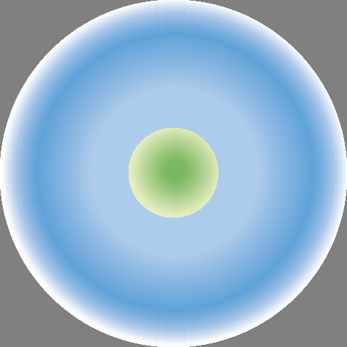

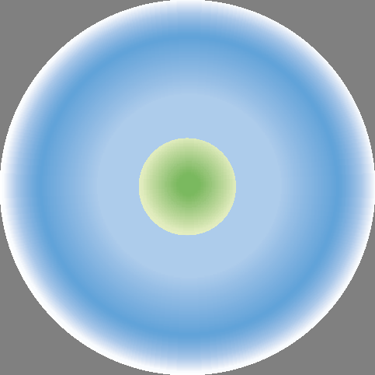



8
CELESTIAL NAVIGATION
A glance at the diagram makes this one obvious, remembering always that LHA is the angular distance of the body from the observer, moving to the westward (clockwise on the diagram). In this case LHA = GHA + longitude east.
₀0
₀0
longitude east
GHA
LHA
GHA
longitude east
LHA
Example
What is the LHA of the Sun at 02 h 17 m 28 s on 3rd May? Your longitude is 172°15′E.
GHA 02 h
+ Increment 17 m 28 s GHA Sun
210° 46′ .4
4° 22′ .0
215° 08′ .4
Example
What is the LHA of the Sun at 03 h 15 m 22 s on 1st May? Your longitude is 110°E.
+ Longitude east
172° 15′ .0
387° 23′ .4
− 360
LHA Sun
360°
27° 23′ .4
GHA 03 h
+ Increment 15 m 22 s GHA Sun
225° 42′ .9
3° 50′ .5
229° 33′ .4
General rules
From the above examples you’ll see that two general rules are applicable when working out LHA.
If you are in west longitude LHA = GHA minus longitude west. If GHA is a smaller figure than longitude west, just add 360° to it and carry on. It’s as simple as that.
If you are in east longitude LHA = GHA plus longitude east. If the answer turns out to be greater than 360°, subtract 360° from it and there is the LHA.
Got it? Good, then carry on.
+ Longitude east LHA Sun
110°
339° 33′ .4
Case 4
East longitude: GHA a greater value than longitude (expressed in 360° notation).
This is easier than a first glance at the diagram might suggest. You are looking for the angular distance to the westward between the observer and the Sun or star. One way to do this is to work your longitude into 360° notation and subtract it from the GHA, but the easiest method is to add up the GHA and the longitude expressed conventionally as degrees east (of Greenwich). The sum of the two will be greater than 360° which is a nonsense, but if you subtract 360° from the result, you will have the right answer.
HORIZON
One final concept. Every schoolchild knows what the horizon is. Or thinks he does. There’s just a

Slide 19
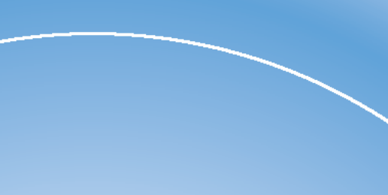


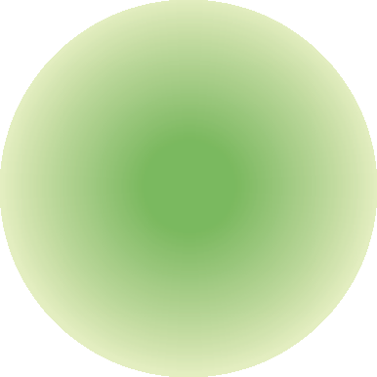
THE EARTH AND THE HEAVENS
9
observed altitude
observer’s horizon
which in consequence requires its own correction table, but it reduces to a fraction of a minute for the Sun and the planets and, as you will see, is very easily dealt with.
The size of the Earth when related to the distance to the nearest star is a pitiful irrelevance so, when working up star sights, parallax is
non-existent.
For purposes of calculation, what we are after is the angle (measured at the centre of the Earth) between the celestial horizon and the altitude of the Sun, Moon, star or planet.
The celestial horizon is on a plane constructed at right angles to a vertical line dropped from the position of the observer to the centre of the Earth.
The observer cannot discern this horizon. What he can see (with a few small adjustments) is the terrestrial horizon. This is a plane drawn at a tangent to the Earth’s surface at right angles to the line joining the observer, his zenith and the centre of the Earth.
Because the observer’s eye will be above the surface of the Earth by anything from six feet in a small yacht to a hundred in a large tanker he is obviously going to see ‘over the edge’ and beyond the terrestrial horizon to his visual horizon. The angular inaccuracy thus caused is called dip and is taken care of by a small angular corrective factor given in the almanac.
Lose no sleep over understanding horizons and parallax. In practice they present no difficulties
at all.
bit more to it than that for the navigator. All astro navigation depends upon observing the altitudes of Sun, Moon, stars and planets. The altitudes are measured with a sextant and can only be observed as the angle at the observer between the heavenly body and the observer’s horizon.
All the navigational tables work on the assumption that the observer is at the centre of the terrestrial sphere, and not on the Earth’s surface.
Because the Earth has a measurable size, at least in comparison with the distance to the Moon, the Sun and some of the planets, this discrepancy leads to an error of parallax between what he is actually seeing (the terrestrial or ‘corrected’ visual horizon) and what the tables want him to see (the celestial horizon).
This error is called horizontal parallax. It can be as much as one degree in the case of the Moon,
to Moon
zenith
to star
corrected sextant altitude
terrestrial horizon
to Moon
dip
visual
horizon
to star
true altitude
celestial horizon
Owing to the close proximity of the Moon, there is a difference between its corrected sextant altitude and its true altitude from the centre of the Earth. Stars, on the other hand, are so far away that the sextant altitude and true altitude are effectively the same.

Slide 20
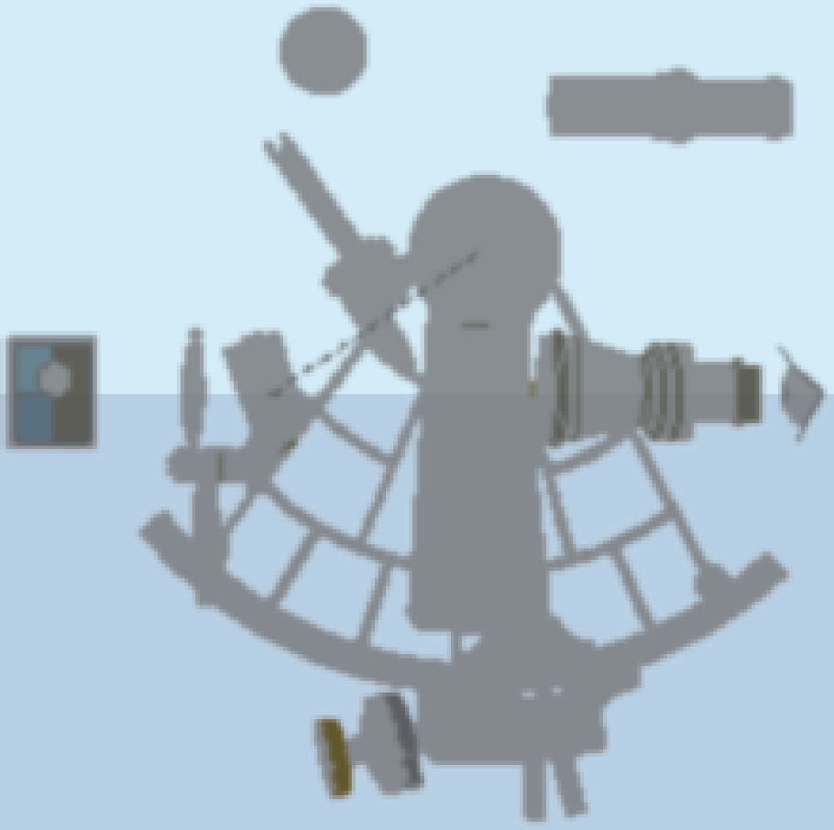




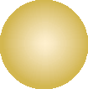


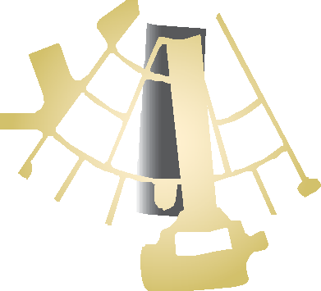










2 The Sextant
In the last chapter we noted that all astro navigation depends upon observing the angle between the horizon and the heavenly body of your choice. Methods of achieving this measurement have improved no end over the years. The tenth-century Vikings, including Bjarni Herjólfsson, the discoverer of America, used to measure the altitude of Polaris using a notched stick. This gave them a crude comparative latitude without involving them in discussions about whether or not the world was round.
Today we have the sextant. It is so called because its calibrated arc is one-sixth of a circle, or 60°. By the doubling effect of its mirrors it is actually able to measure angles of up to 120°. This represents a big leap forward from its predecessor the octant, which has an arc of one-eighth of a circle, doubles up to only 90° and has thus been retired from active service
to languish in picturesque obscurity on pub walls.
Look more closely at the fixed mirror. It consists of two halves. One half is reflective, the other is clear glass. That is the secret of the instrument. Light from the heavenly body is reflected by the index mirror down onto the horizon mirror, which diverts it through the telescope to your eye. If the instrument is set up to view the horizon through the plain glass with the reflected image of the heavenly body apparently ‘sitting’ on it, the sextant will read out the angle between them.
SETTING UP THE SEXTANT
The first thing to do when you buy a sextant is to splice a lanyard to it to go around your neck. The next job is to remove the telescope, focus it on infinity (the horizon) to suit your good eye, and then replace it.
HOW THE SEXTANT
WORKS
If you look at the sextant illustrated, or better still hold yours in your hand, you will see that it consists of a frame with a handle, a moving ‘index arm’ with a mirror at one end and a micrometer at the other, and a fixed mirror upon which the telescope appears to focus.
The index bar of the sextant is slid along the arc until the index mirror reflects the Sun’s image onto the horizon mirror. When the two images coincide, as shown in the ‘Sun in contact’ box, the reading on the arc represents the sextant altitude of
the Sun.

Slide 21
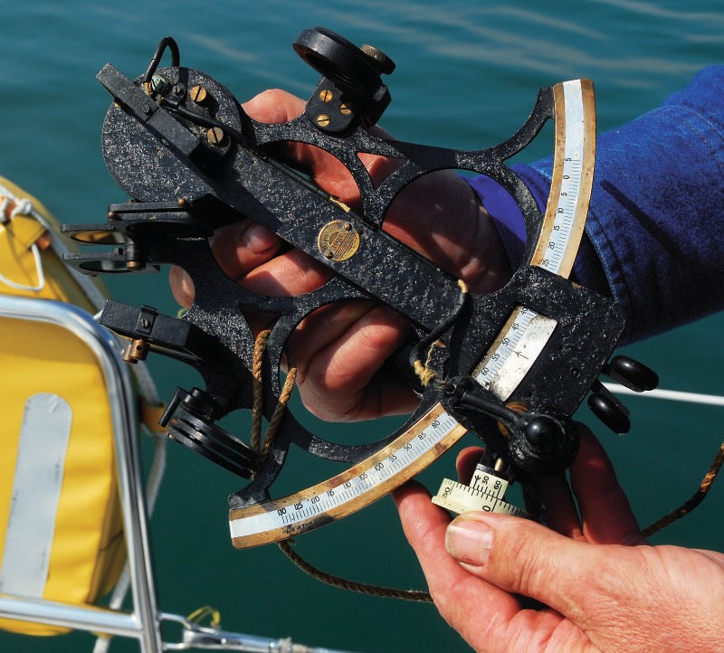
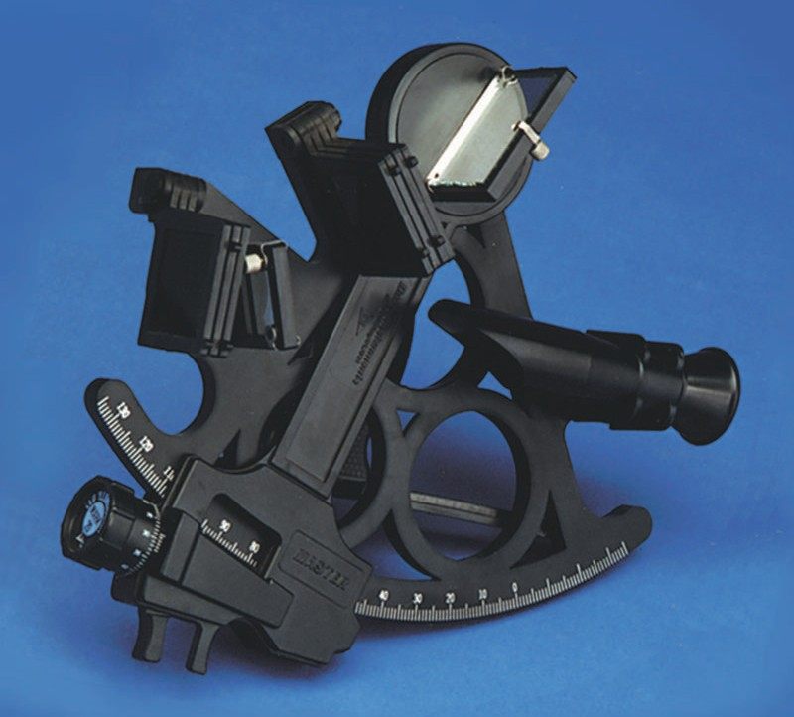
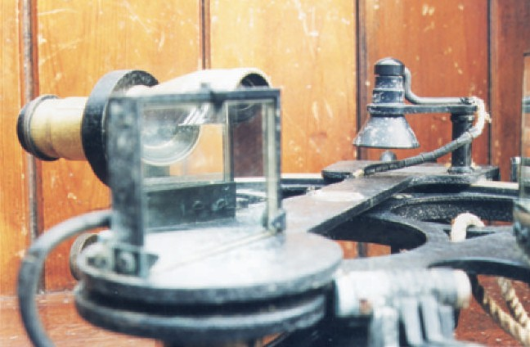
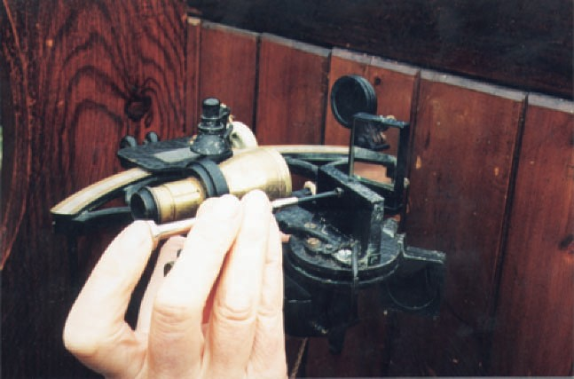
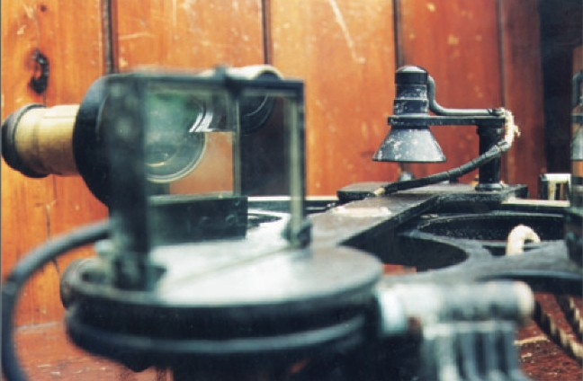
THE SEXTANT
11
The tool of the trade: the sextant. You don’t have to buy an old or expensive one – some of the cheap plastic ones work very well, although they may need adjusting more often.
Once you can see through the device clearly, it can be adjusted to remove the various errors.
These are as follows:
Perpendicularity
Effect: Images side by side.
Cause: Index and horizon mirrors out of parallel.
Cure: Adjust the index mirror. Look across the sextant so that you can see the image of the arc in the index mirror adjacent to the actual arc, as shown in the illustration. To arrange this, set the index bar to something like 60°. If the real arc will not run perfectly into its image without a ‘step’, this shows that there is an error of perpendicularity. Remove it by adjusting the screw in the back of the index mirror with the tool provided. The index mirror is now ‘true’. If the error won’t go, take the instrument to your friendly local sextant guru. There’s no more you can do.
Happily, perpendicularity is not common and you can usually fix it yourself.
This sextant has an error of perpendicularity, shown by the reflection of the arc in the index mirror (centre of top picture). The cure for this is to adjust the mirror (centre picture) until the arc and its reflection run into each other without a step (lower picture).

Slide 22
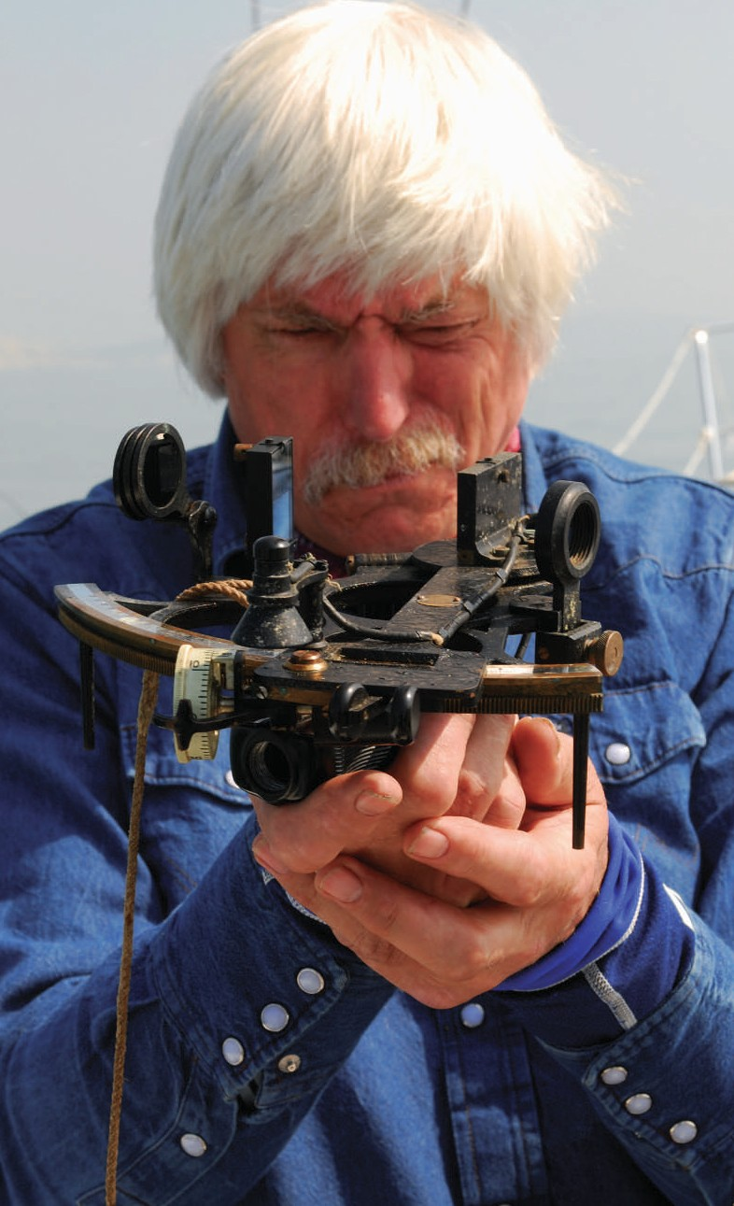
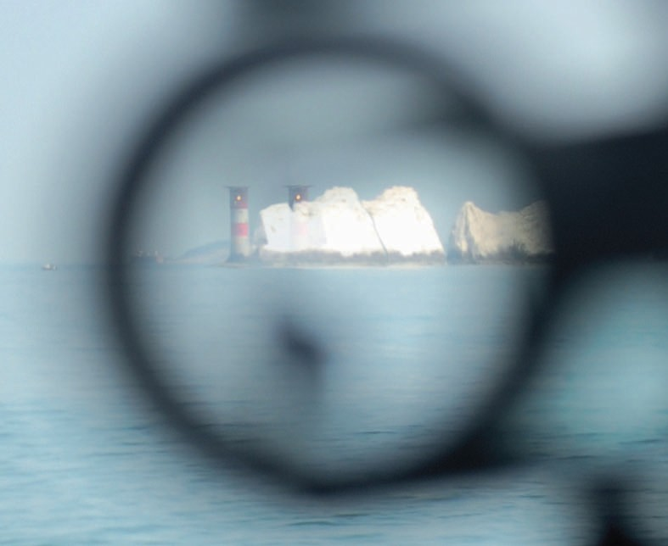
12
CELESTIAL NAVIGATION
When two lighthouses appear side by side, it’s time to get out the adjusting tool and set up the horizon mirror to correct side error.
Index error
Effect: Images one above the other with the instrument set at zero.
Cause: Horizon mirror out of adjustment in the ‘up and down’ plane.
Cure: Adjust the second screw on the horizon mirror. This may reintroduce a little side error; a small amount can be tolerated, but by playing one adjustment against the other you may still be able to eliminate both.
If you can’t, you are stuck with an index error. This, in practice, will not vary with a good instrument and once quantified should be allowed for each time you use the sextant. Check the error every day nonetheless by ‘zeroing’ the micrometer and quickly lining up the horizon before you take a sight.
To quantify an index error, look at a star or the horizon through the instrument and adjust the sextant micrometer so as to place the two images exactly side by side. The reading is the index error. It should not be more than two or three minutes and should be labelled on or off the arc.
Say the sextant is reading 2 minutes, then the index error is on the arc and should be subtracted from all subsequent readings to
render them true. If the instrument is reading 58 minutes, the error is two minutes off the arc and you should add two minutes to all readings. To sum up:
When it’s OFF (the arc), add it ON. When it’s ON take it OFF.
Look across the instrument from above the index mirror to check for an error of perpendicularity.
Side error
Effect: Images side by side.
Cause: Since the index mirror is now ‘proved’, the error must lie in the horizon mirror.
Cure: First set the instrument to zero. The horizon mirror has two adjusting screws. To take out side error, set up the screw which moves the mirror across, rather than up and down. It will be found at one side of the mirror. Don’t worry if this produces a large ‘index error’ (up and down error) because the last adjustment for index error should remove this.

Slide 23
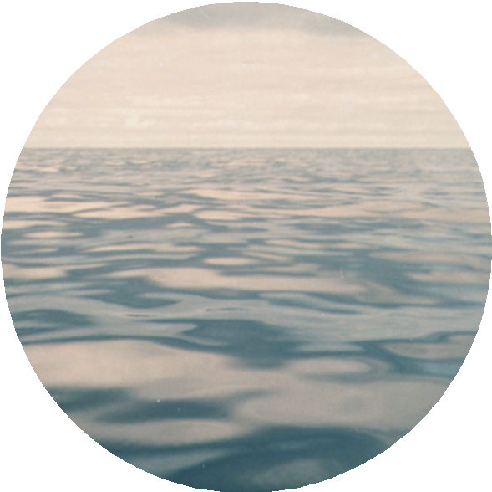
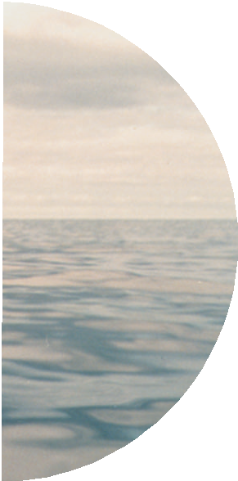
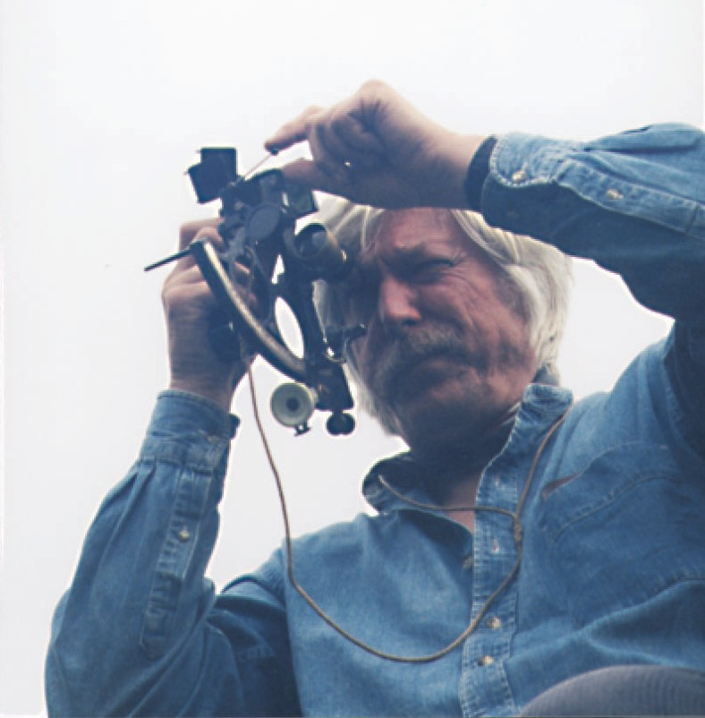
THE SEXTANT
13
horizon) a few corrections must be applied – on paper this time.
Dip
To recap, this is the correction applied because your height of eye enables you to see beyond the theoretical terrestrial horizon.
In the front of The Nautical Almanac, and on the handout bookmark in every copy, is a group of tables for correcting sextant altitude. Notice the corrections for dip at the right-hand side of the table on page 33. If you estimate your height of eye to be, for example, ten feet or three metres, then the correction for dip will be minus 3.1 minutes.
Note: Dip is always subtractive.
Waves and dip
It is normal on the ocean to have a sea running. In the northeast trades in mid-Atlantic there will probably be a ground swell eight to ten feet in height. In the North Atlantic after heavy weather this could easily be piling up to 20 feet or more. If so, you’ll have to estimate the wave height, divide it by two and add the result to your height of eye; you’ll only see the horizon from the top of a wave, so that is where you’ll be when you take your sight, assuming of course that the horizon itself wasn’t obscured by a distant wave of a similar height. This is a moot point, but rather an academic one. In such weather, sights are not super-accurate anyway and your assessment of fix accuracy will reflect this.
Refraction
Because the light from a heavenly body is bent by the Earth’s atmosphere, a correction is necessary for refraction. Fortunately this is included, along with parallax and semidiameter (see next page) where appropriate, in the altitude correction tables.
Semidiameter
Measurements of Sun and Moon are theoretically based on the centre of the body, but nobody
can guess accurately where this is through a sextant, so the upper or lower ‘limb’ (see illustration page 14) is placed on the horizon instead. The altitude correction tables include the corrections required to convert one limb or the other to the real altitude of the Sun. The Moon makes its own arrangements. When entering the tables for the Sun, notice the two columns: one for northern summer and one for winter. The lower limb is given in bold type because, for some reason, it is much easier to shoot than the upper limb and so is preferred by everyone.
The sextant is set at zero, but despite this there is a step in the horizon line, indicating an index error. To deal with this, adjust the vertical alignment screw on the horizon mirror, checking the effect by sighting on the horizon line (below).
TRUE ALTITUDE AND
SEXTANT ALTITUDE
Having set up your sextant you know that, given the possible regular correction for index error, it is reading the correct altitude for the body.
Unless you bounce it, it should remain true for years without further attention. Just check it over once in a while.
In order to reduce the altitude measured with the sextant to the true altitude of the body (that is the angle it is making with the celestial

Slide 24
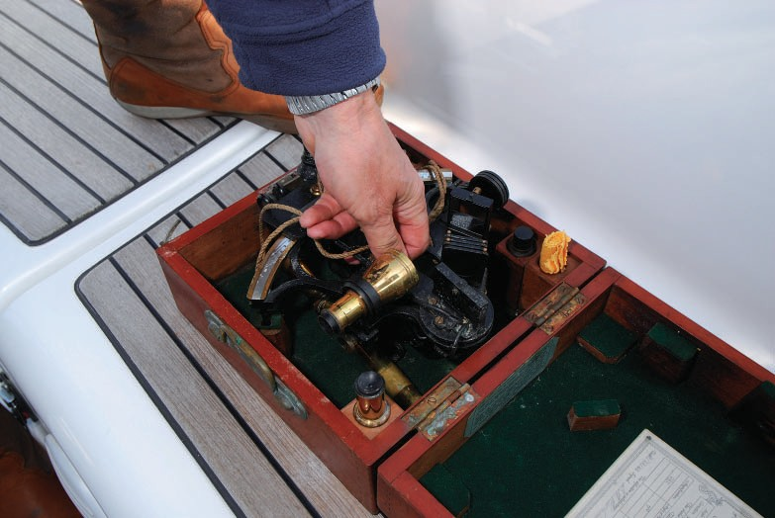
14
CELESTIAL NAVIGATION
Low altitude sights add up to an unpromising picture. Try to keep your altitudes up above
the 10° mark and these difficulties will never arise.
Here is an example of a sextant altitude correction for a typical Sun sight (lower limb):
theory
lower limb
upper limb
Sextant altitude (Hs) | 56° | 17′ | .5
Index error (IE) | – | 2′ | .1
Dip (height of eye 12′) | – | 3′ | .4
Apparent altitude (App alt) | 56° | 12′ | .0
Altitude correction (April–Sept) | + | 15′ | .3
True altitude (Ho) | 56° | 27′ | .3
Now an example on the same sextant for a star:
In theory the centre of the Sun or Moon should coincide with the horizon, but in practice you use the upper or (preferably) lower limb.
Hs | 24° | 15′ | .8
IE | – | 2′ | .1
Dip (HE 8′) | – | 2′ | .7
App alt | 24° | 11′ | .0
Correction | – | 2′ | .1
Ho | 24° | 8′ | .9
Parallax
The Moon is a law unto itself here and will be discussed in due course. The Sun’s parallax is covered by the altitude correction tables and needs to be considered no further.
Interestingly, the two closest planets, Venus and Mars, sometimes produce a touch of parallax themselves. The central table shown on page 33 is the total correction (excluding dip and index error, of course) for the stars and planets, but in its right-hand column is a small additional correction to be made in certain months for the parallax of our nearest neighbours.
Notice that the point of entry into the altitude correction tables is apparent altitude. This is the sextant altitude corrected for index error (if any) and dip.
Low altitude sights
When heavenly bodies are observed at altitudes below 10°, the refraction produced by the Earth’s atmosphere begins to increase rapidly. In practice, this can produce some unreliable results and it’s best to try and avoid taking such a sight. Occasionally, however, you’ll have no option as it may be all that is on offer. Where this is the case, you’ll find a special set of correction tables to deal with low altitudes near the front of The Nautical Almanac. A further table follows to deal with the effects of unusual atmospheric pressure and temperature. These are negligible in practice at normal altitudes but when the object is unusually low down they begin to bite,
so take care.
USING A SEXTANT
Assuming that your sextant is adjusted correctly, and any index error quantified, this is how to measure the altitude of the Sun.
Open the box (right way up).
Grasp the instrument, by the frame as far as possible, in your left hand and lift it out of the box.
Do not lift the sextant by the index bar or by the scale.
3 Take the handle in your right hand and sit yourself comfortably and firmly in a suitable

Slide 25
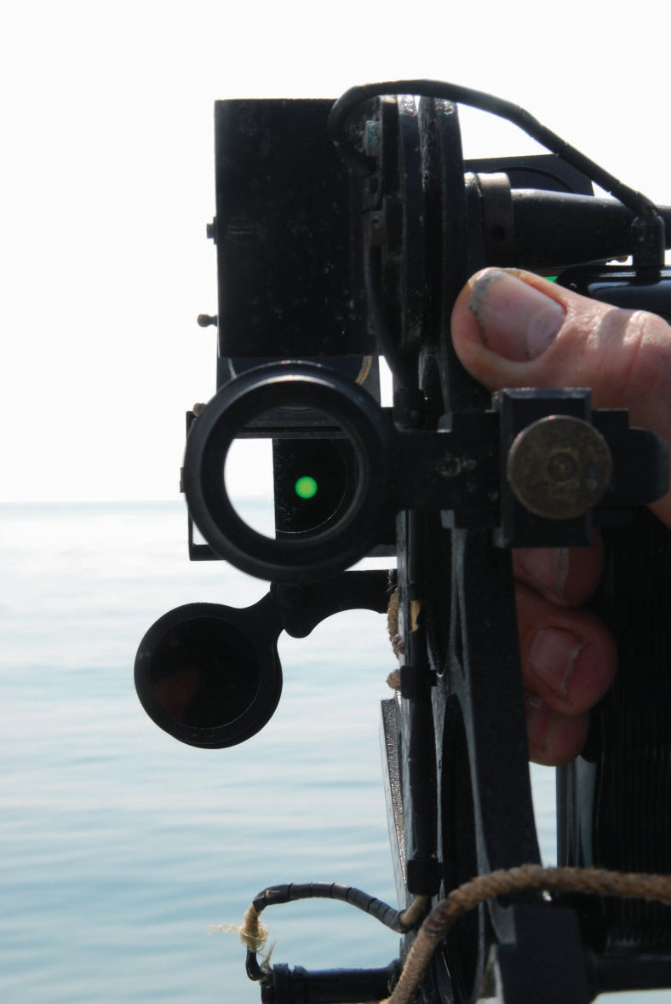
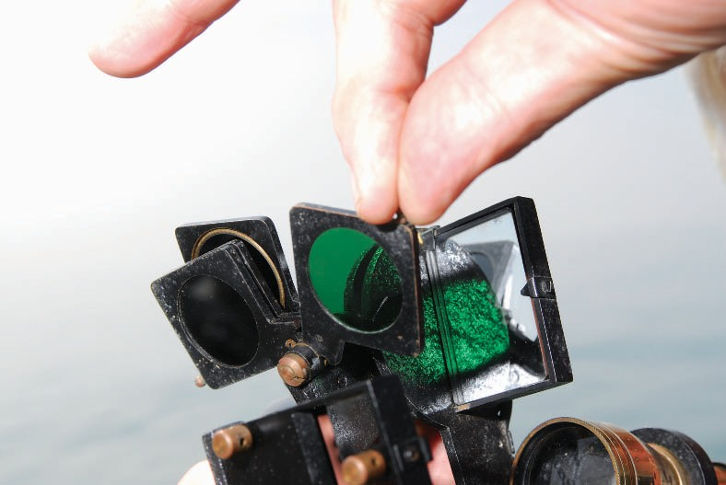
THE SEXTANT
15
position to take a sight. On a large, stable boat it’s perfectly possible to stand on the deck in clement weather, but sitting is usually preferable. Both hands are needed for the sextant. Neither is available for either the ship or yourself, so choose a secure site and try to get wedged in.
Set the instrument to zero and look towards the horizon to check the index error (see page 12).
With the instrument still at zero, drop a shade or two over the index mirror and aim the telescope at the Sun. It may be advisable to put the lightest shade over the horizon mirror as well before you do this in case you glimpse the Sun through the plain glass. On no account look at the Sun without a shade in place.
The green dot is the Sun, seen through the tinted shades. It has been brought down to sit on the horizon.
It is better to start with too many shades and reduce them as required.
When you have the Sun clearly in focus, open the clamp on the index bar with your left hand and, as you sweep the instrument down towards the horizon with your right hand, ‘follow’ the image of the Sun with your left until it is sitting somewhere near the horizon. This is tricky at first, but it comes with practice. On all but the brightest days you’ll need to remove the shade from the horizon mirror before you use the micrometer to work the Sun’s image firmly onto the line of the horizon.
It’s important that the sextant is exactly vertical when measuring an altitude, so once the Sun is approximately in place, twist your right wrist from side to side to rock the sextant; this will make the image of the Sun appear to ‘pendulum’ across the horizon. When it is at its lowest point, the sextant is vertical: this is the moment to set the micrometer and read off the altitude.
Check for verticality by rocking the sextant from side to side, causing the Sun to swing across the image as shown. Take the sight when the Sun’s image is at its lowest point.

Slide 26
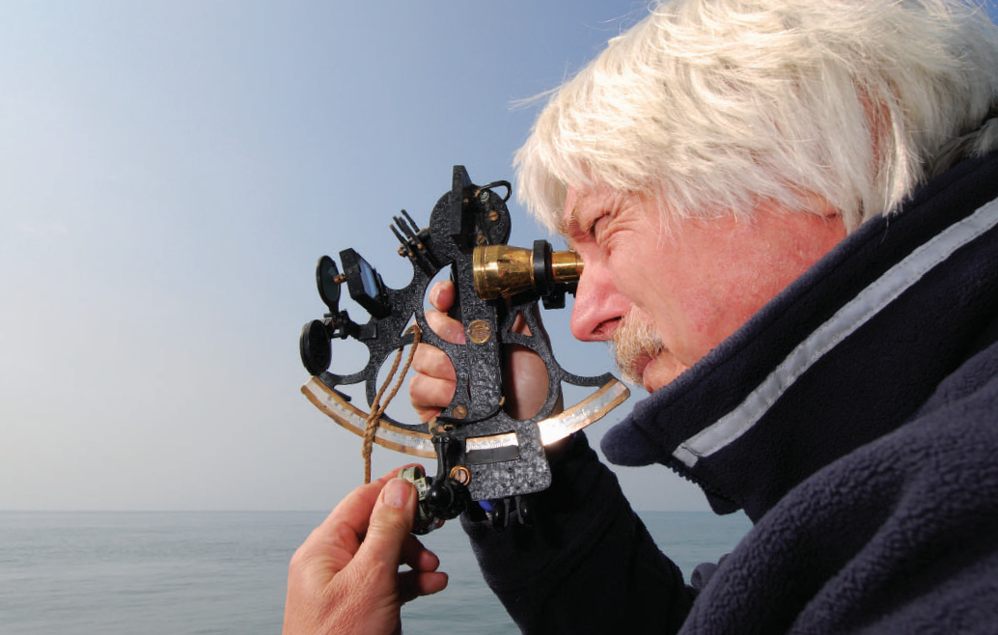
16
CELESTIAL NAVIGATION
By adjusting the micrometer, the index is moved by increments of as little as a tenth of a minute or arc
– which means 200 yards maximum linear distance.
8 If you catch the Sun at ten o’clock on a midsummer morning, its rate of climb will surprise you. Around noon it won’t be moving very fast at all, so be ready for both states.
By the time the Sun has set you’ll be quite proficient, so treat yourself to a beer and wait for twilight. Now see if you can ‘pull down’ a few stars before night swallows the horizon. Don’t worry about which ones they are, just work at the technique.
Only you can teach yourself how to do this, but pretty soon you’ll find it’s no longer necessary to start with the sextant at zero and look directly up at the body. You’ll be able to make a guess at its height, set the sextant and observe in its general direction.
When you have found what you are searching for, fine-tune its image down (or up) to the horizon.
The really good news is that if you can do this on the beach or hill, or even from an upstairs window using a distant rooftop as a horizon, you’ll be able to do it at sea. For some reason the movement of a boat bothers a sextant far less than it bothers a handbearing compass.
CARE OF THE SEXTANT
Handled carefully, a good sextant requires only minimal day-to-day maintenance. Its moving parts are surprisingly robust, and an occasional drop of light machine oil is all they need. The mirrors are vulnerable to seawater so a rinse-off in fresh water is important if the instrument stops a wave. Try to resist the temptation to polish
your sextant at regular intervals, especially if it is a fine brass one. The trouble is that although this makes it look great, it steadily wears away the graduations on the scale. By all means shine up the brass telescope if there is one.
Starting out
Use of the sextant is the essence of celestial navigation. If you are ever to be more than marginally competent you must be a dab hand with the tools. Take the sextant in the car, go down to the nearest south-facing beach, and practise, practise, practise. Ignore the wise-guy taunts of the bathers. You’ll have the last laugh.
Tom Cunliffe shows you how to get to grips with your sextant in a series of free video tutorials to accompany this book.
Visit www.wileynautical.com/celestial to see how it’s done.

Slide 27


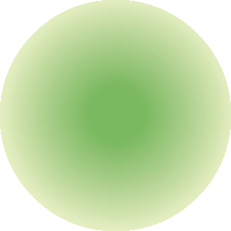
3 The Noon Sight for Latitude
Local noon occurs at the moment when the Sun, on its journey from east to west, crosses the observer’s meridian. At any one time, you are on a particular terrestrial meridian of longitude.
When the Sun bears exactly due south or due north of you, or once in a lifetime is right over your head (at your zenith), its celestial meridian (its GHA) will correspond to your longitude.
As we are about to see, if you can observe the altitude of any celestial body when it is exactly on your meridian, a surprisingly simple calculation leads to the latitude. Since finding this is half the battle, and because the Sun is very much in evidence at noon, the noon sight has always been the cornerstone of the navigator’s day.
FINDING THE TIME OF
LOCAL NOON
Obviously the ‘Greenwich’ time of noon is going to vary from location to location as the Sun appears to travel round the Earth. When you are sitting on deck with your sextant you can tell when the Sun has reached its noon altitude because it doesn’t get any higher. Nevertheless you don’t want to be hanging around all day waiting for it, so it helps to work out the approximate time of local noon.
Since the Sun completes its apparent journey once every 24 hours, and during that time traverses 360°, it follows that in one hour it will move through 15°, or one degree every four minutes.
The Sun is proceeding west from Greenwich, so if you are in west longitude, your local noon will be later than Greenwich, and if you are in east longitude, it will be earlier. To determine how much earlier or later, multiply the number of degrees you are east or west of Greenwich by four: this gives the number of minutes by which your local noon will differ from the time of noon at Greenwich. (An arc-to-time conversion table in the almanac does this for you, if you prefer.)
Have a look at the daily page of the almanac illustrated on page 29, and at the bottom
right-hand corner you will see a box labelled SUN and MOON. The column headed ‘MER PASS’ gives the time that the Sun will cross the Greenwich Meridian on that day.
However unsure of your position you may be, you can always take a stab at a DR (dead reckoning) longitude for the time of local noon. Go for a whole degree and make sure you err on the ‘early’ side. You don’t want to miss it.
₀0
Greenwich Meridian
GHA
observer’s longitude
pole
View from the celestial elevated pole. Local noon, for the observer, occurs when the Sun crosses his meridian of longitude. At this point the GHA of the Sun is the same as the observer’s longitude.
Example 1
What time is local noon in DR longitude 4°W on 2nd May?
Mer pass at Greenwich 11 h 57 m
4W W = + 16 m
Local noon 12 h 13 m GMT

Slide 28
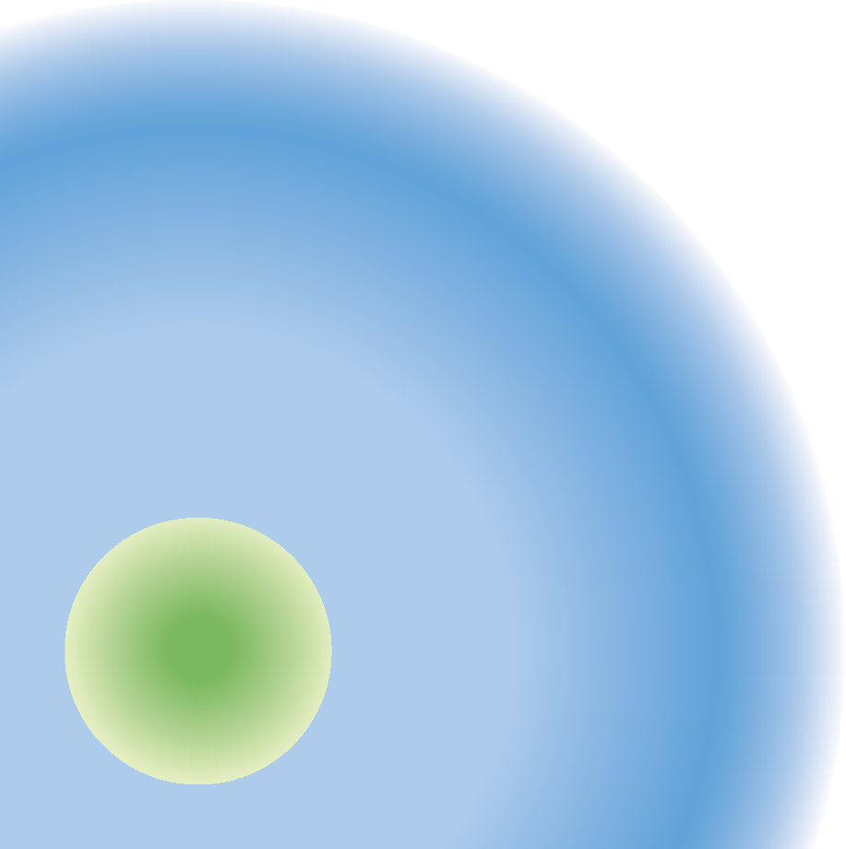

18
CELESTIAL NAVIGATION
Example 2
What time is local noon in DR longitude 73°E on 26th October?
altitude. Whatever you do, don’t start to rack the Sun up again as it begins to fall. Wait until the lower limb bites positively into the horizon without altering the sextant again, and you
know you have it. Noon is past and gone for another day. Note the log; go below, read the sextant, put it away, then work out your latitude.
Mer pass at Greenwich 11 h 44 m
73E E = – 4 h 52 m
Local noon 06 h 52 m GMT
If you happen to be sailing around within a few degrees of the Date Line on the opposite side of the globe from the Greenwich Meridian, a query may arise as to which day it is. If this is so, refer to Chapter 4, page 24. If not, just remember that you have calculated the Greenwich time
of noon for your approximate longitude, and read on.
THE THEORY
The illustration on page 17 demonstrates the noon sight set-up when viewed from the celestial elevated pole.
The picture below shows it as seen from the celestial equator. Note how the celestial horizon makes a right angle with the line dropped from the observer’s zenith, through his geographic position to the centre of the Earth. Zenith Distance (ZD) is the only new concept to grab hold of. It is, quite simply, the angular distance (measured in degrees) between the observer’s zenith and the position of the Sun on the celestial sphere.
Since the line from the observer’s zenith meets the celestial horizon at 90°, the zenith distance must equal 90° minus the Sun’s altitude:
ZD = 90° − ALTITUDE
TAKING THE SIGHT
Once you know the approximate time of local noon, all that remains is to get up on deck ten minutes or so early and start shooting the Sun’s altitude.
It should still be rising when you begin. As it approaches its highest point you’ll be ‘racking it down’ slower and slower until finally it stands still for a moment or two. That is the noon
celestial elevated pole
Latitude at noon. Latitude greater than declination – same name (e.g. both north).
zenith
zenith distance
latitude
declination
altitude
celestial equator
celestial
horizon

Slide 29

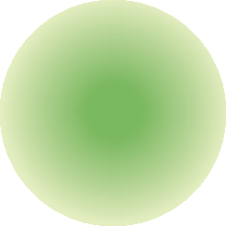


THE NOON SIGHT FOR LATITUDE
19
zenith
zenith distance
latitude
equator
declination altitude
horizon
Latitude and declination with different names.
You can see from the illustration opposite that latitude is the same angle on the terrestrial sphere as ZD + declination is on the celestial. Declination can be found in the almanac, and you can easily work out ZD.
Add them together, and that’s your latitude
– given that your latitude is greater than the Sun’s declination, and of the same ‘name’ (i.e. north or south), as it is in this case:
Spelled out in rote rule form, latitudes can be expressed as follows:
Latitude GREATER than declination. Same name:
LAT = ZD + DEC
Latitude OPPOSITE name to declination:
LAT = ZD − DEC
Latitude LESS than declination. Same name:
LAT = DEC − ZD
In practice, unless your voyage passes ‘under’ the Sun or takes place during an equinox when the Sun’s declination changes name, you’ll have to make this decision only once per trip. The answer is then the same every day.
So, to work a noon sight, what do you need?
A corrected sextant altitude (Ho).
The zenith distance (ZD = 90° − Ho).
The declination of the Sun at the time of your sight (not at Greenwich noon, please!)
Insert ZD and DEC into one of the three formulae and you have a latitude.
LAT = ZD + DEC
Quite frequently, however, depending upon the season and where you are, latitude and declination will have different names and relative values, and two other cases may arise. In the diagram above, the latitude is the opposite ‘name’ to the declination and you can see that LAT = ZD − DEC.
The diagram on page 20 shows a situation often met in the tropics, where the latitude may be the same name as the declination, but could well be a lower value (e.g. latitude 12°N, Sun’s declination 22°N). Here, LAT = DEC − ZD.

Slide 30
20
CELESTIAL NAVIGATION
altitude
zenith distance
dec.
Z
equator
lat.
horizon
Latitude less than declination, same name.
CALCULATING A LATITUDE
Example
2nd May. Your DR is 50°25′N 7°W. Local noon is therefore 1225 GMT. This enables you to obtain the declination of the Sun (DEC) from the almanac. Using the sextant, you find that the Sun’s corrected altitude (Ho) at noon is 54°47′.4. What is your latitude?
OTHER BODIES
The theory of working out a latitude from a body on your meridian holds good for everything in the sky, not just the Sun. The Sun is the most popular, though, because it is on the meridian at noon and can be employed in conjunction with a forenoon sight (see Chapter 6) to produce a fix, but don’t discount the possibility of using a
suitable star at twilight, a planet, or the Moon. A latitude is a very useful thing to have.
LAT = ZD + DEC
Dec 12 h N 15° 22′ .4
+ 25 m (‘d’ = +0.7) 0′ .3
‘MAXIMUM’ ALTITUDES
In theory, the system described above for determining latitude works perfectly only from a stationary vessel, or one which is travelling exactly east or west. The reason is that if you are in the northern hemisphere and sailing southwards towards the Sun (your latitude being greater than its declination), your changing latitude will cause the Sun to continue to ‘rise’
Dec 1225 N 15° 22′ .7
90 89° 60′*
− Ho 54° 47′ .4
= ZD 35° 12′ .6
+ Dec N 15° 22′ .7
Lat N 50° 35′ .3
(* To make the subtraction easier I always express 90° as 89°60′. It gives you less figures to carry.)

Slide 31
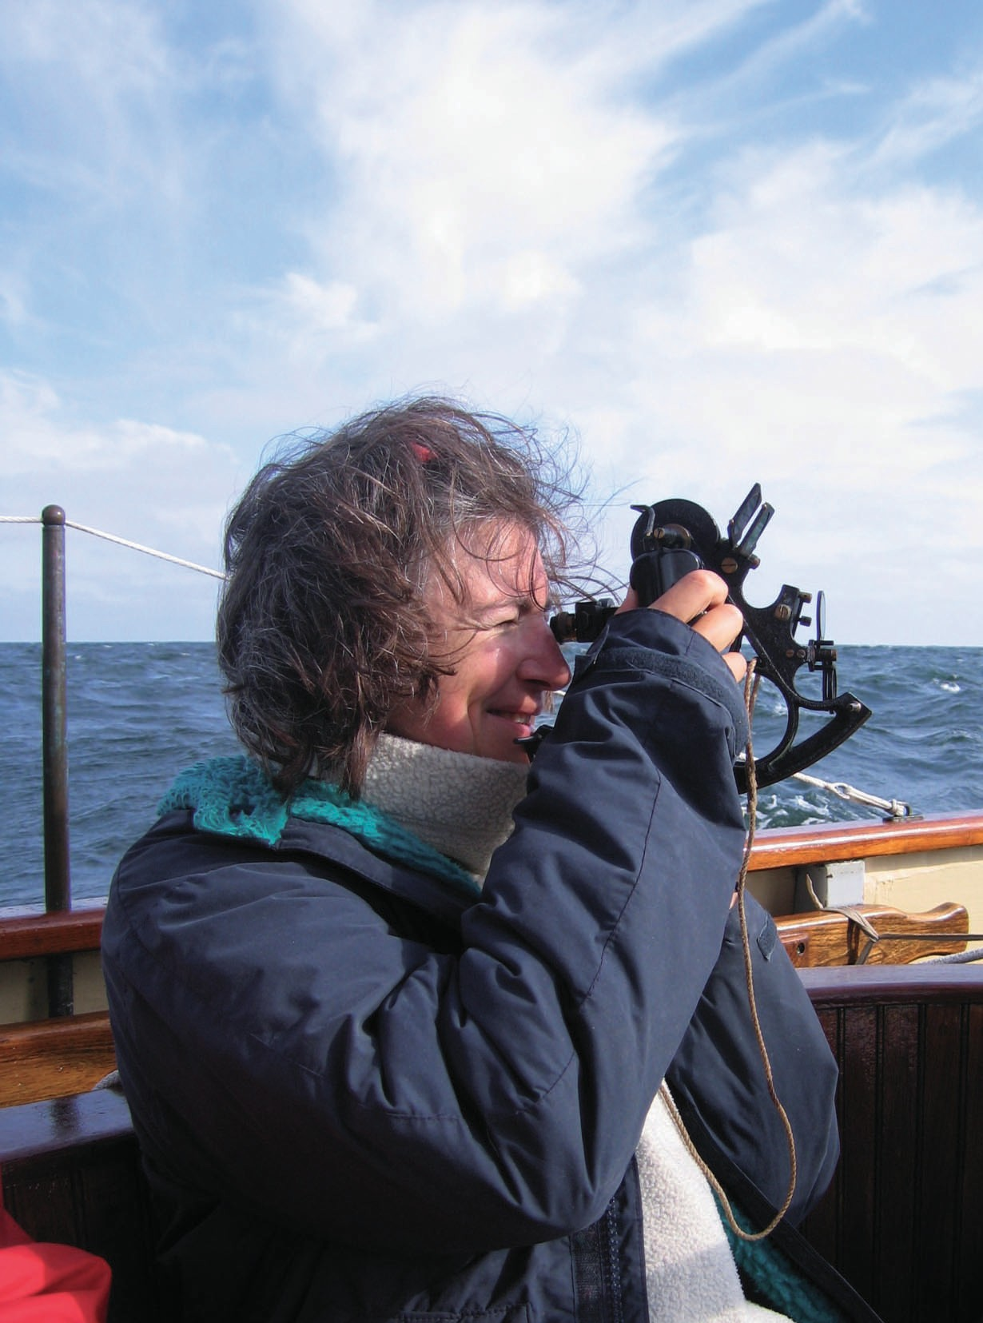
THE NOON SIGHT FOR LATITUDE
21
while it is actually past your meridian. Similarly if you were moving in a northerly direction, the Sun’s altitude would begin to decrease before it reached your meridian.
For a fast-moving ship doing 20 knots or so due north or south, this can produce errors of up to five minutes of arc. In a sailing yacht working manfully to keep up her five knots it is rarely a factor to consider. However, if you have a big north–south component in your course, bear in mind that your latitude from a meridian sight may not be quite as accurate as you would
hope.
Allowing for the maximum altitude effect
Since the Sun is crossing the meridians at the rate of one every four minutes you should, unless your DR is wildly astray, be able to work out to the nearest minute or so the time that the Sun will pass the meridian of your noon DR longitude.
Take the Sun’s altitude at about this time instead of waiting for it to reach its highest point, and that will be as near to the meridian altitude as you are going to get. Remember that, this close to noon, if the altitude is changing at all, it will be changing very slowly.
Wedge yourself in somewhere comfortable before settling down to take a sight.

Slide 32
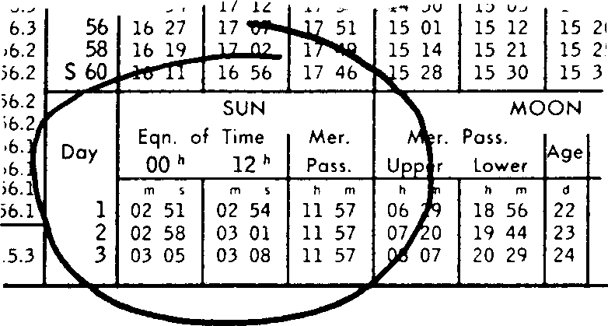
4 Time
In Chapter 3, while considering the Greenwich time of local noon for a given longitude, we looked at the basic relationship of arc and time, and found it to be:
ONE DAY = 360°
ONE HOUR = 360° ÷ 24 = 15° FOUR MINUTES = 1°
However, whereas a degree can be defined as 1/360 of a circle, the definition of a day is not quite so clear-cut. This is because, amongst other things, the Earth is travelling in its orbit round the Sun at the same time as it revolves, and orbits are sometimes a little less regular than the mathematicians would desire.
A suitable definition of a day might be the time taken for the Sun to proceed from our nadir (midnight) through Sunrise, across our meridian, down through Sunset and back to the nadir once more. Unfortunately, when measured in hours this does not take exactly the same amount of time on every occasion, so to make life tolerable for everyone who uses a watch and measures appointments in hours and minutes, an average must be taken.
Since the celestial co-ordinates for every day are tabulated in a single nautical almanac it was decided long ago to refer them all to the average, or mean time as measured at the Greenwich Observatory, England, giving us our old friend Greenwich Mean Time (GMT).
The mean Sun is the imaginary body moving with perfect regularity from which GMT is taken. It represents an average of the motions of the true or apparent Sun (both words have the same meaning in this instance). The mean Sun and the true Sun are frequently well adrift from one another.
The difference between the two is called the equation of time and is to be found in the same box as the time of the Sun’s meridian passage in the daily pages of the almanac. If, for example, the Sun were 1°30′ East of Greenwich at noon GMT, the equation of time would be six minutes.
Although this figure is seldom used in practice, the fact that there is a difference between the mean and the apparent Sun makes it important to check the actual time of the Sun’s meridian passage (i.e. apparent noon) each day before deciding when to take your noon sight.
ZONE TIME
Navigators and astronomers may be content to live their lives by GMT, but the general public spoil all that by insisting on lunching at 1300 hours, no matter where they are, and expecting the Sun to rise at 0600. They set their clocks by the movement of the Sun and, in consequence, ‘working time’ alters from place to place around the globe.
In fact, the time of Sunrise varies with every step you take east or west. A century or two ago, each town and village worked to its own time, but if this were the case today, the result would be chaos. In order to simplify this business, the world is divided into 24 time zones. Not surprisingly, each time zone is 15° of longitude across.
Each meridian divisible by 15 is a zone meridian and its time zone spreads out 7½° to either side of it.
NAMING THE ZONES: ‘+’ OR ‘−’
Since the Sun rises in the east and proceeds to the westward across the sky it follows that it will rise later in 90°W than it does at Greenwich.
Actually it will rise 90 ÷ 15, or six hours later. So
THE ‘MEAN SUN’ AND THE
‘APPARENT SUN’
The actual time of the Sun’s meridian passage, and the difference between this and noon GMT, is given in the daily pages of the almanac.

Slide 33
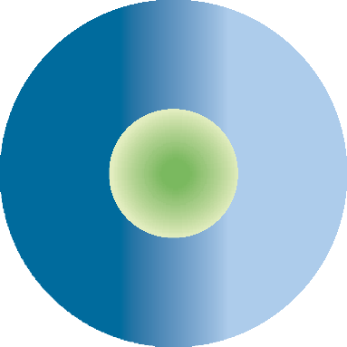
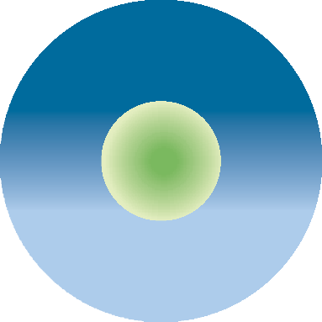


TIME
23
0600 GMT
1200 GMT
Midnight (0000
zone time)
Sun rising (0600
zone time)
Chicago
Pole
Chicago
Pole
90⁰ W
90⁰ W
Greenwich Meridian (Sunrise)
Noon at Greenwich (Sun on meridian)
when the Sun is rising at 0600 at Greenwich, it is midnight (0000 hours) in Chicago at 90°W.
Six hours later, when the Sun does rise in Chicago, the time there will be, conveniently, 0600 hours.
By then it will be 1200 (noon) at Greenwich and nearly time for lunch.
At any given instant, if you have your watch set to Chicago time and you want to convert it to Greenwich, you’ll have to add six hours. Chicago is therefore said to be in ‘Zone + 6’. In the same way, all the western time zones, right round to the International Date Line, are named ‘plus’.
All the eastern time zones are named ‘minus’. The Sun rises in Moscow before it does at Greenwich, so zone time at Moscow will be later than Greenwich and you’ll have to subtract the relevant number of hours to reduce Moscow time to Greenwich time.
The divisions between time zones, for reasons of national convenience, do not always fall exactly halfway between the zone meridians concerned. France, for example, in order to fit in with the rest of continental Europe, has placed itself in ‘Zone − 1’, although most of its land mass falls plumb into the Greenwich time zone. Even Portugal, well into west longitude, lines up with Germany for reasons of convenience. The United Kingdom does not.
This sort of thing won’t affect your ship’s working clock in mid-ocean, but it is as well to be aware of it. Tide tables, for example, are usually issued in the official zone time of the country concerned, regardless of its longitude. A useful aide-memoire for deciding whether to add or subtract is: Longitude East, Greenwich time least. Longitude West, Greenwich time best (biggest).
A few examples
Since all tabulated celestial data refer to GMT, you will constantly be converting from ship’s zone time to Greenwich time and vice versa. Once again, practice makes it easy, but in the meantime here are some examples to clarify the matter:
Q What time zone are you in if your longitude is 170°W?
A Zone + 11.
Q What will your ship’s clock say at 1000 GMT in 10°E longitude?
A 10°E is Zone − 1. This means that you must subtract one hour from your zone time to get down to Greenwich, so your zone time must be 1100.
Q Which meridian will you have crossed on a westbound passage of the North Atlantic when the ship’s clock goes back from GMT − 3 to GMT − 4? (Remember that in west longitude, you are in Zone + 3 and
moving to Zone + 4 as you move away from Greenwich. At any time you must add time to your zone time to get up to Greenwich, so your ship’s clock will show an earlier time than Greenwich. Remember that the man in Chicago was getting up when the Greenwich observer sat down to his lunch.)
A The zone meridian for Zone + 3 is 3 × 15°
= 45°W.
The zone meridian for Zone + 4 is 4 × 15°
= 60°W.
Halfway between the two you change zones, so the boundary between Zone + 3 and Zone + 4 falls at 52½°W. (See diagram page 24.)

Slide 34

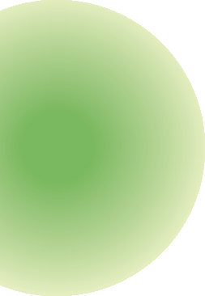
24
CELESTIAL NAVIGATION
₀0
While this arrangement will stand you in good stead for navigational purposes, it does not do
to forget the International Date Line which runs north–south from pole to pole and where
the date advances for ease of administration. This generally follows
the 180th meridian, but it diverts here and there to keep the administrators happy. The zigzag which separates
Alaska from Siberia is a case in point, as are a number of kinks holding Pacific island groups
together.
Greenwich Meridian
37¹/2⁰
Zone + 3
45⁰
52¹/2⁰
ship’s clock
Zone + 4
GMT - 3 hours
60⁰
ship’s clock
67¹/2⁰
STANDARD TIME
In order to make best use of the local electricity supplies by extending daylight into the evenings, many countries choose to add one hour (or even two hours) to their zone time during the summer.
These arrangements are purely domestic and have no relevance to the astro navigator, but if you are setting sail on a voyage from a country operating
such an arrangement, don’t forget to set your ship’s clock to something more sensible as soon as you leave, or you may
have a debacle.
It’s also important to be aware of standard time when you arrive
or you may be caught out by that greatest of disasters: to step ashore
GMT - 4 hours
ship’s clock
112¹/2⁰
GMT - 8 hours
120⁰
Zone + 8
127¹/2⁰
after crossing an ocean only to discover that the pubs have just shut.
THE NAVIGATION CLOCK
Just in case you have a mental block on questions of time when you are at sea, all problems can be solved by referring to your navigation clock, which you should keep set on GMT. Even if you actually time your sights with a quartz wristwatch, as I do, you should always have a back-up clock somewhere on board.
Personally I keep my wristwatch on zone time which, on my boat, is usually ship’s time. If my mind blows a fuse while thrashing to windward when I am dog tired, I can always refer to the navigation clock to check up on GMT.
Change of date and the International Date Line
Watch out for this one. If it arises, tackle it logically and it will present no problem. Let us assume you are in Zone + 8. It is 1830 zone time (ZT) on 25th March. What is GMT? If you are in Zone + 8, you will add eight hours to 1830 ZT and come up with 2630 GMT on 25th March. Obviously this means 0230 GMT on 26th March. That’s better.

Slide 35





5 Position Lines and Plotting
As with coastal navigation, a position obtained using astro-navigation techniques is plotted on a chart using position lines (PLs). Instead of being straight, however, these are theoretically circular. Most of the old-fashioned PLs used in coastal navigation are straight lines, but there are one or two sources of PL, generally thought of as methods of determining ‘distance off’, which are in fact circular lines of position.
around it and know that we would be somewhere on that circle.
In astro navigation, all the PLs are actually parts of a circle scribed around the terrestrial geographic position of the body observed, but the circles are so huge that a short section of the circle looks like a straight line.
AZIMUTH
For such a huge circle to be usable you need to know which section of it to plot. To determine this a line is employed which gives the bearing of the body from your rough position (in degrees
observer
Circular position line. If you know your distance from a lighthouse but you have no compass, you know that you are somewhere on a circular position line.
Consider, for example, the ‘rising’ or ‘dipping’ lighthouse. The tables tell us that with a height of eye
of eight feet we will see such and such a light ‘rise’ at a distance of 15 miles. When
it pops up we dutifully take a magnetic bearing and mark off our position 15 miles out from the lighthouse. If we didn’t have any means of determining
the bearing of the light, however, we would be left with just
the knowledge that we were 15 miles from it. We could scribe a circle 15 miles in radius
Zn
GP
circle of position
Azimuth. If you know the altitude of a star, you can locate yourself on a circle of position because the altitude of the star will be the same from any point on the circle. The azimuth (Zn) is a bearing to the geographic position (GP) that tells you which part of the circle to use.

Slide 36

26
CELESTIAL NAVIGATION
PL
GP
azimuth (Zn)
intercept away
AP
circle of
position
Ho1
Hc
Ho2
GP
intercept towards
AP
intercept away
The side view shows how the difference between observed altitude (Ho) and calculated altitude (Hc) is used to find the direction of the intercept from the assumed position (AP). If Ho is less than Hc, for example, the intercept is away from the celestial body, as shown in the top view. Notice that the PL is actually at a tangent to the circle of position.
True). The PL is then constructed at right angles to this. This ‘bearing line’ is called an azimuth (Zn) and is defined as ‘the horizontal direction of a celestial point from a terrestrial point’. (Incidentally, the word is pronounced ‘azzmuth’.)
The first step in working up a PL is to calculate what the altitude and azimuth of the body would be at the time of your sight from a convenient assumed position (AP). This should be as close as possible to where you think you are (your DR position), but is rarely the same. The AP is selected to fit in with the information in the almanac and sight reduction tables which is presented in convenient ‘steps’ of whole degrees. The technique of calculating the altitude and azimuth of the body from the AP is described in Chapter 6.
Because the distances from both your DR and AP to the geographic position of the body are so enormous, the azimuth to either position can be considered to be the same. The altitude that you have observed using your sextant, however, is usually different from the one you have calculated from your assumed position. This
difference, which is measured in minutes of arc, is called the intercept and can be expressed on the chart as minutes of latitude, or nautical miles. In effect, your AP is functioning as a datum point. The intercept gives you the distance from this to your PL.
In the diagram above you can see what all this actually means. Notice that if the observed altitude from the actual position (Ho) is greater than the calculated altitude at the assumed position (Hc), then the PL will be nearer to the geographic position (GP) of the body. Conversely, if the Ho is less than the Hc, the PL will be further away. Because your assumed position is effectively on the same azimuth as the actual position you never need to know what the GP of the body really is. It’s enough to draw a short section of the azimuth through the assumed position on your chart. Then, if the Ho is greater than the Hc, mark off the intercept so many miles in the direction of the body. If the Ho is less than the Hc, mark it off away from it. Then draw your PL through the intercept, at right angles to the azimuth.

Slide 37

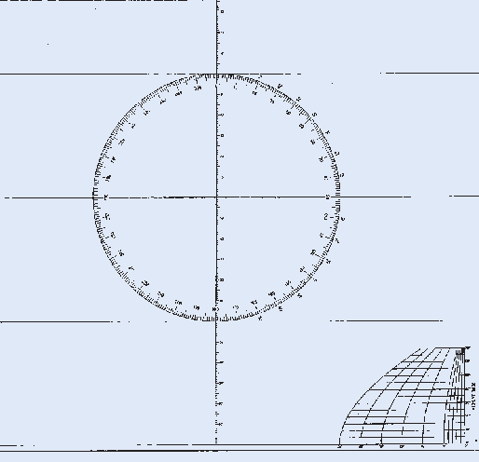
POSITION LINES AND PLOTTING
27
5307
3627
2725
Mark the assumed position (AP).
Draw the azimuth (Zn) passing through it.
Decide whether the intercept is towards or away from the body. In this case it is towards. The Zn is 250° which means that the body bears 250° from the AP, so you measure off the intercept in that direction.
Construct the PL. This will pass through the intercept at right angles to the azimuth. The PL is marked as a straight line with arrowheads at each end pointing towards the body.
Note: The point at which the PL crosses the azimuth is NOT A FIX. It is merely a reference point from which to construct your PL, which has much the same function as a bearing line from an observed object such as a buoy. To achieve a fix you need at least one more PL. More about this later.
Accuracy
With practice, there is no reason not to produce PLs to within a couple of miles accuracy, given decent conditions and accurate time. With indifferent visibility and a big sea, you’ll do well to come within five or more.
Plotting charts
In coastal waters the scale may well allow a sight to be plotted directly onto the working chart.
On an ocean chart, the width of the pencil line becomes a significant factor and accurate plotting is impossible. Instead, use a plotting sheet.
These can be made up yourself, but they are so cheap to buy that I always kit up with a sheaf before I set sail. So long as a quality eraser and a sharp 2B pencil make up your plotting kit, they are recyclable, so don’t worry about having enough to last the voyage. Plotting sheets come in various forms. I prefer those issued by the United States Defense Mapping Agency. The scale is small but realistic and, with care, a whole day’s run can be fitted onto one chart.
The illustration shows a blank of this form. To use it, designate one of the transverse lines as your assumed latitude and then take measurements for your assumed longitude from the scale at the bottom right-hand corner. All further measurements of intercept etc., are marked off utilising the latitude scale printed down the middle of the sheet.
The compass rose is there purely for the convenience of those plotting with parallel rulers. Personally I always use a Douglas (square)
protractor or a Breton plotter for plotting astro PLs. Once a position is fixed on the plotting sheet, it can be expressed in terms of latitude and longitude, logged, and transferred to the ocean chart.
4800
42°
13°
30′ AP 0900³⁸⁷⁰ 12°
30′
M
4884
4000
5305
5080
32
5000
3634
Zn 250
2816
30′
3579
5317
4464
A position line (PL) plotted on a chart. The azimuth has been drawn in at 250° from the AP, and the PL drawn across it at right angles 30′ from the AP towards the body.
An American plotting sheet.
The rule to remember for which way to mark off an intercept is this:
Calculated (Tabulated) altitude less (Tinier) than observed altitude: intercept Towards the body. Tabulated; Tinier; Towards – TTT
Clearly, if the Ho is less than the Hc the converse will apply. Intercepts are always labelled ‘towards’ or ‘away’.
PRACTICAL PLOTTING
Illustrated above is a section of a chart. In order to plot a sight all you have to do is:

Slide 38
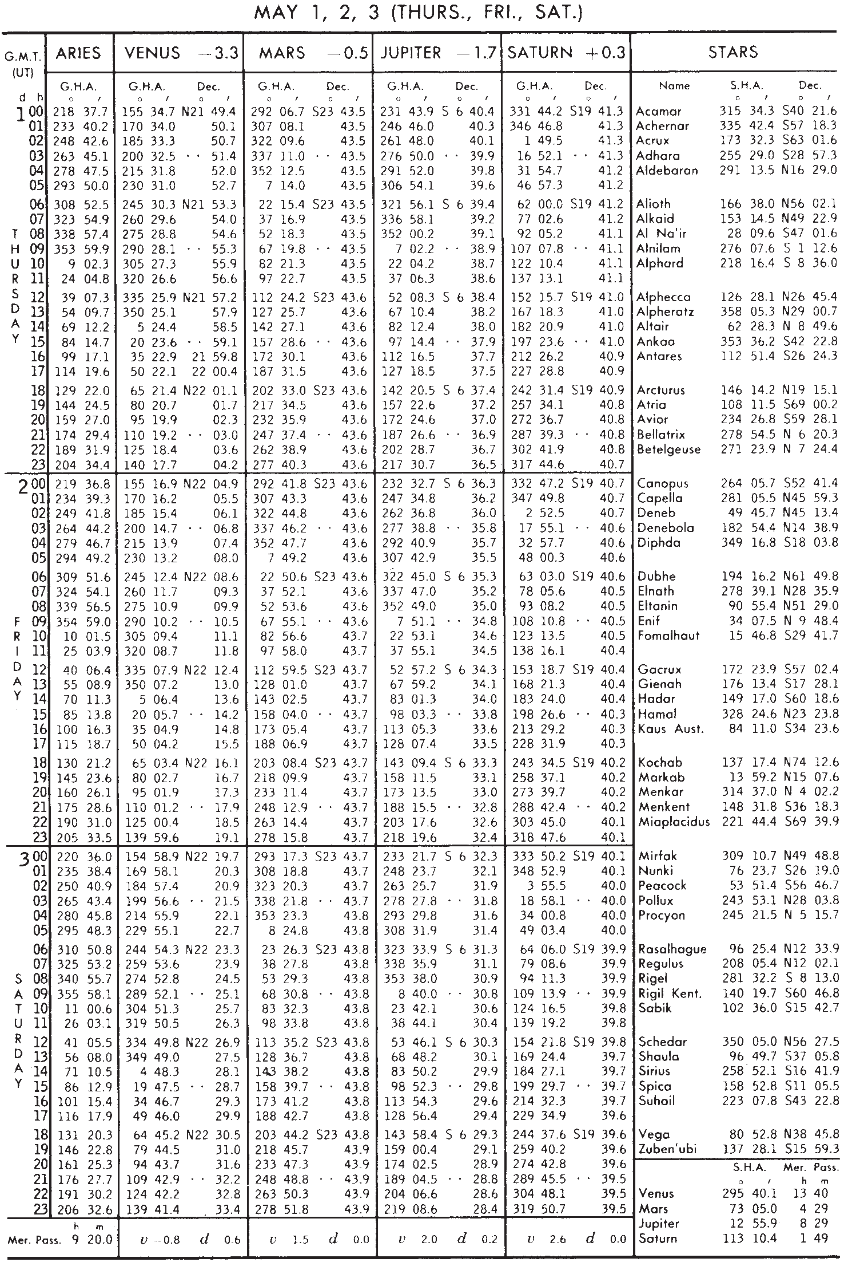
28
CELESTIAL NAVIGATION
Table 1. Daily page from The Nautical Almanac.

Slide 39
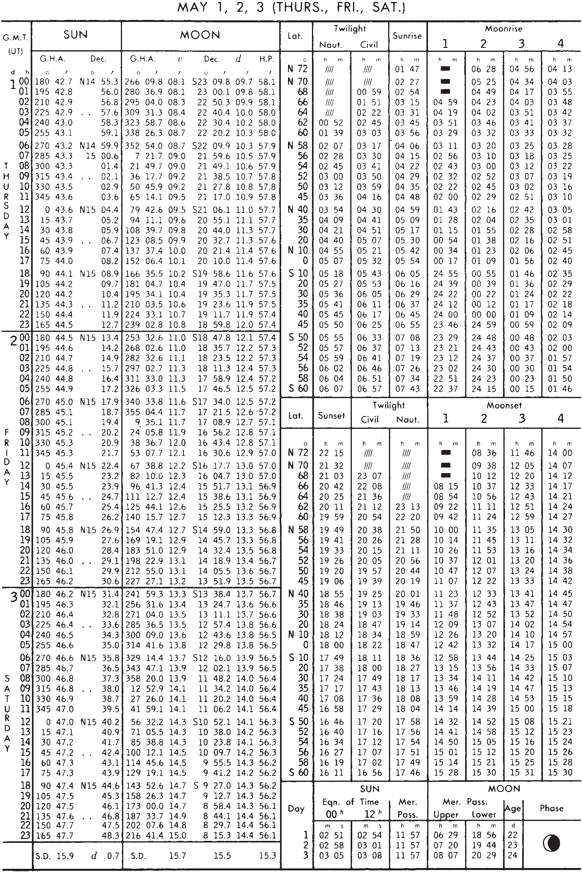
TABLES
29
Table 2. Daily page from The Nautical Almanac.

Slide 40
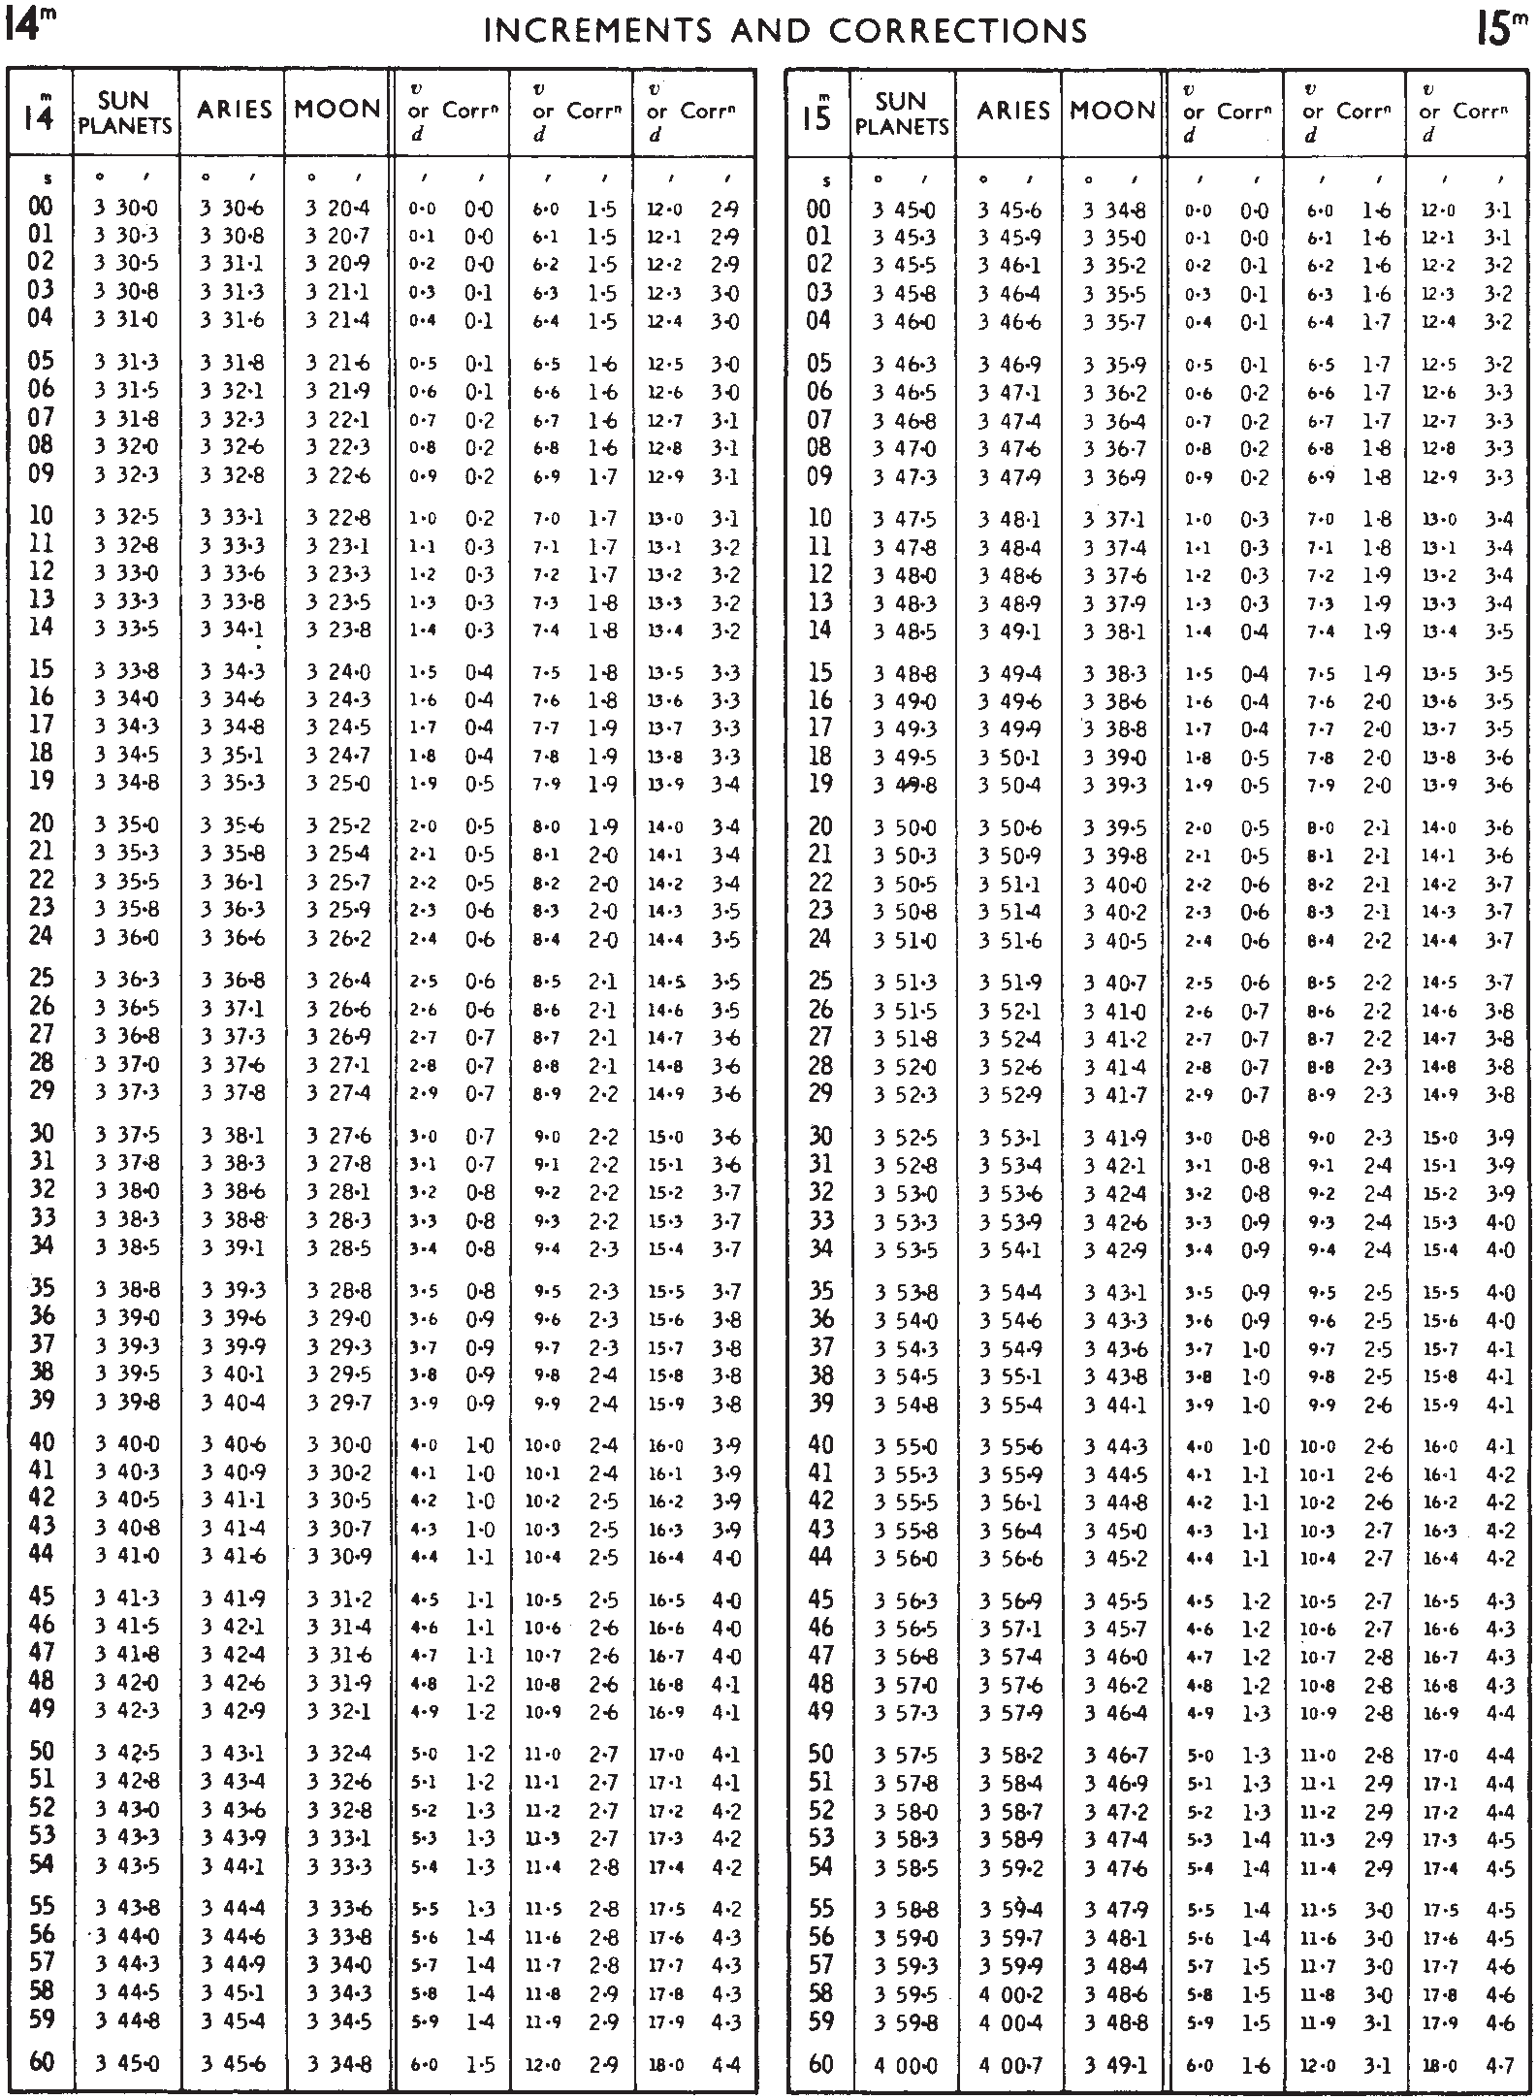
30
CELESTIAL NAVIGATION
Table 3. An increment (yellow) page from The Nautical Almanac.

Slide 41
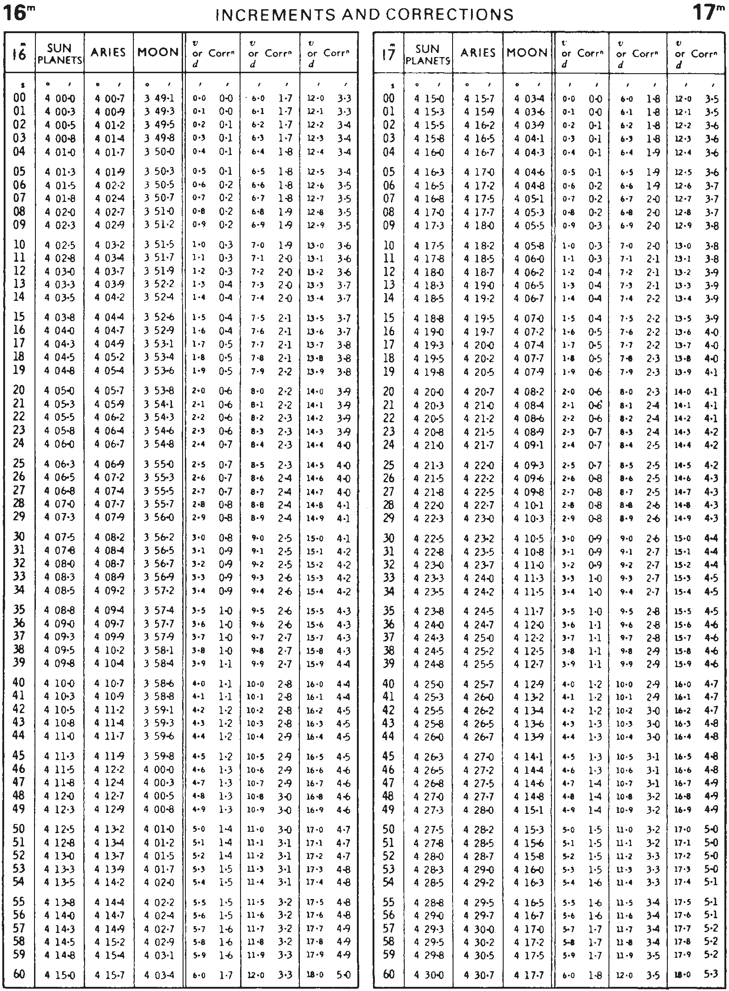
TABLES
31
Table 4. An increment (yellow) page from The Nautical Almanac.

Slide 42
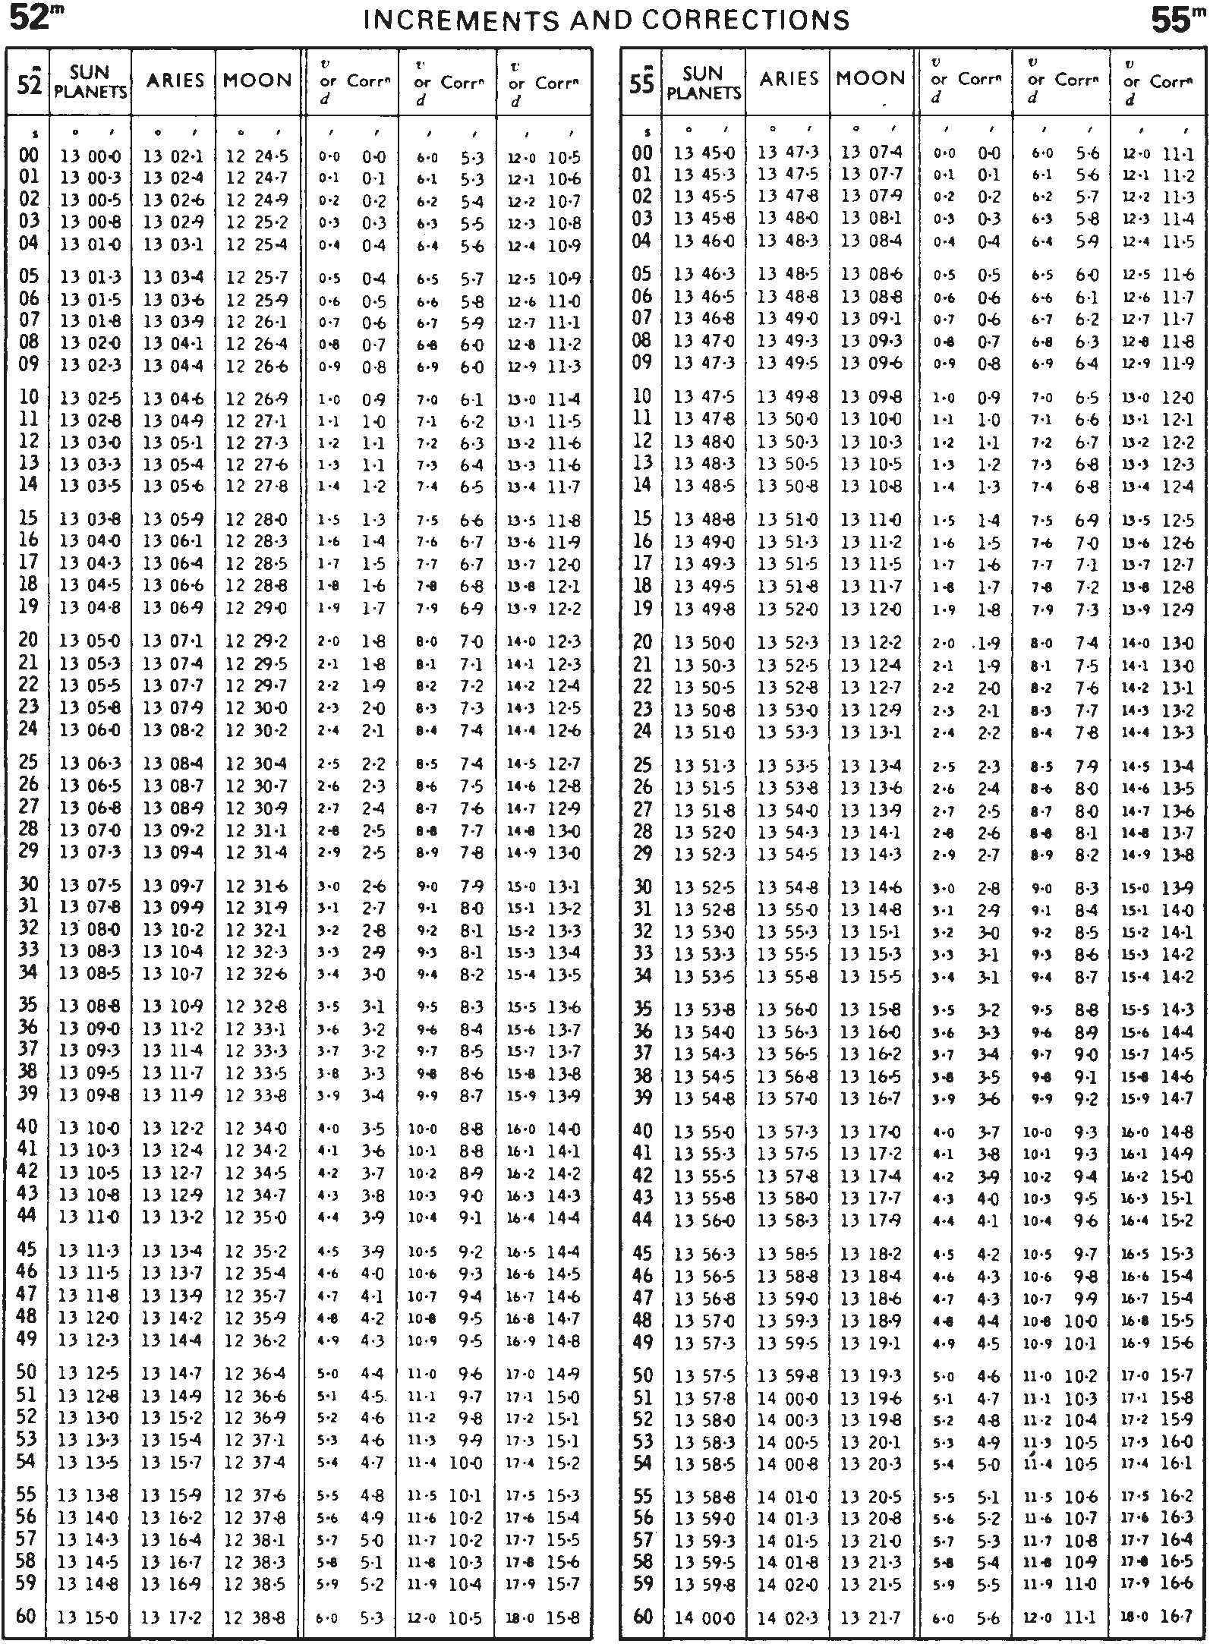
32
CELESTIAL NAVIGATION
Table 5. Increments and corrections from The Nautical Almanac.

Slide 43
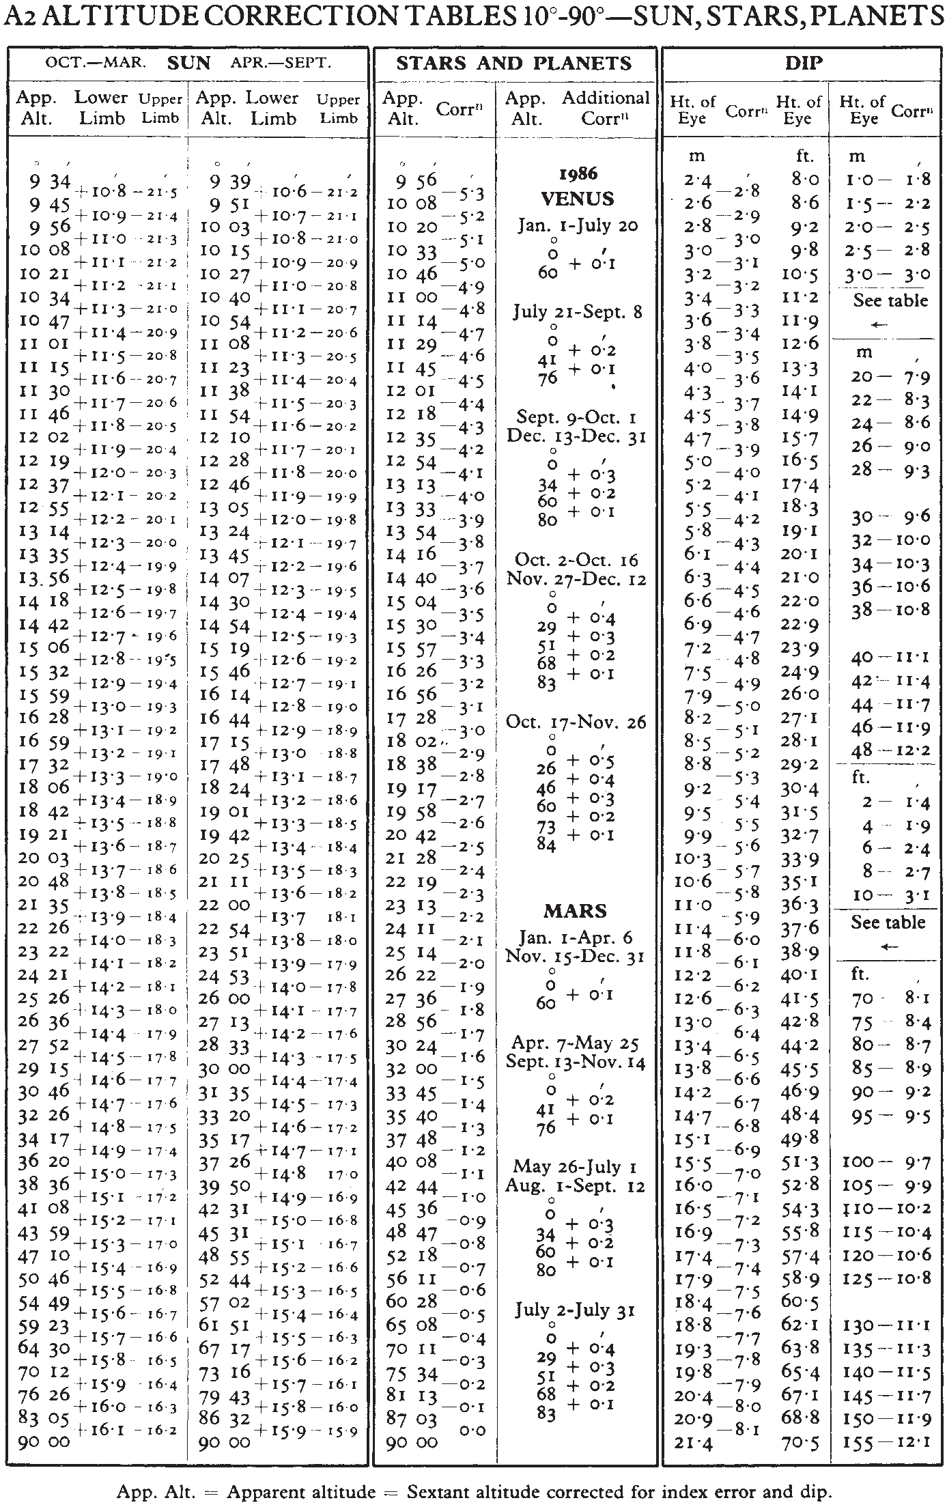
TABLES
33
Table 6. ‘Bookmark’ from The Nautical Almanac.

Slide 44
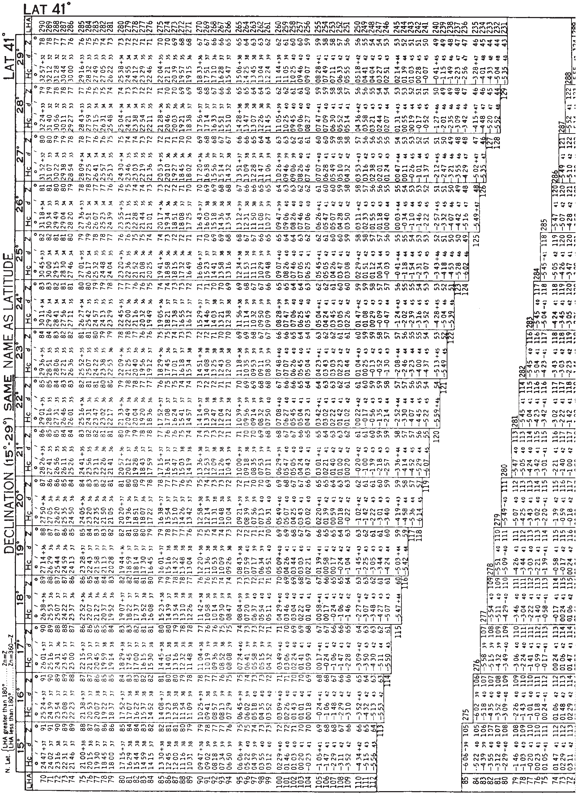
34
CELESTIAL NAVIGATION
Table 7. A page from AP3270 Sight Reduction Tables for Air Navigation Volume 3.

Slide 45
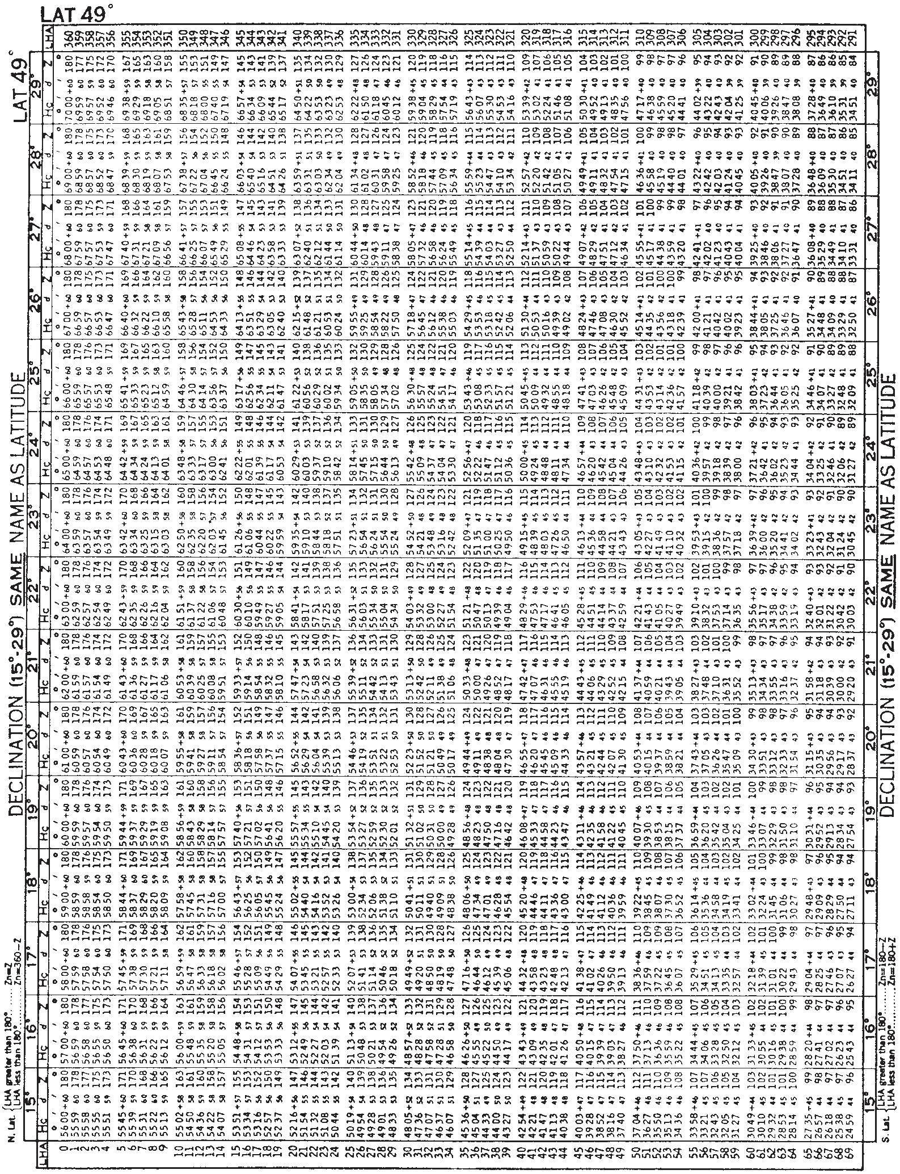
TABLES
35
Table 8. A page from AP3270 Sight Reduction Tables for Air Navigation Volume 3.

Slide 46
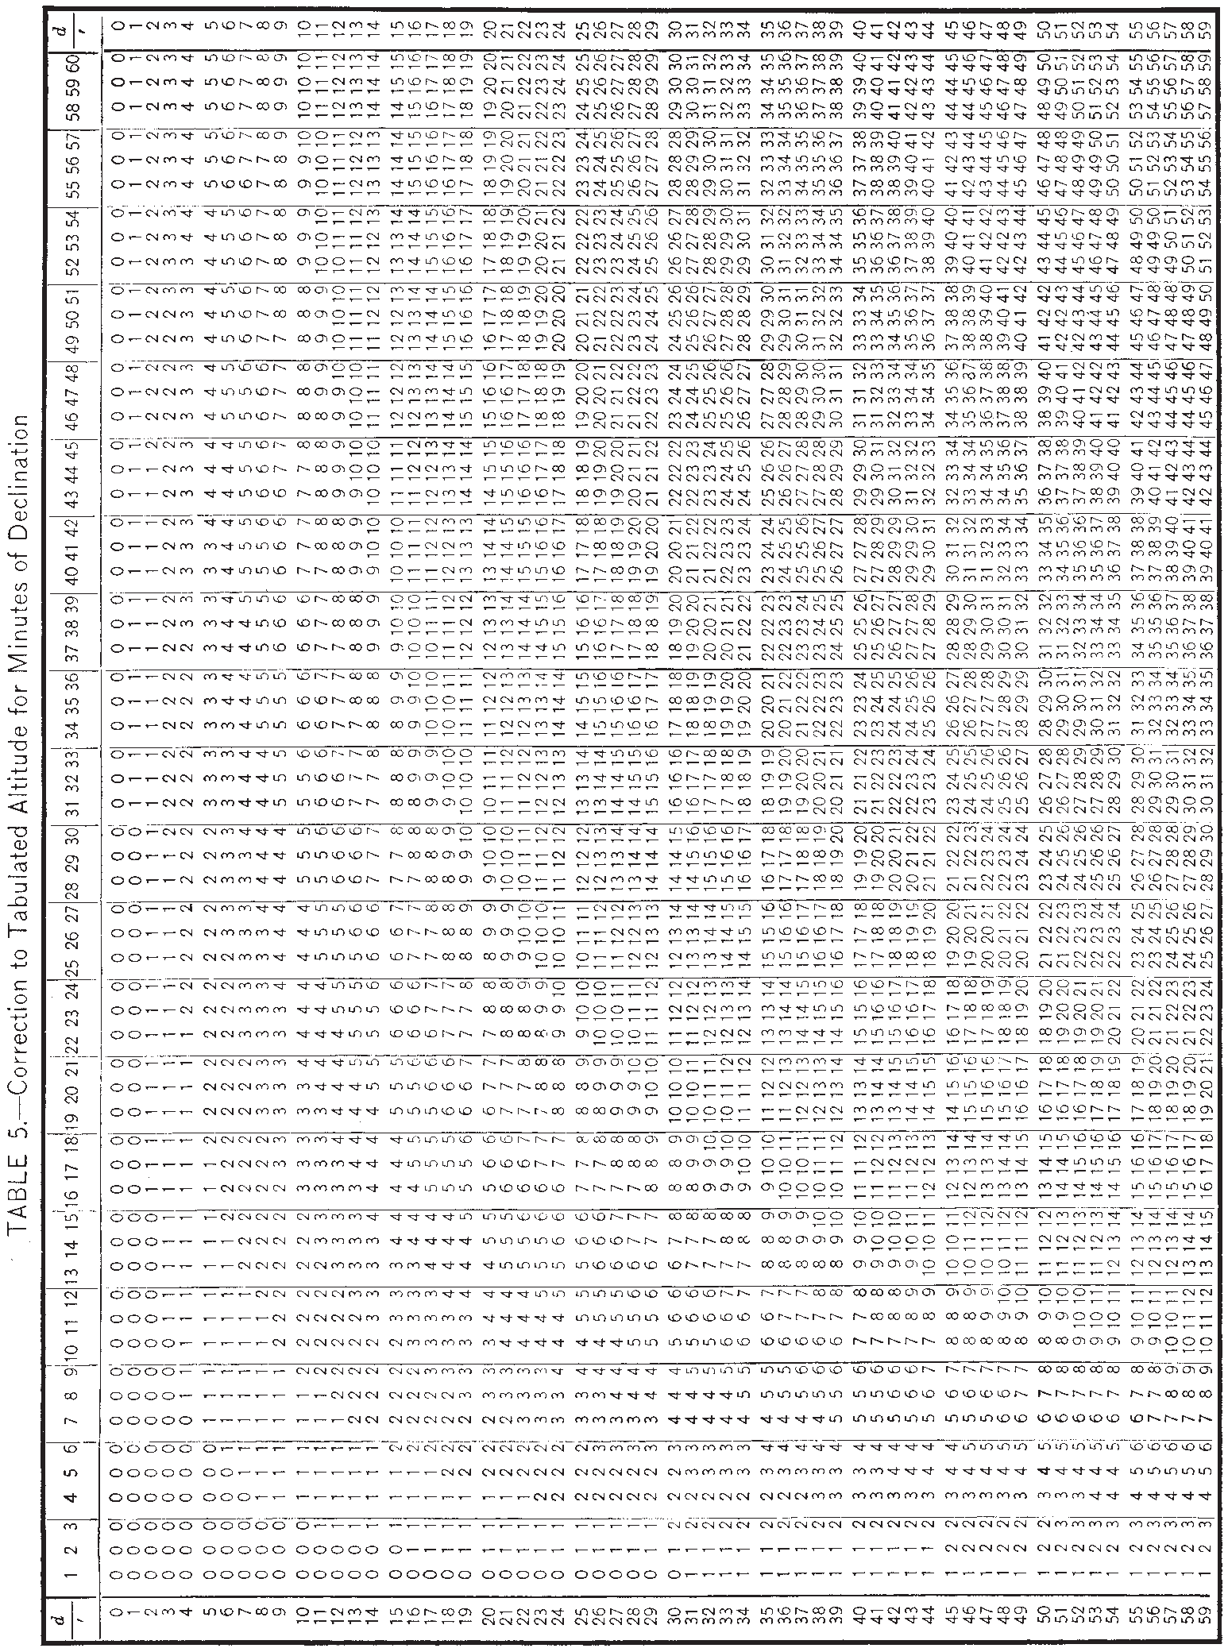
36
CELESTIAL NAVIGATION
Table 9. Bookmark and inside back cover of AP3270 Volumes 2 and 3.

Slide 47
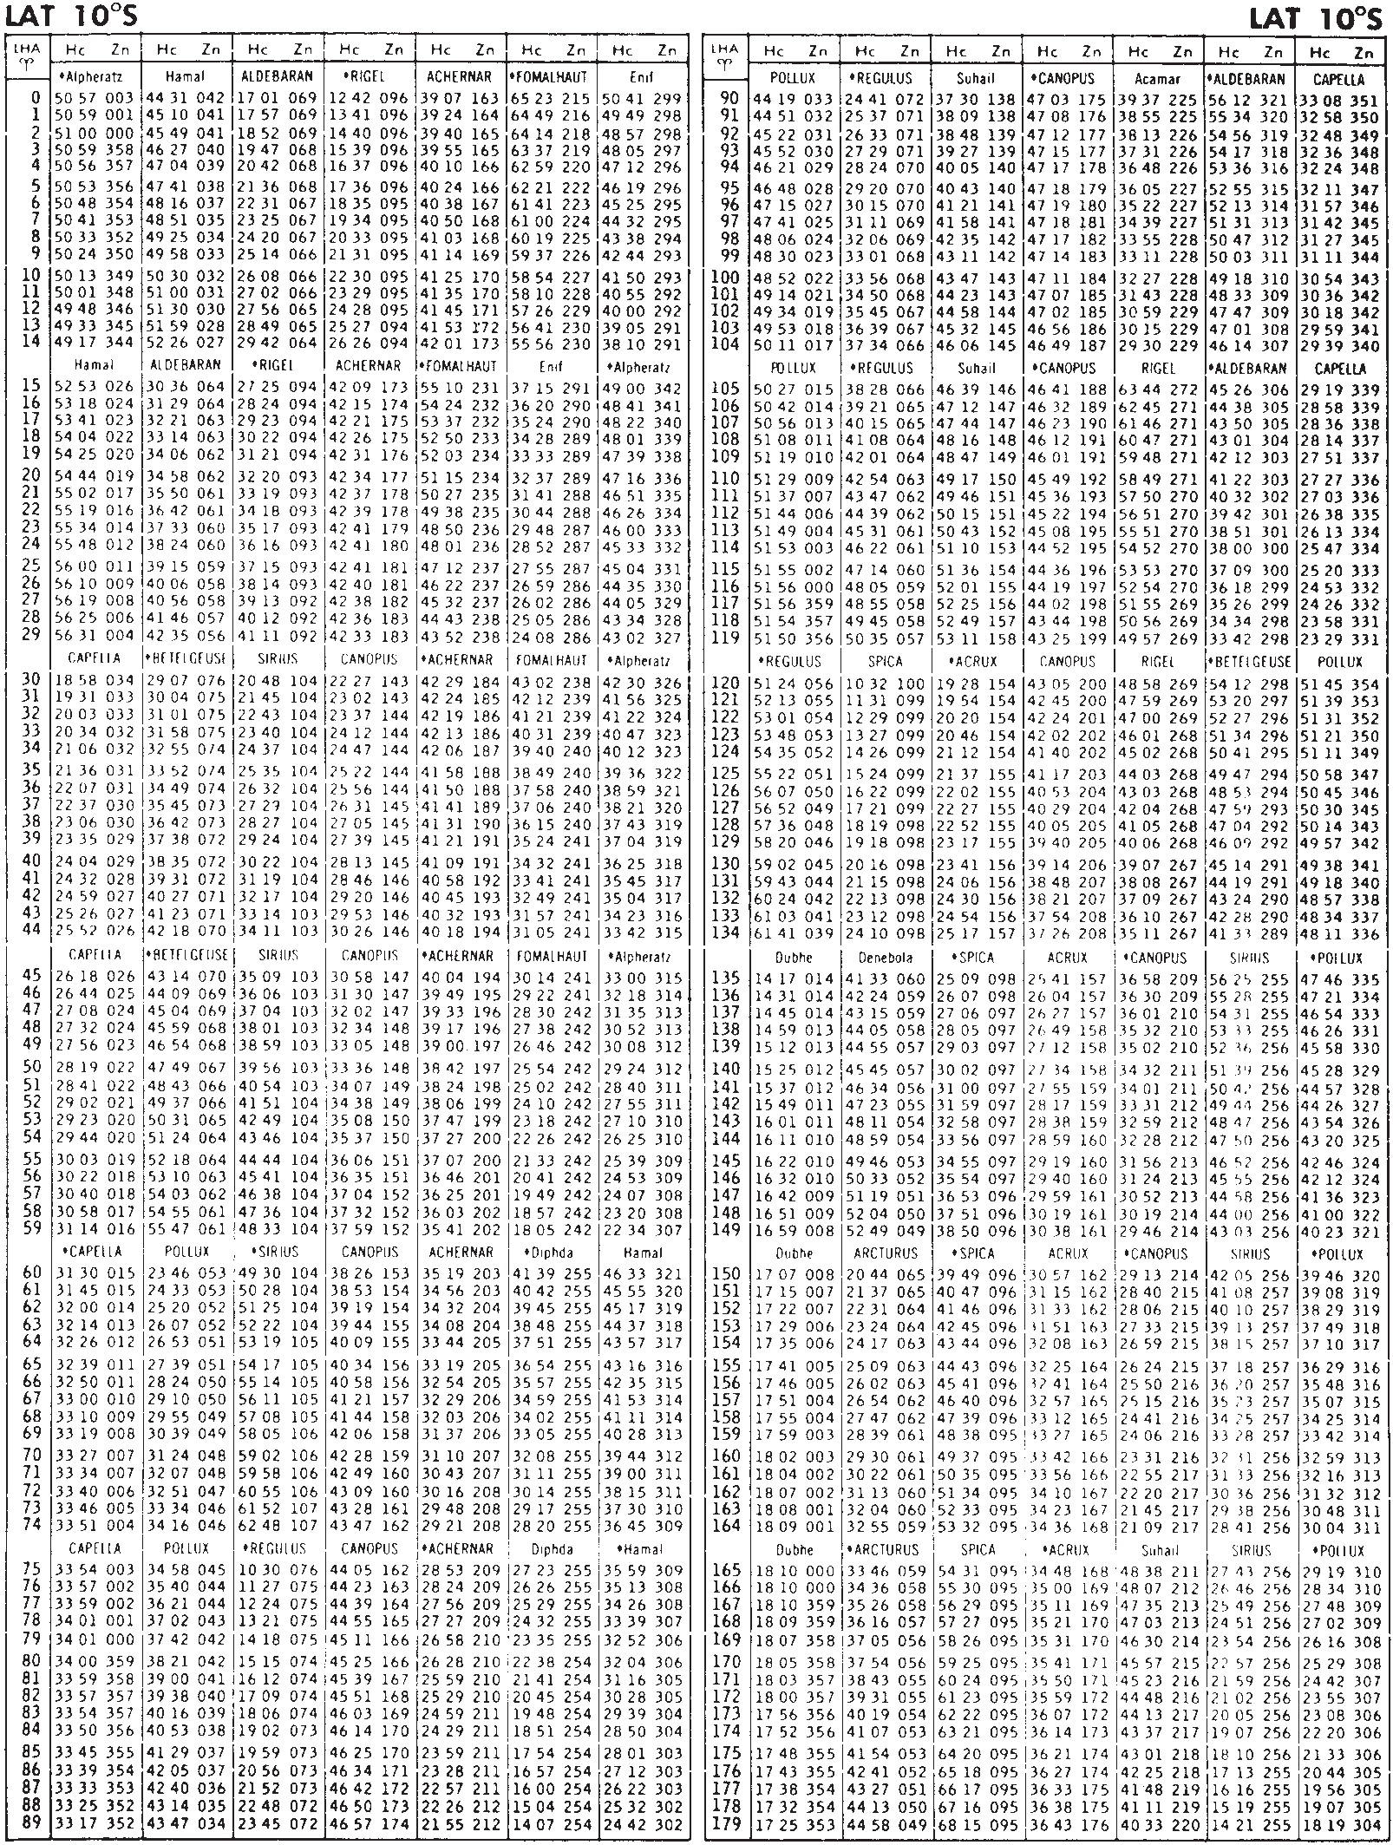
TABLES
37
Table 10. A page from AP3270 Sight Reduction Tables for Air Navigation Volume 1.

Slide 48
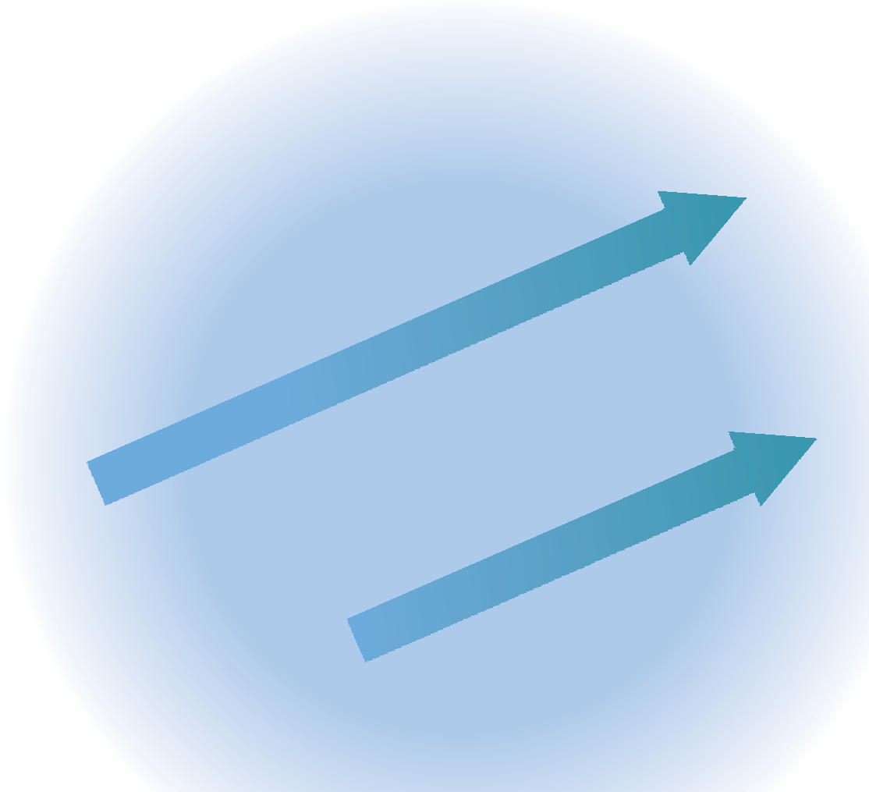
6 Sun Sights
For many yacht navigators, Sun sights form the guts of the whole business. They are taken during the forenoon or afternoon; a forenoon sight produces a position line which, when ‘run up’ along the course line to the noon latitude, will give a running fix to supply a noon position. Similarly, the noon latitude can be advanced to the PL produced by the afternoon sight to give a running fix later in the day. The afternoon PL can also be transferred back to the noon latitude to check the noon position.
This system is called ‘Sun-run-Sun’ and can be operated effectively in quite poor weather conditions. A good navigator needs only a glimpse of the Sun to achieve an altitude. The limitations of the method are obvious. All traditional navigators know the inaccuracies of the running fix from their efforts along the coast. Also, you can only have one noon fix per
24-hour day. While it is possible to transfer one Sun PL up to another taken quite soon afterwards, the small change in their angles
means that the resulting ‘cut’ of the PLs will be very poor. In general, a forenoon sight should be taken not less than one and a half hours before noon. How much earlier you take it will be a trade-off. The earlier the better for the cut of the PLs, but this will mean a longer run-up for the transferred PL to the noon latitude. The longer the run, the bigger the potential running-fix error, particularly if the current is in doubt. Despite these reservations,
a good Sun sight is a very useful thing to have, particularly when the stars and planets are obscured by cloud, or you expect a landfall before dusk.
In Chapter 5 we found that what was needed to plot any sight other than a meridian altitude was an assumed position, an azimuth and an intercept.
Sight reduction
You will almost certainly be reducing your sights using sight reduction tables. These come in
Using Sun sights to give a running fix. Taking the distance run between sights indicated on the log, the forenoon PL has been transferred along the bearing of the track to intersect
with the noon latitude. The afternoon sight has been run back to the noon line in the same way to give a ‘cocked hat’. This should give a good indication of the
noon position, but owing to the
PM
noon latitude
intrinsic inaccuracies of the running fix the technique cannot be relied upon.
AM
afternoon PL run
back to noon latitude
forenoon PL run
PM
up to noon latitude
Taking the sights at shorter time intervals diminishes the distance between them, and reduces the margin of error when transferring them. But the angles of the three PLs are
so similar that a small error makes a big difference to the area covered by the ‘cocked hat’, and the resulting inaccuracy could well exceed that produced by a long run-up.
noon
AM

Slide 49
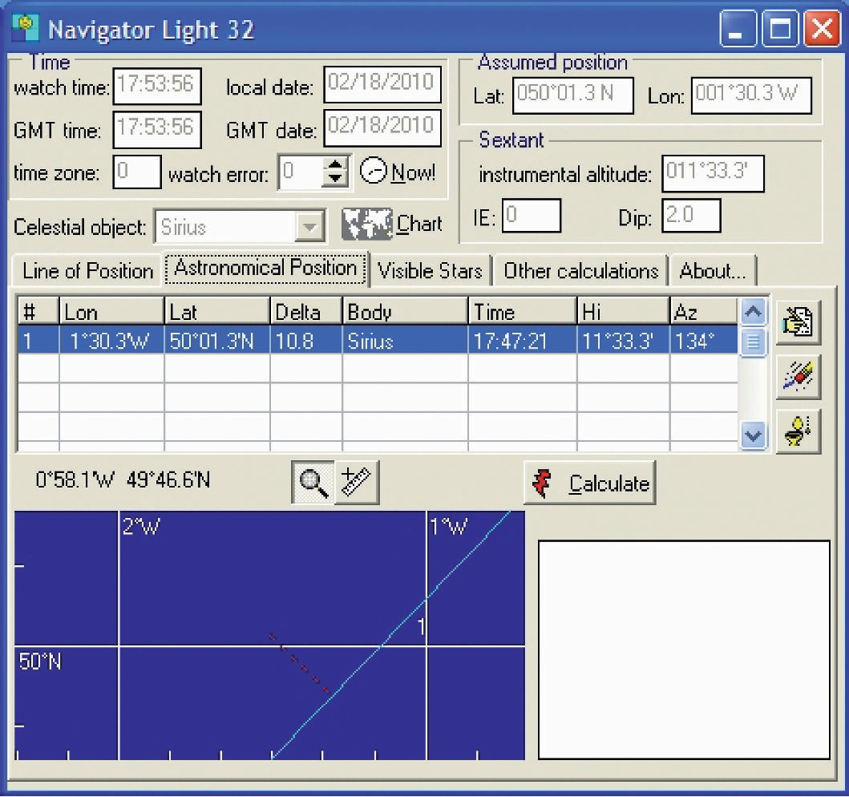
SUN SIGHTS
39
either a marine form running to several volumes, or a condensed version officially for aviators which gets the number of books down to three. The latter are more economical to buy and take up less room on board. They are nominally slightly less accurate than the marine equivalent because the air tables round up or down for decimals of minutes of declination. If this really worries you, making up the deficiency is merely a question of interpolation by eye. The business of sight reduction is dealt with in this book on the basis of the Sight Reduction Tables for Air Navigation (AP3270 in the UK, or Pub. No. 249 in the US). Volume 1 deals with stars, while Volumes 2 and 3 handle all celestial bodies with a declination of less than 30°. This encompasses everything in the solar system: the Moon, the planets and, needless to say, the Sun itself.
Calculators and computer programs
It is possible to buy pre-programmed navigation calculators loaded with almanac information as well as complete sight reduction data. These remarkable pieces of kit will reduce your sights and give azimuth and intercept from a DR or an assumed position. Computer programs are taking over from these as the way ahead, with simple and effective Navigator Light 32 a good example. The advantages are obvious, but it is recommended that before relying upon them as
a primary tool, the following simple methods based on tables are mastered. In any case, it would be foolish to go to sea without an almanac and a set of sight reduction tables, lest all else should fail.
THE ASSUMED POSITION
Assumed latitude
You can rarely reduce a sight using your DR latitude because the sight reduction tables only give altitudes and azimuths from positions whose latitudes are whole numbers. The first thing to do then, is shift your DR latitude to the nearest whole degree. This is called the assumed latitude.
Assumed longitude
Next, doctor your DR longitude so that the LHA of the Sun for the time of your sight turns out to be a whole number as well. The reason for this is that, once again, the tables will tolerate no fractions of degrees of LHA.
Now work out the GHA for the Sun at the time of the sight and then, if in west longitude, juggle your DR so that the minutes and decimals are the same as those of the Sun’s GHA. When you subtract the longitude from the GHA they will disappear. (See page 6: Local Hour Angle.)
A computer program for sight reduction makes life easy, but not before the user understands how to do the job without it.

Slide 50
40
CELESTIAL NAVIGATION
In east longitude, adjust the minutes of longitude so that when added to the minutes and seconds of the Sun’s GHA they add up to a whole number. It’s as simple as that.
Calculated altitude
‘Hc’ is the calculated altitude for the whole degree of declination. To adjust this for minutes of declination, note the figure given under ‘d’. Using this, enter the ‘bookmark’ Table 5 (see page 36). With ‘d’ as one argument and ‘minutes of declination’ as the other, extract the value you require and use it to adjust the main figure for Hc. Notice that ‘d’ is labelled + or − in the main tables. You now have a calculated altitude.
Example
What is the calculated altitude and azimuth for a body whose declination at the time of the sight was 24°19′, whose local hour angle is 315° and which was observed from an assumed latitude of 49°N?
Find the LHA (on the right-hand side of the table) and move across to the column marked 24°. This gives you the following:
Hc 46 57 d + 44 Z 109
Since you are in northern latitudes and the LHA is greater than 180°, Zn = Z. So the azimuth (Zn) is 109°.
For the calculated altitude, go to the ‘bookmark’ (page 36). Find 44 in the ‘d’ column down the side, and move across to the figure in the column beneath the figure 19 (remember that the declination is 24°19′). This gives you 14, and since the ‘d’ figure is plus 44 the resulting increment is +14.
Example 1
DR longitude 17°46′W
Sun’s GHA at 04 h 12 m 07 s
Assumed longitude west
LHA
242° 57′ .3
17° 57′ .3
225°
Example 2
DR longitude 27°49′E
Sun’s GHA at 04 h 12 m 07 s
+ Assumed longitude east
LHA
242° 57′ .3
28° 02′ .7
271°
AZIMUTH AND INTERCEPT
A working page from Volume 3 of AP3270 will be found on page 35. Notice that the top
right-hand corner gives the latitude 49°. There is a different set of pages for each latitude. Which page of the set you choose is decided by the top central legend, which in this case reads ‘Declination (15°–29°) SAME name as latitude’. This means that to choose the right page you need to know the declination of the Sun (obtained from The Nautical Almanac) as well as your assumed latitude.
On the extreme left and right of the page are columns showing LHA. Choose the value your assumed position has given and move across into the page until you reach the correct column
for declination, as shown in the boxes at top and bottom of the page. Three figures are given, labelled ‘Hc’, ‘d’ and ‘Z’.
Hc 46° 57′
d + 44 14′
Hc 47° 11′
You now have an assumed position and an azimuth. By finding the difference between the calculated altitude above and your observed (corrected sextant) altitude, you have an intercept as well.
Azimuth
‘Z’ is the figure from which the Sun’s azimuth (Zn) is determined. The formula for doing this is to be found at the top and bottom left-hand corners of the page – north latitudes at the top, and south latitudes at the bottom, as follows:
PRODUCING A SUN SIGHT
Put your pro forma ready on the chart table (see page 42). After you’ve crossed the Atlantic once, you won’t need it any more, you’ll do it from memory, but it will help a lot in the early days.
Go up on deck, take a sight of the Sun, time it and then read the log. Make sure the time is right because every four seconds can give an error of up to one mile.
Fill in ‘watch time’ in the pro forma. Correct for GMT.
N.Lat LHA greater than 180°… LHA less than 180°…
S.Lat LHA greater than 180°… LHA less than 180°…
Zn = Z
Zn = 360 − Z
Zn = 180 − Z Zn = 180 + Z
Azimuths are, of course, always expressed in degrees True.

Slide 51
SUN SIGHTS
41
Extract the Sun’s GHA and declination for the hour concerned from the daily pages of The Nautical Almanac. Enter them in the pro forma.
Work up the actual declination for the minute of the sight, using the ‘d’ correction if you need to (see page 5). Round any decimals up or down.
Turn to the increments pages of the almanac for the minutes and seconds of GHA (see pages 30–32) and enter them in the pro forma. Work up the Sun’s GHA (see pages 3–4).
Decide on a suitable assumed longitude and enter it so as to come up with an LHA for the Sun as a whole number of degrees (see pages 6 and 40). While you are about it, decide on your assumed latitude and enter it. This will give an assumed position.
Open the sight reduction tables (AP3270). Check that you have the right page with reference to your assumed latitude, the ‘name’ of the Sun’s declination etc. Extract ‘Hc’, ‘d’ and ‘Z’ and enter them on the pro forma. Take care to note the sign of ‘d’. Is it + or −?
While AP3270 is open, check what to do with ‘Z’ to convert it to ‘Zn’, and thereby provide you with an azimuth (see page 40). Enter this in the pro forma.
Consult the ‘bookmark’ Table 5 in AP3270 to deal with the minutes of declination (see page 36). Enter the answer and then work up the final, corrected, calculated altitude (Hc).
Enter your sextant reading in the pro forma. Enter the index error (if any) and dip, (see pages 12−13) then work up the apparent altitude. Extract the altitude correction from the ‘bookmark’ of The Nautical Almanac (the left-hand table), enter it and work up the true altitude (Ho).
Compare this with Hc; the difference is your intercept (see page 26). Label it towards or away, and you have all you need to plot your sight (see Chapter 5).
1500 local time, and then running the PL back. See what sort of cocked hat you produce and evaluate the result. In good conditions you could expect to achieve an area of probable position two to four miles across. You may do much better – but remember, at best this is only a running fix.
Sorting the good from the bad
The more experienced you are, the easier it is to assess the quality of a particular sight. If you are in doubt about the standard of an important one, and if conditions and time available for navigation permit, take a series of observations (five or seven is customary) and graph the results, time against altitude.
The good sights should produce a reasonably straight line. Any duffers can be thrown out, and a time and altitude average taken for those which remain. That is the value to use in your workings.
At this point, let me remind you that most difficulties and errors arise from carelessness in looking things up or in reading the sextant. Keep a firm grip on your head. Go one step at a time and every sight will be a winner.
Now try it
1st May. You take a forenoon sight at 09 h 15 m 23 s watch time. The sextant altitude was 39°28′ and the log read 206.4. Your height of eye was estimated to be eight feet, your watch was six seconds fast and your sextant has no index error. The DR position was 49°12′N 5°10′W. At noon the log reads 218.9 and you observe the latitude to be 49°15.5. You have been steering 085°T and the tide has cancelled itself out. Plot
your PL.
You will find the working and the finished plot on page 43. Don’t look at it now; use it to check your own efforts. Working through an example like this is the best way to learn, and with a subject like celestial navigation it is probably the only way.
This chapter on Sun sights is very important. In many ways it forms the basis for most of the subsequent chapters, so make sure you understand it thoroughly before standing on any further.
USING THE SIGHT
If you take a forenoon sight like this at about 0930 local time and then run it up to your noon latitude by transferring the PL along your course line the appropriate number of miles, you will have a fix at the point where the transferred PL cuts the latitude (see page 38).
You can check this by taking another observation in the afternoon, between 1400 and

Slide 52
42
CELESTIAL NAVIGATION
PRO FORMA FOR SUN SIGHT
Date
Watch time Correction
GMT
GHA (hrs) +Correction (mins/secs)
GHA Assumed Long
LHA
Assumed Lat
Hc d
Hc
z 180/360
Zn
Declination (hrs)
d difference
Declination
Hs Index Error Dip
Apparent Alt Main Correction
Ho Hc
Intercept | T
OWARDS/AWAY
Visit www.wileynautical.com/celestial to download blank calculation forms.

Slide 53


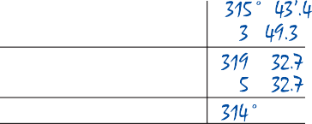





SUN SIGHTS
43
PRO FORMA FOR SUN SIGHT
Date
Watch time Correction GMT
GHA (hrs)
+ Correction (mins/secs)
GHA
Assumed Long
LHA
Assumed Lat
Hc d
Hc
z 180/360
Zn
Declination (hrs) d difference
Declination
Hs
Index Error Dip
Apparent Alt Main Correction
Ho Hc
Intercept
TOWARDS/AWAY
Use the blank pro forma on the opposite page for your own working.
Visit www.wileynautical.com/celestial to download blank calculation forms.

Slide 54
7 The Planets
Of the various planets in the solar system, only Venus, Mars, Jupiter and Saturn are useful to the navigator. If they are available for observation they will be clearly visible at twilight, morning or evening. The planets burn so brightly that once you have worked out where one is likely to be, it is extremely easy to identify. The method for reducing your observation to a position line is very similar to that used for the Sun.
TWILIGHT
To measure the altitude of any heavenly body you need a horizon. At night there is generally no horizon and in the daytime you can’t see the stars and planets, so the time to observe them is twilight.
In practice, the time span of twilight is obvious. In the evening it starts when you see the first planet or star appear and ends when you can no longer discern a horizon. In the morning, it begins as the horizon firms up into a line and ends when the brightest star disappears.
This period, depending on season and latitude, is generally within 20 minutes (plus or minus) of the time of civil twilight which is tabulated for various latitudes on the daily pages of The Nautical Almanac.
If you are pre-computing the approximate position of a planet, and certainly when you come to work out which star is which (see Chapter 9), you will need to know the time of civil twilight for your rough position.
Don’t get bogged down with ‘nautical twilight’, since it is not relevant to your calculations. Just look up the time of civil twilight (CT) in the almanac, make a mental interpolation for latitude, and you will have it in GMT for the Greenwich Meridian. A quick arc-to-time calculation will adjust this for your own longitude.
Example
3rd May. What time approximately is civil twilight in the morning at DR 22°N 55°W? See page 29. Interpolating between 20°N and 30°N, civil twilight on the Greenwich Meridian at 22°N is 0504 GMT. Since the Sun is moving towards the west, twilight will be later in 55° west
longitude by 55 × 4 minutes = 220 minutes = 3 h 40 minutes. Therefore civil twilight is at 0844 GMT at our position.
PLANET IDENTIFICATION
There is a fine description of the planets and their movements in The Nautical Almanac which tells you which planet is likely to be where. You may also find the data in other sources, such as www.stellarium.org. Once you’ve sorted out what’s likely to be around, a planet is usually visually obvious because of its brightness and unwillingness to twinkle. If in doubt, the most accurate method for confirming what you see is as follows.
Extract the time of civil twilight and then, using a planet pro forma, enter this time as the time of an observation. Working from this, consult the almanac to find an approximate LHA, assumed latitude and declination for the planet concerned (you can be very rough) and enter the sight reduction tables. These will give you a calculated altitude and an azimuth. Don’t bother to correct the calculated altitude for minutes of declination.
At twilight, sight along the azimuth and look up to something like the calculated altitude. The bright star there is your planet.
Once you have a planet well and truly recognised you can, in all probability, use it for the rest of the voyage. They don’t change their position very rapidly so you don’t have to go through this every day.
It is said that with careful pre-computing you can find Venus in your sextant telescope during the day and so take a sight of it. Bright though it undoubtedly is, I have had no luck with this one. You might like to try it all the same because it could be extremely useful. I’m still working on it myself…
SHOOTING A PLANET OR STAR
Having identified your planet you’ll find shooting it is easier than the Sun. There is always a hint of doubt about when the Sun’s lower limb is perfectly on the horizon, but a star or planet is

Slide 55

THE PLANETS
45
The planets are so much brighter than the stars that they are easy to identify and can be seen when the sky is quite bright. This is Venus rising (time-lapse photography).
just a point source of light. It is either on the horizon or it isn’t. Pull it down, give the sextant wrist a quick pendulum twist to ensure you are perpendicular, and note the time.
Apparent altitude and parallax
As with the Sun, an apparent altitude correction is applied to the sextant altitude after dealing with index error and dip. You will find the correction in the centre of the bookmark page of the almanac. The figure is much smaller for stars and planets than for the Sun. This is because it contains no correction for semidiameter.
Don’t forget that Mars and Venus may have an additional small correction for parallax (see page 14). This can be found alongside the apparent altitude correction on the bookmark page. Apply it below the apparent altitude correction in the sextant corrections on the pro forma.
Example
1st May. You are in DR 49°N 35°30′W and you observe Venus through the sextant telescope at 20 h 15 m 18 s watch time. Your watch is set to GMT, and is 10 seconds slow. Sextant altitude is 33°13′.6, index error is 2.8′ on the arc and you estimate your height of eye to be 12 feet. Plot your PL.
PLANET SIGHT REDUCTION
A study of the planet pro forma will show that the system for working out a planet sight is virtually identical to that used for the Sun with a few minor variations.
The ‘v’ correction for GHA
This is an extra incremental correction for the GHA of a planet. You will find ‘v’ alongside ‘d’ at the bottom of the daily page column for your planet in the almanac. This is applied to GHA in the same way as ‘d’ is for declination. You can look it up at the same time as you check the
GHA minutes and seconds increment. Notice that it is not always positive. For Venus, for example, ‘v’ is sometimes negative – so watch out.

Slide 56









46
CELESTIAL NAVIGATION
PRO FORMA FOR PLANET SIGHT
Date Planet DR
Watch time Correction GMT
GHA (hrs)
+ Correction (mins/secs) v
GHA
Assumed Long
LHA
Assumed Lat
Hc d
Hc
z 180/360
Zn
Declination (hrs) d
Declination
Hs
Index Error Dip
Apparent Alt Correction Parallax
Ho Hc
Intercept
Visit www.wileynautical.com/celestial to download blank calculation forms.
The completed pro forma and plot are illustrated here – but see if you can do it yourself first.
That is all there is to planet sights. They can be useful on their own, and can often form part of a set of star and planet sights for a good fix at twilight. You can also make them part of a running fix by transferring an afternoon Sun PL up to an evening planet PL, or transferring a morning planet PL up to the forenoon Sun sight.

Slide 57
8 The Moon
Traditionally, while the Moon has delighted poets down the ages, it has not been the navigator’s favourite body. This is because it requires extra effort to reduce a Moon sight and therefore leaves more room for the careless to come unstuck. It also sometimes demands the more awkward upper limb observation. ‘The Moon is inaccurate’, they cry, shaking their fists at it. The Moon is no such thing. All its movements are ordered and they are tabulated in the almanac. It’s up to you, mate, what you make of it.
The wonderful thing about the Moon is that it is often visible at the same time as the Sun and at a reasonable angular distance from it. This gives you the opportunity to take ‘simultaneous’ sights and achieve a real fix, albeit a two-point one.
‘Simultaneous’, in this context, means taking two or more sights within such a short time that you do not have to bother about how far you have run between them. If you are doing five knots and you take two sights five minutes apart, your change of position isn’t going to make a lot of difference to the results.
Generally, the Moon is usefully available for observation a few days before and after ‘half’, both waxing and waning, but it also offers itself at other times.
inverted melon slice. For some reason this is more difficult to observe accurately.
Horizontal parallax corrections are tabulated for both the upper and lower limb. All other corrections assume that you are taking a lower limb observation. This creates no problems, however, because if you shoot the upper limb you simply subtract 30′ from your corrected altitude and that takes care of the matter.
THE MOON SIGHT PRO FORMA
Referring to the Moon in the daily pages of the almanac (see page 29) you will notice five columns of information. GHA we know about, and ‘v’ is just the same as for the planets: it is the increment by which the GHA varies from the regular. Because this changes so frequently in the case of the Moon, it warrants a column of its own. Note that the Moon also has its own column in the increment tables for minutes and seconds of time for GHA as well.
Declination is self-explanatory and ‘d’, the increment correction, is treated like ‘v’ because of its rapid variations.
The only newcomer is the horizontal parallax (HP) column. You will find a space on the pro forma for ‘HP’ in the altitude corrections, because HP (see page 9) represents an error in the observed altitude.
All these values are entered into the pro forma (see page 49). Note that ‘v’ is always additive to the GHA because the Moon rises later each day.
Like all declination increments, ‘d’ may be added or subtracted. Find out which by inspection of the hours adjacent to the one you are interested in. If the declination is increasing by the hour, then the ‘d’ value is positive. If it is decreasing, then it is negative.
Everything else is straightforward until you come to the altitude.
CORRECTIONS IN SIGHT
REDUCTION
As a basic proposition, the closer the target to Earth, the more corrections you will have to make when reducing the sight. The Moon, a mere 250,000 miles away, is particularly susceptible. Its GHA varies a lot from the regular, as does the rate of change in declination. Its closeness also makes horizontal parallax a very real factor when correcting apparent altitude.
Upper and lower limb
Unlike the Sun, which usually presents us with a view of its whole disc, the Moon is frequently partially obscured. In many of its phases you have no choice but to shoot the upper limb.
Shooting the ‘ghostly galleon’ can be pleasant, but often you are stuck with the dreaded
ALTITUDE CORRECTION TABLES
FOR THE MOON
These are to be found at the very back of the almanac. They are easy enough to follow and the system described in the tables leaves no

Slide 58

48
CELESTIAL NAVIGATION
doubt about how to do it. So ‘when all else fails, read the instructions’. They even give you a ‘dip’ table on the same page so you don’t have to scrabble through the book looking for the one used for everything else.
Correct your sextant altitude for index error and dip just as you would for any other sight. This gives the apparent altitude.
There are now two corrections to apply. The first correction is found in the upper section of the altitude correction tables for the Moon. It is straightforward enough, but is set out in a rather unusual manner. The only argument for
entry into the table is apparent altitude. Here are two examples to help you familiarise yourself with it.
Example 1
Your apparent altitude is 12°20′. What is the first correction?
Find 12° (one of the bold figures in the body of the table), then go down the adjacent column until you find the correction figure
opposite 20′ in the App Alt column. The answer is 62.6′.
Example 2
Your apparent altitude is 34°37′. What is the first correction?
The answer is 56.7′.
The second correction will refer to horizontal parallax (HP) which you extract from the fifth ‘Moon’ column of the daily page in the almanac and note on your pro forma. The Moon altitude correction table is entered with HP as your argument (side columns). Move across the table until you are in the column from which you took the first correction for apparent altitude. ‘L’ and ‘U’ refer to the upper and lower limb and you can choose accordingly.
Example 3
What are corrections 1 and 2 for an apparent altitude of 25°42′ and an HP figure of 56.4? The sight was of the Moon’s lower limb.
Correction 1 is 60.6.
Correction 2 is 3.5, obtained by dropping straight down the column from correction 1 and selecting the subcolumn headed ‘L’.
Both corrections are added to the apparent altitude and when applied give the true altitude (Ho) for the Moon’s lower limb. If you observed the upper limb, you’ll have to subtract 30′ from the result, as in the third correction on the pro forma. This compensates for the Moon’s diameter.
You now have all the information you need to take a Moon sight.
One of the altitude correction tables for the Moon from the end of The Nautical Almanac.

Slide 59








THE MOON
49
PRO FORMA FOR MOON SIGHT
Date
Watch time Correction GMT
GHA (hrs)
+ Correction (mins/secs)
+ v
GHA
Assumed Long
LHA
Assumed Lat
Hc d
Hc
z 180/360
Zn
Declination (hrs) d
Declination
Hs
Index Error Dip
Apparent Alt
+ 1st correction
+ 2nd correction
Ho Lower Limb 3rd Correction
Ho Upper Limb Hc
INTERCEPT
Hp
TOWARDS/AWAY
Visit www.wileynautical.com/celestial to download blank calculation forms.
Example 4
1st May. You are in DR 41°S 25°38′E and are able to observe the Moon’s upper limb. The time is 10 h 14 m 09 s GMT (you have just adjusted your watch) and the sextant altitude was 20°48.2. Index error is 1′ on the arc and your height of eye is about 12 feet. Plot your PL. The worked pro forma and plot are shown here, but as before, see if you can figure out the answer yourself.
If you use your pro forma as a guide and work through it step by step, Moon sight reduction should not prove a problem. If, however, you are struggling to cope with the Moon’s eccentricities, leave it alone for a while and go on to the stars. These are the easiest of the lot to reduce and, as you’ll see, simple to identify. You will find that they are of immense importance to your navigation.

Slide 60

9 The Stars
Most people who dabble in celestial navigation are under the mistaken impression that star sights are a problem. This misconception arises from two great fallacies:
It is difficult to identify the star you want because it is twilight and the constellations are invisible. You would be involved in an unacceptable amount of rote learning to memorise all the names.
Working out star sights is complicated. Plotting is a nightmare.
Given the general mystique in which astro navigation is held by outsiders, these objections are understandable. In truth, they are without foundation. Here’s why:
You don’t personally have to identify the star you require because Volume 1 of AP3270 does it for you. The arithmetic needed to extract the information can be readily handled by a ten-year-old.
Like many of us, you may choose to identify the stars by name for your own satisfaction. If the night is bright and it’s your watch, what better way can there be of keeping awake to your place in the universe than kitting yourself up with a well-laced coffee and a map of the sky, then watching the stars as they wheel above you. The names are as beautiful as the constellations they make up: Aldebaran, Sirius, Procyon, Altair and the rest. While you are out there, treat yourself to a look into the Pleiades or the nebula in the sword of Orion with your ship’s binoculars. As the sky leaps into 3-D, it is like peering down the throat of infinity. If all this fails to turn you on, stick with the simple arithmetic. It won’t let you down.
Working out sights and plotting them is like every other job – building a boat, climbing a mountain, or even installing central heating. Squint up the hill from the beginning to the end result and it presents a daunting prospect. Take the task as a series of small stages leading towards completion, and the psychological barrier is conquered with ease. Indeed, if you reconsider the apparently complicated star pro forma you’ll realise that these are actually the simplest of all sight reductions.
Just as a guide, a competent navigator working with a mate to note the times of the observations can shoot seven stars in about 15 minutes on a good evening. It will then take another half hour or so to reduce and plot them. For less than an hour’s pleasant work you can produce a fix which could well be good to a mile or less anywhere on the Earth, using bodies whose distance away from us shivers the brain on its mountings.
Brightness of stars (magnitude)
Over 4,000 stars are visible from Earth, but the vast majority are of no benefit to the navigator. Fifty-seven are readily identified and bright enough to be used. All of these are indexed in the almanac and also on the back of the bookmark page. The lists give the name of each star, its magnitude, its SHA (Sidereal Hour Angle), of which more shortly, and its approximate declination.
The magnitude of a star is its brightness. The
higher the number, the dimmer the star. Capella
Part of the index of 57 selected stars.

Slide 61





THE STARS
51
at 0.2 is much brighter than Menkar at 2.8. Sirius is so bright it is off the scale and has the negative value of −1.6. The bigger the negative number, the brighter the star.
It is worth noting here that the magnitude of the planets varies and is tabulated in the daily pages of the almanac alongside each planet’s name in the top box of the ‘planet columns’.
positions relative to one another on the celestial sphere do not vary significantly owing to the effectively infinite distance between us and them. The declinations of the stars remain the same throughout the year as the Earth moves round its microscopic orbit, but as it turns beneath them once a day, their GHAs advance with a marvellous regularity. Since the stars are a fixed angular distance apart, their GHAs all proceed at the same rate. So if the movement of just one is tabulated and the angles from this to all the others are known, it is a simple matter to calculate the GHA of any star at a given time.
The point on the celestial sphere from which all the other GHAs are calculated is called the First Point of Aries and given the symbol of the ram . GHA Aries is found at the extreme
FIRST POINT OF ARIES AND
SIDEREAL HOUR ANGLE (SHA)
Because there are so many stars it would be impractical and expensive to tabulate the movements of every one for each day of the year. Despite the expanding universe, their
₀0
GHA
SHA
GHA
The First Point of Aries is given the symbol of the ram .

Slide 62
52
CELESTIAL NAVIGATION
left-hand column of the daily pages of the almanac (page 28). Data are given here on an hourly basis. Minutes and seconds are found in the increment pages in the usual way, in the next column to the Sun.
The east-west angle between Aries and the position of a given star is known as the Sidereal Hour Angle (SHA) of the star; in other words, the star’s SHA is its angular distance to the west of Aries. For example, the GHA of Altair = GHA
+ SHA Altair.
If the resulting GHA turns out to be greater than 360°, 360 is subtracted from it to arrive at a workable figure, as usual.
If you need to know the exact SHA and declination of a star, they are tabulated in the daily pages of the almanac, at the right-hand side of the stars and planets half of the double- page daily spread (page 28). They are also set out on the bookmark (page 33). Here, SHA and declination are rounded to the nearest whole number for quick reference, but an additional column gives the magnitude. All handy information to work out which stars might be visible.
Example
What is the celestial position (GHA and dec.) of Diphda on 1st May at 18 h 14 m 26 s?
beneath the title it bears the legend, ‘Epoch 2015.0’ or some later date. This edition covers five years either side of 2015. Volumes 2 and 3 are unaffected by the passing years. They go on for as long as you can hold the pages together.
The illustration on page 37 is a reproduction of a working page from AP 3270 Volume 1.
Notice the assumed latitude at the top of the page – this time named north or south (in this case south).
The argument for entry is LHA of Aries. Reading across for a given LHA seven stars are listed, all with their calculated altitude (Hc) and azimuth (Zn), arrayed in ascending order of azimuth. These are the actual values for this LHA. No further calculation is required.
The stars whose names are in capital letters are the brightest, and those marked with the symbol ◆ will, when plotted, give the best ‘cut’ for a fix.
PLANNING A STAR
SIGHT SESSION
Given a clear twilight in decent weather there is no reason why, with practice, you should not be able to shoot all seven of the stars recommended for your location in Volume 1. The seven chosen are selected for their probable visibility and their viability as sources of good PLs.
Prepare for them all, then. Even if you don’t
catch the lot because of cloud, weather or
old-fashioned lack of practice, you should get enough for a fix. But, to be in with a chance of shooting even one, you need to know where to find them. Here is the big secret…
Determine the time of civil twilight for your DR position (see page 44).
Work out the LHA of Aries for this time and location. As always, it needs to be a whole number to enter the tables, so choose an assumed longitude accordingly. You can use the top of the star sight pro forma for this.
Open Volume 1 at the page for your latitude and look up the LHA you have calculated.
Those are your stars, together with their altitudes and azimuths for your assumed position. For purposes of finding the stars these values will be as effective as the real values from your actual position.
You will probably be able to start observing the brighter stars before the official time of civil twilight. In order to do this, just go back one degree of LHA for four minutes of time. I generally make a note like this, going forward from civil twilight as well to give myself an extra chance at that end.
GHA Aries 18 h 129° 22′ .0
+ Increment (page 30) 3° 37′ .1
GHA Aries
+ SHA Diphda
132° 59′ .1
349° 16′ .8
GHA Diphda 482° 15′ .9
− 360 360°
GHA Diphda 122° 15′ .9
Declination S18°03′.8 (from almanac star tables).
REDUCING A SINGLE STAR SIGHT
If the declination of a star is less than 30° then it can be reduced like the Sun or a planet using Volumes 2 or 3 of AP3270. Work out the GHA of the star from the GHA of Aries and the star’s SHA, then proceed. There will be no incremental changes in declination since this is constant.
It is actually quite rare to reduce a star sight like this because of the potential problems of identifying stars and because there is an easier way by using the planned system described below.
Volume 1 of AP3270 – ‘Selected Stars’ When you get hold of a copy of this wonderful book you will see that on the front cover

Slide 63
THE STARS
53
Time |  | LHA
1828 |  | 132
1832 |  | 133
1836 |  | 134
1840 | –Civil Twilight– | 135
1844 |  | 136
1848 |  | 137
1852 |  | 138
If you can’t find a particular star, carry on to the next. You have only a short time to shoot the lot and there is none to waste. If you go for seven, you may not hit them all but you should find plenty for a satisfactory fix. If there is a nice, fat planet sidling around the sky, pull it down too for good measure. You may not bother to reduce it, but it could be a useful ace up your sleeve if there is ambiguity in your plot. Planets
are always a bonus because they are visible when the sky is too bright to see the stars. For this reason you needn’t waste any ‘star time’ shooting them. Nab them late in the morning, or early in the evening.
Have Volume 1 open on the chart table, with your note of LHAs and times (see above) beside it. Give the deck watch to your mate and put the pro forma on the table as well. No doubt you’ll improvise if you have only a small chart table.
The moment conditions allow (shortly before the first star comes out in the evening, or as soon as the eastern horizon firms up in the morning) decide on your first star. It’s generally more useful to begin with the stars to the east of you and work towards those in the west. The eastern horizon sharpens up first in the morning, and in the evening the western horizon stays visible longest. If there is a lot of cloud about, however, common sense must prevail. Grab what you can when you can.
Look up the star’s altitude for the current LHA of Aries and set your sextant to this figure.
Then hang your handbearing compass round your neck and nip up on deck. Use the compass to look down the azimuth of the star (don’t forget to allow for magnetic variation: azimuths are in degrees True), then ‘fix’ the direction with a cloud, or star, or ship, or something. If there is nothing, you’ll just have to concentrate harder. Now look towards the horizon in that direction through your pre-set sextant.
If all is well the star will appear somewhere in your field of view. Rack it up or down until it is sitting on the horizon and call ‘NOW’, at which point your mate marks the exact time. Go back to the chart table and note the time, the sextant angle and the name of the star in your pro forma. Read the sextant carefully, because there’s no going back to check as there is with a single Sun sight. Once this is done, check the data on the next star and do it again.
DISTANCE RUN BETWEEN
STAR SIGHTS
We have seen that the great benefit of a set of ‘simultaneous’ star sights is that the element of a ‘run’ between sights is removed and the resulting fix can be far more accurate in consequence. Unfortunately, if your boat is sailing at six knots and it takes you 25 minutes to shoot all your stars, she will have travelled two and a half miles through the water between the first and the last sight. If you’re racing an ‘Open 50’, the distance may well be seriously significant.
There are two answers to this. If you are in no hurry, the best option is to heave to while you make your observations. This will not only stop the boat, it will also considerably reduce her motion and make your job quicker and easier. If you are cursed with a vessel that won’t heave to happily, or if you don’t want to stop, you should note the log reading at the beginning, the middle and the end of your set of sights. I generally run the early ones up to the middle sight and the last ones back, so that the time of the actual fix is around the centre of the span of your observations. By reference to the various times and your approximate heading, you can make the necessary adjustments to the PLs in your head with an adequate degree of accuracy. There is no practical advantage in covering the plot with a network of confusing spider lines for half a dozen running fixes.
MULTIPLE STAR SIGHT
You’ll be amazed at how well this works. It may be necessary to ‘sweep the horizon’ to find the star, but usually they appear without much trouble. Pick bright stars to start with. Some of the feeble ones can be a trifle demoralising and may need to be abandoned altogether.
REDUCTION
Take a look at the pro forma for star sight reduction and you’ll see that it is in two sections. The first half helps you work out the LHA of Aries, so as to be able to pre-compute which

Slide 64














































54
CELESTIAL NAVIGATION
STARSIGHT PRO FORMA
Date:
Time of CT:
DR:
GHA
Increment (mins)
Assumed Lat:
GHA
Ass. Long.
LHA
STAR
WATCH TIME CORRECTION
GMT
GHA INCREMENT
GHA ASS. LONG.
LHA
Hs INDEX ERROR DIP
APP. ALT. CORRECTION
Ho Hc
INTERCEPT
Zn
Visit www.wileynautical.com/celestial to download blank calculation forms.
stars to observe (see page 52). To use this part of the form, enter the GHA of Aries for the GMT of civil twilight at your position in the box for GHA, followed by its increments – minutes only; seconds don’t matter here – and carry on from there.
Whilst taking a set of sights you will have filled in the names of the stars observed, the exact
time of each observation and the sextant altitudes. As you complete the other sections of the pro forma you’ll find that several have the same entry ‘across the board’. The ‘watch time’ correction, for example, will be common to each sight. The GHA of Aries will be the same if all the observations fall in the same hour, but note that the increments for minutes will vary from

Slide 65


THE STARS
55
Plot showing seven position lines. Pollux may have been misidentified.
sight to sight. So will your assumed longitude because, as with all the other forms for sight reduction, you are going for a whole number of degrees for each LHA of Aries.
Index error can be filled in right across, but watch out for dip. On my boat I have to move around quite a bit to shoot all seven stars.
Some I can get from the comfort of the wheel box aft, (height of eye eight feet); for others
I have to stand on the bow, (height of eye 13 feet); and it is not unknown for me to be
seen lying in the lee scuppers with my sextant on a calm evening looking under the sails with my height of eye down to four feet
at the most.
The corrections to apparent altitude are extracted from the centre column of the bookmark of the almanac (page 33). The calculated altitude (Hc) and the azimuth come, of course, from Volume 1 of AP3270. The assumed latitude will be the same for all the sights.
Here, then, is a worked example of a set of star sights.
Example
It is 1st May. Your DR position is 10°S 139°E and evening twilight is approaching. What will be the time of civil twilight expressed in GMT at your position? Which stars will you go for? Your sextant has no index error.
From the daily pages of the almanac (see page 29) you’ll see that civil twilight in 10°S is at 1811 on the Greenwich Meridian.
139° angular distance = 9 h 16 minutes, because each degree of longitude is equal to 4 minutes of time. Because civil twilight, like any other celestial event, will be earlier in east longitude, the GMT of civil twilight in 139°E will be 1811 minus 9 hrs 16 mins = 0855 GMT.
You won’t find the minutes and seconds for all the sights in this example on the increments table given on pages 30–32. Space forbids, I fear, so you’ll have to take my word for it that the GHA increments are correct. Don’t forget that if you are in doubt as to whether to add or subtract the 9 h 16 minutes, a quick look at your navigation clock will reveal the answer. You’ll

Slide 66

56
CELESTIAL NAVIGATION
probably be doing the sum in mid-afternoon when the navigation clock shows about 0600 GMT. You know it’s about three hours until twilight, so Greenwich time is less than the ship’s working time. If your mind starts refusing duty at this point, try the old maxim – Longitude East, Greenwich time least. Longitude West, Greenwich time best.
Once you’ve calculated the GMT time of civil twilight, enter it into the boxes on the upper part of the pro forma and work out the LHA of Aries at your position for that time.
When the LHA has been determined, you can enter Volume 1 of AP3270. The illustration on page 37 shows a page for latitude 10°S. You can see the stars available and the Hc and Zn of each for the LHA in question as well as for several others ‘either side’ of it.
The lower part of the pro forma is filled out for the sights and times as they were actually taken. The plot illustrated shows the resulting PLs. Notice that there are no azimuths on the plot. With seven PLs to draw on the chart, marking in seven azimuths as well would just confuse the issue and make the plot unreadable. I generally lay my protractor up the direction of the azimuth from the AP, make a mark at the point where the intercept crosses it (‘towards’ or ‘away’, of course) and then construct the PL from that point by adding 90° to the direction of the azimuth.
Five of these PLs form a lovely fix. Acrux is slightly outside, while Pollux is a long way adrift.
In a situation like this it would be a safe assumption that what you thought was Pollux was really something else (Castor, perhaps – this is not uncommon by any means). I would suggest discarding that one. Acrux, on the other hand, is not far out at all. There is a strong possibility that it is right, so you might want to adjust your position accordingly. On the other hand, it may be that you recall having a struggle finding it. It was the first you took and it was very faint. How good a sight was it? Only you can decide, but this is an example of the way you should evaluate your fix.
PRECESSION AND NUTATION
As the years roll on, the stars are creeping slowly to the westward across the celestial sphere. This movement is called precession. It is generally considered at the same time as a second tiny discrepancy which disturbs perfect order.
Nutation is the name given to the amount that the Earth wobbles on its axis.
The combined effect of these two is that every ten years you need a new Volume 1 of AP3270. If you have a ‘2015.0 Epoch’ copy and it is 2019, look in the back for a correction on Table
5. This is applied, in nautical miles and an angular direction, to any star fix to maintain its accuracy. It is also to be used on the PL from a single star, but it only concerns stars reduced through Volume 1.
The Moon doesn’t have a good reputation for accurate position lines, but sometimes it can be seen at the same time as the sun, giving the potential for a simultaneous fix in daylight – too good an opportunity to miss!

Slide 67

10 Polaris – the Pole Star
As every schoolboy knows, the Pole Star is located directly over the North Pole, for which it is named. Alone amongst the heavenly bodies it sits apparently still while the whole ‘bowl of night’ revolves in splendour around it. Because of its unique situation almost exactly on the Earth’s axis, a corrected altitude of Polaris delivers, without further ado, the observer’s latitude. Long before the Sun’s declination was tabulated, Polaris was giving early navigators a yardstick for north–south distance. They didn’t know the Earth was round, so they had no idea why it worked. We do, and it goes like this.
From the illustration you can see that since the terrestrial horizon is a tangent to the Earth’s surface (and hence forms a right angle with the radius which designates the observer’s latitude), the altitude of Polaris above this tangent is the same as the angle subtended by the observer’s zenith at the centre of the Earth. This is, of course, his latitude.
This works out because the distance to Polaris being for all practical purposes infinite, the line joining Polaris to the observer is parallel to the axis of the Earth.
CORRECTIONS TO THE APPARENT
ALTITUDE OF POLARIS
Unfortunately, it seems that nothing in the universe is going to give us an even break. Even Polaris wanders from the pole by as much as two degrees. It is therefore necessary to apply
some corrections to the apparent altitude, which, as always, is the sextant altitude corrected for index error and dip.
The first job after correcting the sextant altitude to determine apparent altitude is to make the standard ‘star’ correction for refraction, as found in the middle column of the bookmark of the almanac (see page 33). Now enter the
Polaris
Polaris
horizon
zenith
horizon
elevated
elevated
pole
alt
45⁰N
pole
alt
zenith
20⁰N
lat
equator
lat
The altitude of Polaris (alt) is virtually the same as the observer’s latitude (lat), regardless of whether the navigator is on a latitude of 45°N, as on the left, or 20°N, as on the right.

Slide 68

58
CELESTIAL NAVIGATION
PRO FORMA FOR POLARIS
Date
Approximate Latitude: DR Long
Watch time Correction GMT
GHA (hrs)
+ Increment (mins/secs)
GHA
DR Long (approx) LHA
Hs
Index error Dip Apparent Alt
Star Correction Ho
(LHA
(Lat (month
Sum
-1⁰
LATITUDE
)
)
)
Visit www.wileynautical.com/celestial to download blank calculation forms.
tables for Polaris immediately before the ‘minutes and seconds’ increment pages at the back of the almanac (see page 59). The page is divided into three sections, each dealing with a correction factor. These are called a₀, a_{l}, and a₂.
For a₀, enter the table with your LHA Aries.
In order to keep the arithmetic simple, each of these corrections is made positive. After they have all been added, however, one degree must be subtracted from the final result to produce a latitude. The pro forma puts all this down in
step-by-step form and should remove any doubts you may have about it.
For a , enter with your approximate latitude.
l
For a₂ you simply need to know what month it is.
The only work required here is to determine the LHA of Aries for your approximate position at the time of the sight – to the nearest minute of time is fine.
Example
1st May. DR 51°N 20°W. Polaris is observed during morning twilight at 0552 GMT. Sextant altitude is 51°12′.6. Height of eye is 15 feet and index error is 2.8 off the arc. What is your latitude?

Slide 69

POLARIS – THE POLE STAR
59
Part of the tables for the Polaris from The Nautical Almanac. The ringed figures are those entered in the example pro forma.

Slide 70

11 Compass Checking on the Ocean
When you are out on the ocean the only external means available for checking your compass are those provided by the sky.
It’s always worthwhile to know that your deviation card is up-to-date when you are set up on a heading that may, wind permitting, stay more or less constant for days or even weeks.
This is how it’s done.
If you are able to use your steering compass to take a bearing of the rising Sun, the difference between this and the bearing tabulated will be the total compass error. As you know, compass error is the sum of variation and deviation.
Variation in a given area is known from the routeing, or pilot, charts used for ocean passage planning. Once this has been applied to the True bearing from the tables, any error remaining can only be deviation.
It’s worth noting that while pilot charts will last a lifetime in terms of wind and current, the variation curves they give alter with the years. In the past, they were either replaced with new ones, or the user had to find another source of up-to-date variation. The arrival of GPS receivers has removed this requirement. Most GPS sets offer the option either to read out the course to steer to a waypoint in degrees True or degrees Magnetic corrected for zone and annual changes. Even if the read-out will not give the variation as a specific item, it is easily worked out by programming the instrument to give a course in Magnetic, then re-jigging it to give the same one in True. Any difference is the variation.
Points to note
Because of refraction, the Sun is technically ‘rising’ or ‘setting’ when it is one semidiameter above the horizon, as in the illustration.
SUNSET AND SUNRISE:
AMPLITUDE TABLES
Every proprietary nautical almanac should have a page devoted to tables known as amplitude tables. These give the bearing of the Sun in degrees True from your approximate position as it rises or sets.
A small section of the amplitude tables which give the bearing of the rising or setting Sun. You need to obtain the rough declination of the Sun from the daily pages of the almanac, and an approximate latitude.

Slide 71

COMPASS CHECKING ON THE OCEAN
61
On east–west passages, the Sun often rises or sets on a bearing quite close to your course, either dead ahead or dead astern. If this is almost so, but not quite, a small course alteration to bring it right on the course line will give you its bearing from the lubber line on the steering compass. The difference in deviation between this heading and the course is unlikely to be significant.
If the Sun both sets and rises a large angular distance from your ship’s heading then you’ll have to measure its bearing relative to the ship’s head. By applying that to the compass heading you can deduce its bearing on the steering compass. The best way of taking the bearing of the setting or rising Sun is by sighting it directly across the steering compass. This is often possible where the instrument is mounted on a binnacle, or is the old-fashioned but ever-green Sestrel Moore compass sited on the coachroof ahead of the cockpit. If you aren’t lucky enough to have such an arrangement, you must take a bearing of the Sun relative to the ship’s head by some mechanical means. The classic instrument for achieving such a bearing is a pelorus with proper sights and a finely graduated scale, but most yachts do not carry such a thing. However, nearly all use a chart plotter of some description. A workable relative bearing can be taken by setting this up somewhere on deck with zero degrees on the ship’s head. You can use the moving arm of the plotter, if it has one, to sight on the Sun. Take some care to ‘aim’ the arm at the Sun’s average position as the boat yaws from side to side of its course. You will have plenty of time to take pains and the results are better than nothing.
A far superior outcome will be achieved if a shadow pin can be stood up vertically in the centre of the plotter ‘rose’. Best of all, however, is an open CD case with a compass rose cut out of a pensioned-off chart pasted inside around
the hole in the middle. Rig a thin rod to stand up at dead centre, orientate the case fore and aft with zero degrees at the bow, and the shadow will read the reciprocal of the exact nearing of the Sun.
If sea conditions permit, I generally do this every time I’m able to observe the Sunrise or the Sunset. I enter the results in the back of my log book and maintain a running check on my ship’s deviation card. Any new errors are noticed straightaway.
Example
Ship’s head by steering compass 250°C
Relative bearing of setting Sun 037°
compass bearing of Sun 287°C
Bearing from amplitude tables 283°T
total compass error
4°W
But, variation (from pilot chart or GPS) 7°W
deviation on this heading 3°East
AZIMUTHS FOR
COMPASS CHECKS
Another excellent method of using the Sun to check the steering compass when your course is nowhere near east or west is to wait until the Sun is dead ahead or dead astern, note its bearing, and take a sight.
It won’t take a moment to work out just the azimuth part of the sight reduction calculation. This is your exact ship’s heading in degrees ‘True’. You know your compass heading, the chart gives the local variation, so away you go…
Sunset or sunrise give the perfect opportunity for a compass check, but make sure there’s a semi- diameter of daylight between the lower limb and the horizon.

Slide 72


12 The Shortest Way
We all know that the shortest distance from ‘A’ to ‘B’ is a straight line. Using a chart produced to the usual Mercator projection, a ruled line connecting two points will indicate a compass heading between them that does not vary. This ‘rhumb line’ course also represents more or less the least mileage where a traverse is of insignificant length compared with the size of the Earth. This feature of Mercator charts is eminently convenient for coastal work. At ocean scales, however, its practicality often breaks down.
Where a course line encompasses a substantial proportion of the globe, the inevitable distortions of the Mercator projection, particularly in higher latitudes, affect routeing to a serious degree.
GREAT CIRCLE SAILING
As we discussed on page 1 of this book, a great circle can be one of the meridians of longitude which converge at the poles. Apart from the equator, no parallel of latitude fits the description. However, a great circle does not have to be one of these two. It is any line delineated on the surface of the Earth by a plane which passes through the centre of the sphere. The shortest distance between two points on the surface of the globe is always the track of the great circle on which both are situated. When deciding which course to steer from one side of an ocean to the other, this is one of the factors you should consider.
Were you to sail a rhumb line on the Mercator projection of your chosen ocean, you would end up travelling a more or less greater distance than you need have done, depending upon your latitude and how closely your course approaches due east or due west.
In high latitudes, on east–west headings, the rhumb line diverges significantly from the great circle route, while on similar headings on the equator (itself a great circle), they are one and the same. In any latitude, a heading of due north or south is, by definition, a great circle, but as headings swing away from this, the differences begin to compound.
In practice, if you are crossing the North Atlantic from Cape Race Newfoundland to the Bishop Rock and you are able to steer the desired course all the way, you will save 60 miles or more by operating on the great circle. In
great circle route
rhumb line
small circle
great circle
great circle route rhumb line
Mercator chart
Right and above: On a Mercator chart a great circle route near the pole appears as a curved line, longer than the rhumb line. But if you look at the two routes as they appear on the globe, it is obvious that the great circle route is shorter.

Slide 73

THE SHORTEST WAY
63
A great circle route from Cape Race to the Bishop Rock, plotted on a gnomonic chart.
higher latitudes, the benefits are greater. If you are crossing in the trades from the Cape Verdes to the Caribbean, any savings on the great circle track will be much smaller and will almost certainly be overshadowed by other considerations.
Working the Great Circle
Fortunately for the non-mathematical ocean navigator, charts covering all major routes are available upon which a straight line is, in fact, a great circle. This happy property of the gnomonic projection makes planning a great circle route the simplest of tasks.
The illustration shows a gnomonic chart of the North Atlantic, with the great circle route from Cape Race to the Bishop Rock drawn in. You will notice that it crosses each of the converging meridians at a slightly different angle. To determine the course at any particular meridian, read off the course at that point using a chart protractor. Although ideally the course should change at each meridian, in practice, a boat always travels five or ten degrees before the next heading is laid off, proceeding in a series of rhumb lines from one great circle point to the next.
To lift a course from a gnomonic chart you will need a plotter of the ‘Breton’ type or a small Douglas (square) protractor. Parallel rules will be of little use. Lay the north-south line of the plotter rose along the charted meridian at your
position, and read off the course from a light line plotted from it to the destination.
Navigators of steamers and motor yachts are advised to lift a series of points from their gnomonic chart and pre-plot them onto a Mercator projection for day-to-day navigation purposes. The results look like the diagram on page 62. This is not recommended for sailing craft because the nature of ocean weather generally dictates the detail of their tracks. As with navigation along the coast, it is rarely worth plotting a line along which you expect to travel, because however carefully you may plan a
great-circle route, if you are in a sailing vessel I would stake a case of rum to a can of beer that you will not follow it.
A hundred miles out you will experience either a headwind or, in the trades, a wind that puts you onto a dead run. In neither case will you steer your course anymore and all your planning will have been blown to bits.
Here’s what actually happens in a well-run yacht: set out on a great circle with hope in your heart, but at all times sail your ship so as to travel as fast as sensibly possible in the most achievable comfort. Soon you’ll be miles from your hoped-for track. Ocean navigation, like all navigation, consists of estimating or fixing your position and then shaping the best course you can from there to your destination. So, after you have produced a decent fix and plotted it onto your Mercator chart, you whip out your

Slide 74


64
CELESTIAL NAVIGATION
A rhumb line (top) and a great circle course (above) on the same Meridian PC chart plotter.

Slide 75
THE SHORTEST WAY
65
gnomonic projection and pop it on there as well. Now lay off a new great circle heading. If you’re lucky, this one will last you more than a couple of days, but the sea and fore-and-aft rig being what they are, it probably won’t happen.
GPS and the Great Circle
An interesting development in great circle sailing which is a by-product of the GPS package is that the GoTo screen on a chart plotter will give you a course from your current position to your destination waypoint. Investigate the menus and most units can deliver this either as a rhumb line or a great circle. This instant great circle heading from any point on the passage theoretically renders the gnomonic chart redundant but, for an old-fashioned chap like me, it’s still reassuring to see the actual great circle laid out as a straight line across that weird grid.
the danger, run east or west along it until the great circle re-emerges from the danger area and then join it once more to continue to your destination.
A classic example of this is a vessel running her easting down in the Southern Ocean with nearly half the globe to traverse. The great circle would pass far too close to the ice, so it is up to the skipper to decide by how much he wants to clear this hazard. When the chosen latitude is reached, course is altered to run as nearly as possible along the parallel. As soon as the great circle veers off towards the safe side of the danger zone, the yacht can re-join it.
Great circle sailing may only make a small difference in the Tropics, but the conscientious application of these principles as you sail the oceans in mid or high latitudes can save literally days. Every little helps when you are out there and, as Norie’s definition of navigation points out, we must conduct our ships not only with “the greatest safety” from one part of the ocean to another, but also “in the shortest time possible”.
COMPOSITE TRACKS
There can be any number of reasons why a pure great circle may take you to unacceptable places. Perhaps it skirts unlit, isolated dangers too closely. Maybe it goes too far towards the pole and the iceberg menace for your fancy, or perchance it is leading you into an area notorious for its lack of breeze. If any of these
is the case, the usual solution is to follow the great circle track until you arrive at the parallel of latitude which you have decided will delimit
Tom Cunliffe shows you how to get to grips with your sextant in a series of free video tutorials to accompany this book.
Visit www.wileynautical.com/celestial to see how it’s done and to download blank calculation forms.

