Slide 1
Coastal Navigation
Session 6
Part 1 Distance from a landmark (Chapter 15) a. With a hand bearing compass or pelorus b. With a vertical sextant c. with a horizontal sextant
Part 2 GPS and Electronic Charts (Chapter 16) a. Accuracy b. Limiting factors c. Displays d. Electronic charts (Raster; Vector)
Dominique Prinet www.MarineNavigationBooks.com June 2020

Slide 2
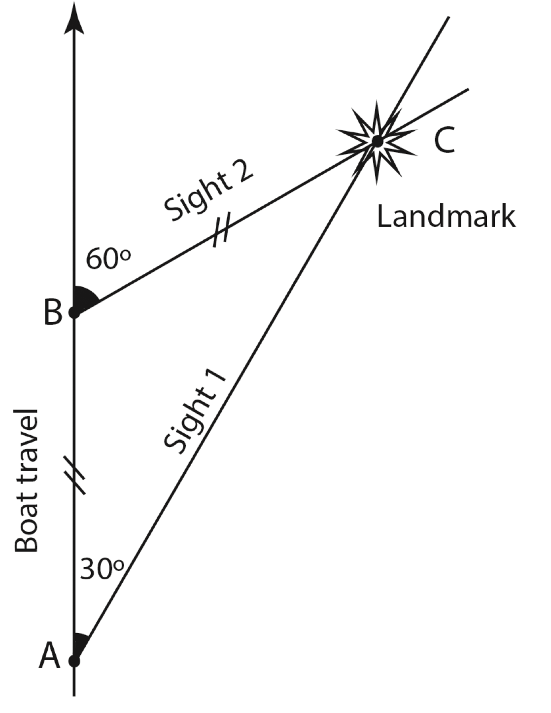
1. Distance from a landmark
a. Using a hand bearing compass, a pelorus, or an Automatic Direction Finder (ADF)
Doubling the bearing, e.g. from 30° to 60°:
Distance from the landmark (BC)
= distance travelled by the boat (AB)
Fig. 15.1 (left half)

Slide 3
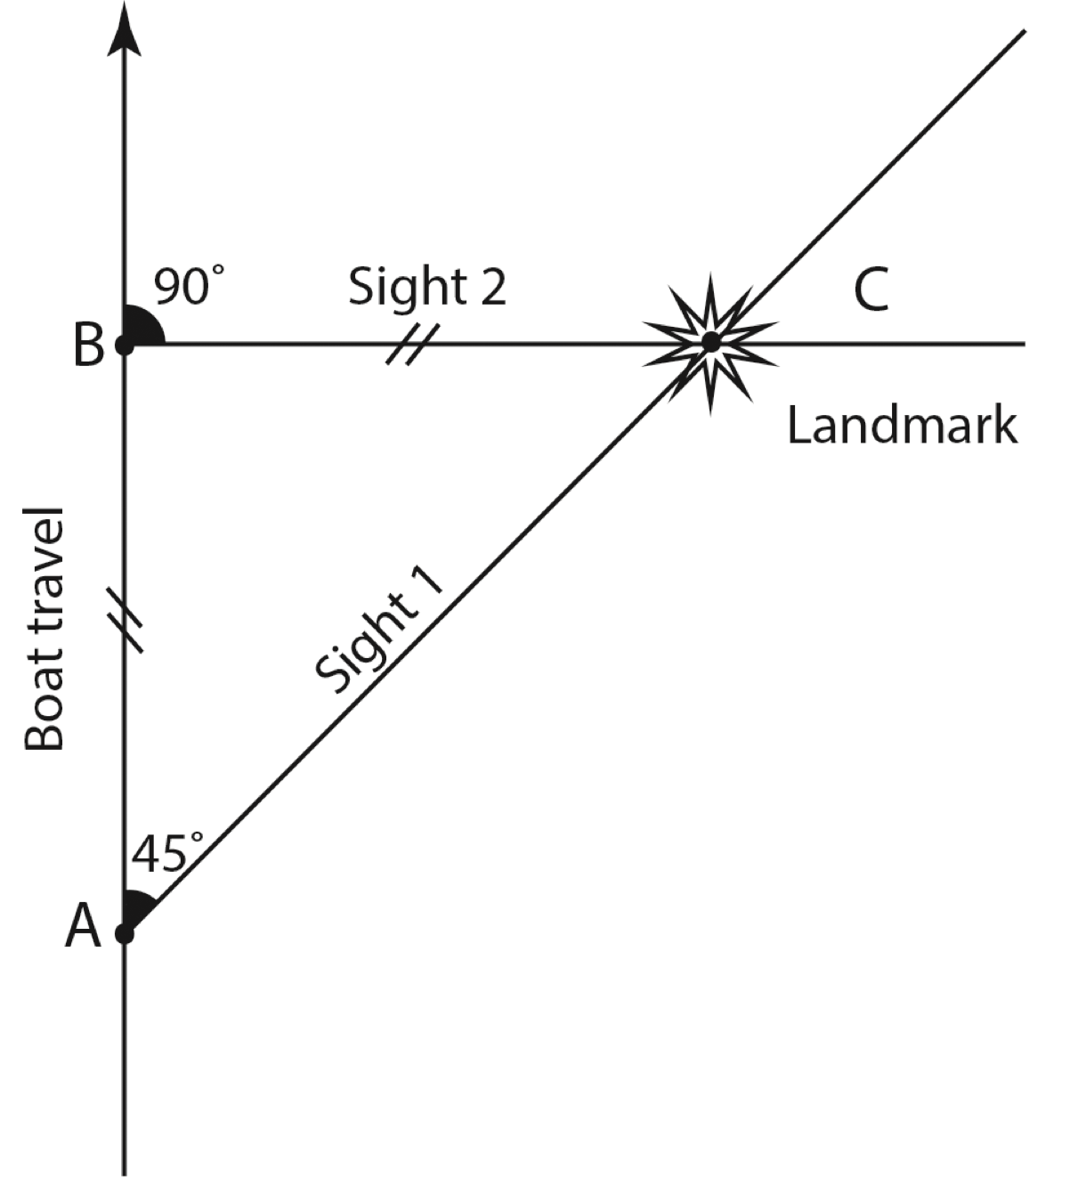
Doubling the bearing, e.g. from 45° to 90°:
Distance from the landmark (BC)
= distance travelled by the boat (AB)
Fig. 15.1 (right half)

Slide 4
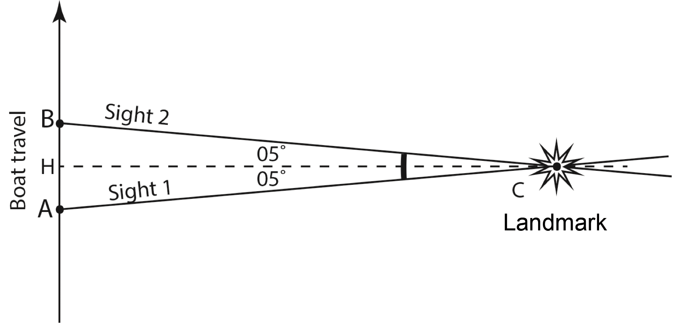
Distance from the landmark ≈
6 times the distance travelled (A-B)
for a change of bearing of 10°.
Fig. 15.2

Slide 5
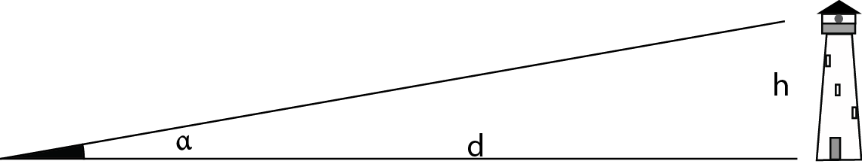
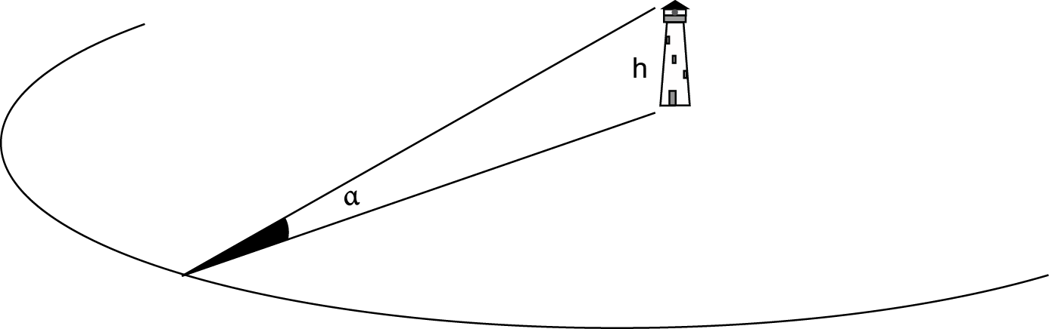
b. Using a vertical sextant
d = h / tg α
Measure α with a vertical sextant;
read “tg α” off a trigonometric table; and
read “h” off the marine chart.
Fig. 15.4
Without trigonometry table, use the formula:
d (in NM) = [height of landmark in m] x 1.85
angle α in minutes of angle
Valid for small angles α.
Fig. 15.5

Slide 6
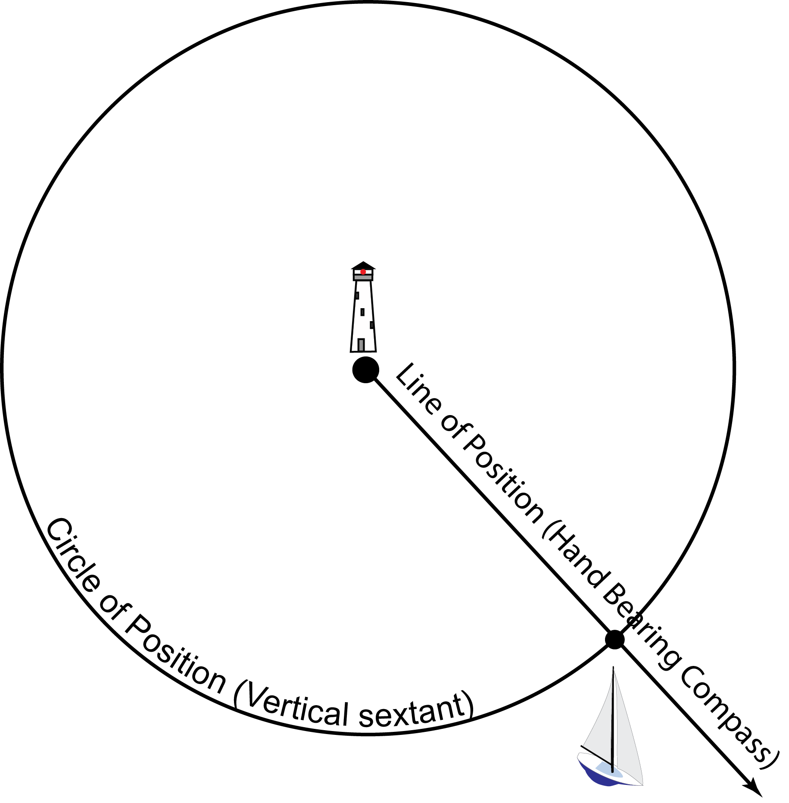
Fig. 15.6
The boat position can be determined from a distance to the landmark (circle of position, vertical sextant), and a bearing (hand-bearing compass)

Slide 7
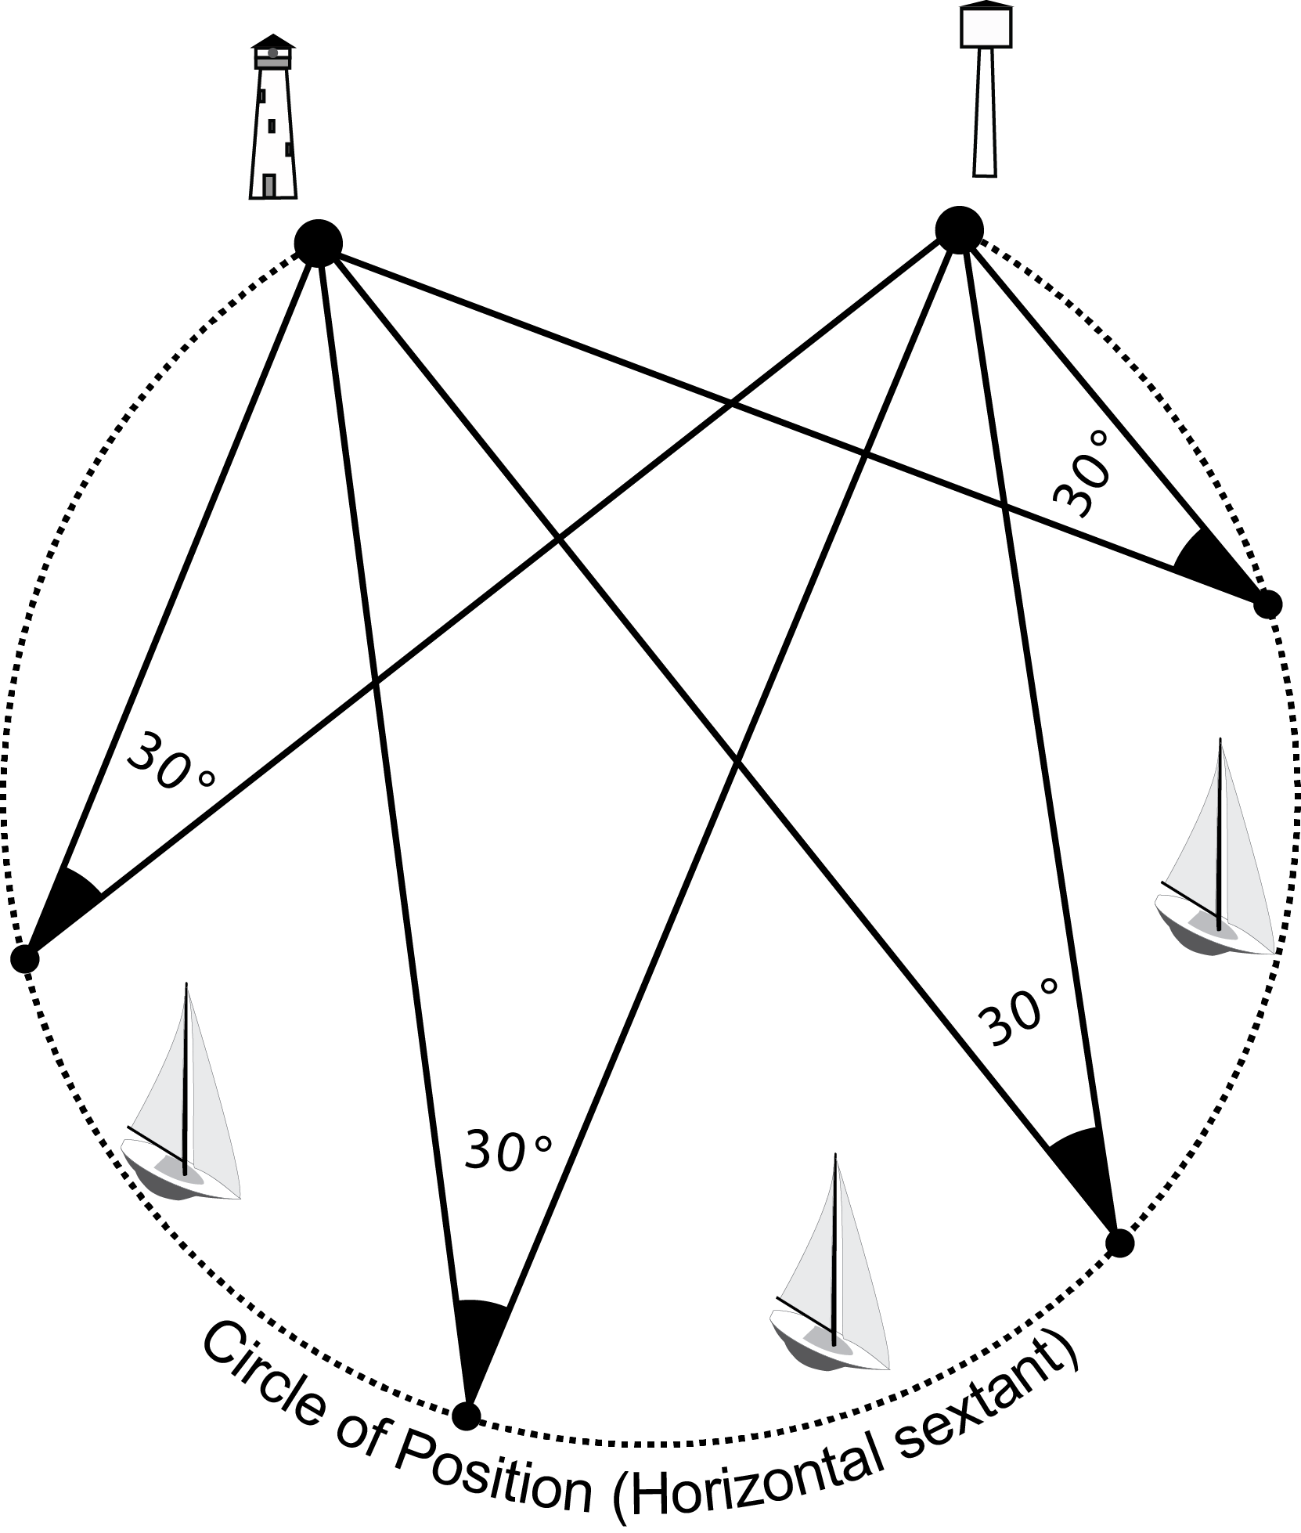
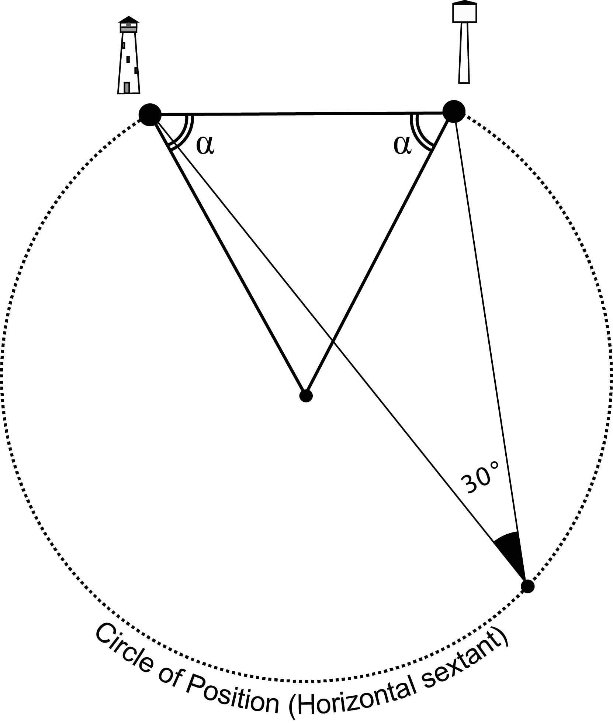
c. Using a horizontal sextant
Fig. 15.7
Fig. 15.8
The circle of position from which two landmarks can be seen at a given sextant angle (e.g. 30°, Fig. 15.7) is centered at the intersection of two radii drawn at
α = (90° - sextant angle = 90° - 30° = 60° in this example) off the base line linking the two landmarks (Fig. 15.8).

Slide 8
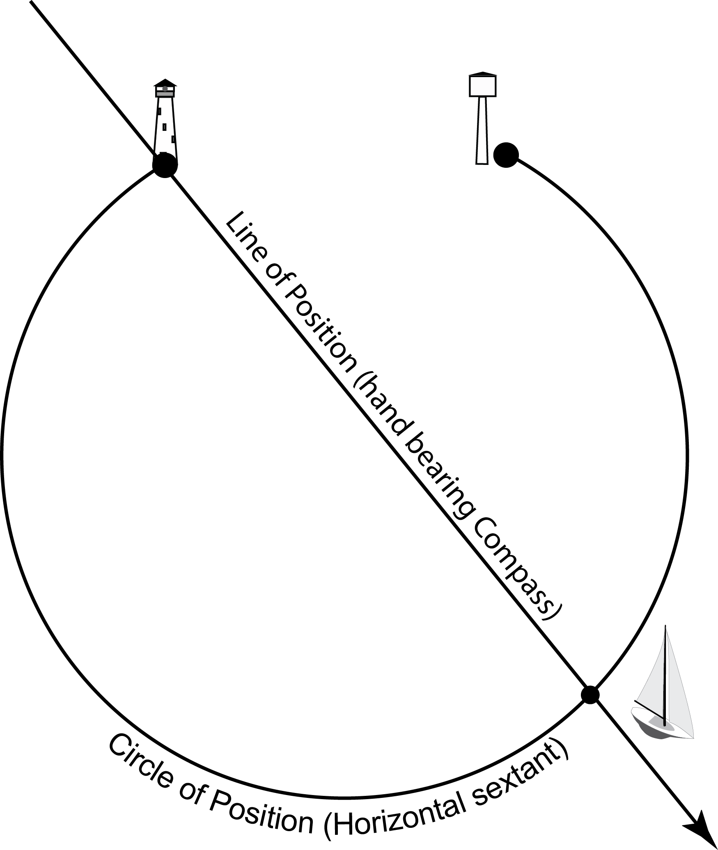
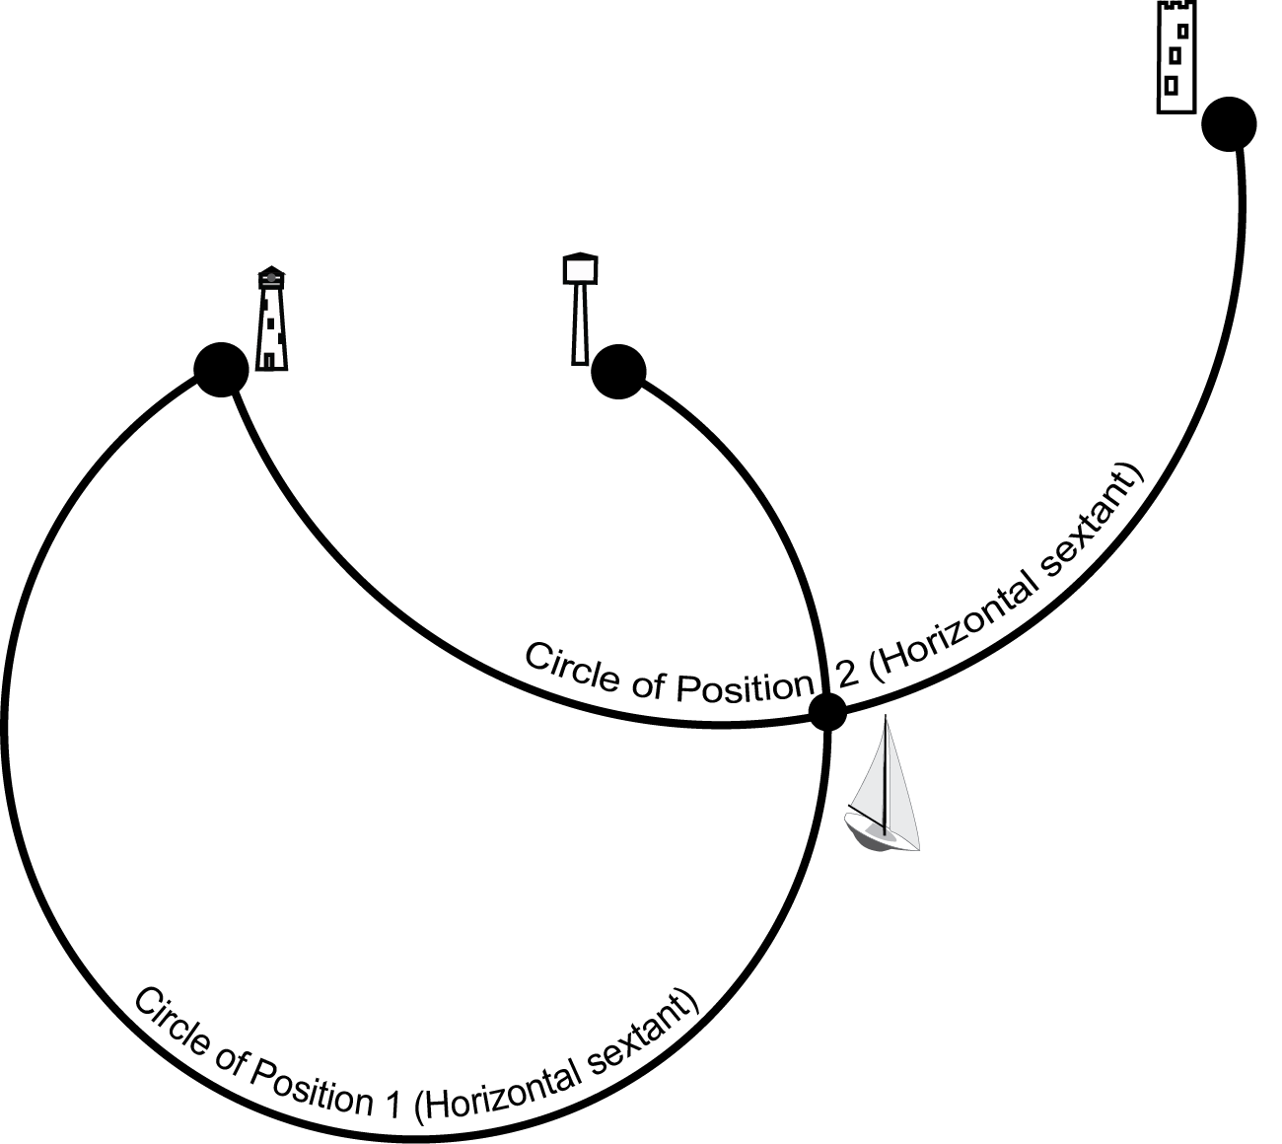
Fig. 15.9
Fig. 15.10
The boat position can be established from:
a circle of position (horizontal sextant) and a bearing (hand-bearing compass, Fig. 15.9) or
from two circles of position (horizontal sextant, Fig. 15.10) using three landmarks

Slide 9
2. GPS; Electronic charts
a. Accuracy
Under the best conditions (see limiting factors, next slide), the horizontal accuracy of the GPS system is approximately 3 to 8 metres 95% of the time
The use of the Wide Area Augmentation System (WAAS), which provides corrections through a geostationary satellite, is one way to increase accuracy. Differential GPS, sending local corrections via ground transmitters close to US and Canadian shorelines, is another way.
Vertical accuracy is considerably lower.
The new European “Galileo” system (with partial implementation in 2017) will provide increased accuracy.

Slide 10
b. Limiting factors of the GPS
Ionospheric and tropospheric interference
Satellite positioning
Calculating ability and accuracy of the GPS unit
Multipath signals; Natural or artificial interference
Horizontal chart datum and chart reliability
Disappearance of details in vector charts at small scales
Loss of signal due to accidental disconnection
Loss of signal due to automatic cut-off at slow speed

Slide 11
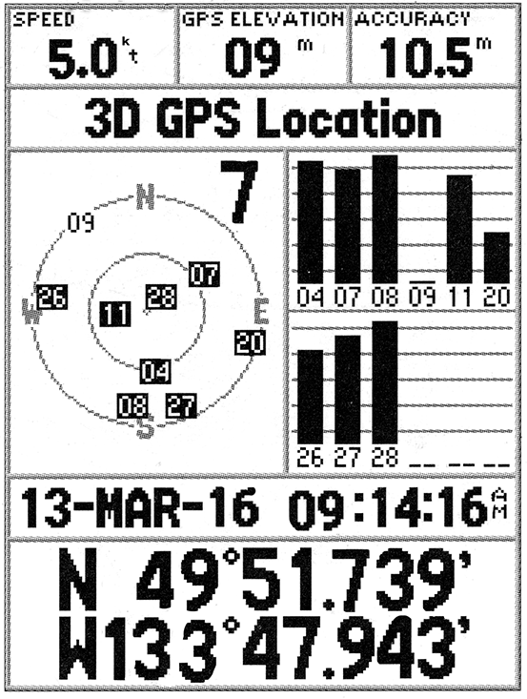
c. Displays
Satellite page
Note satellite 09 is too close to NW horizon
Fig. 16.1

Slide 12
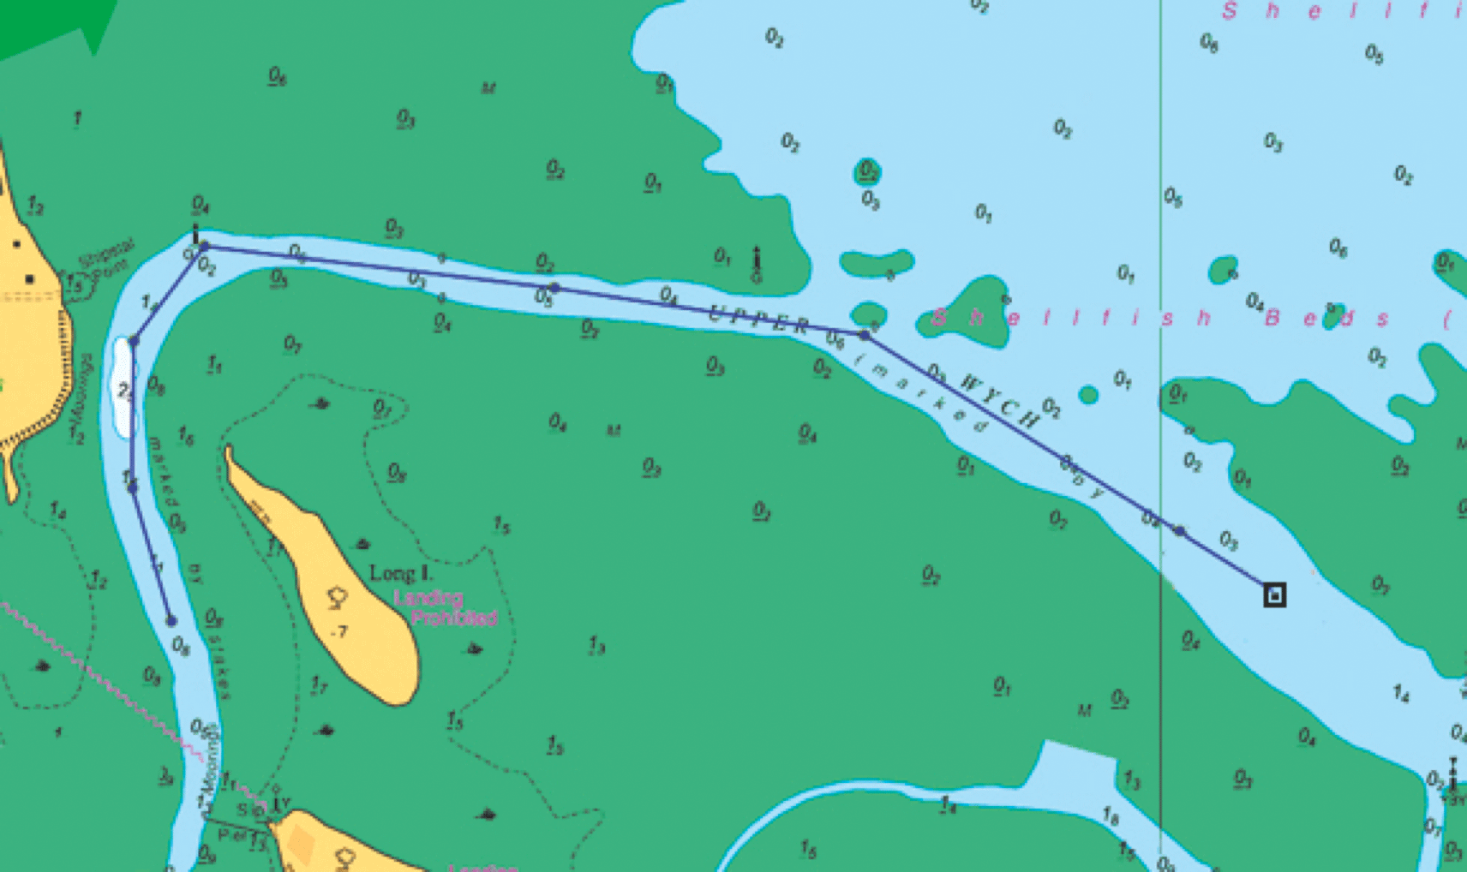
Waypoints and Routes (1/2)
Fig. 16.2

Slide 13
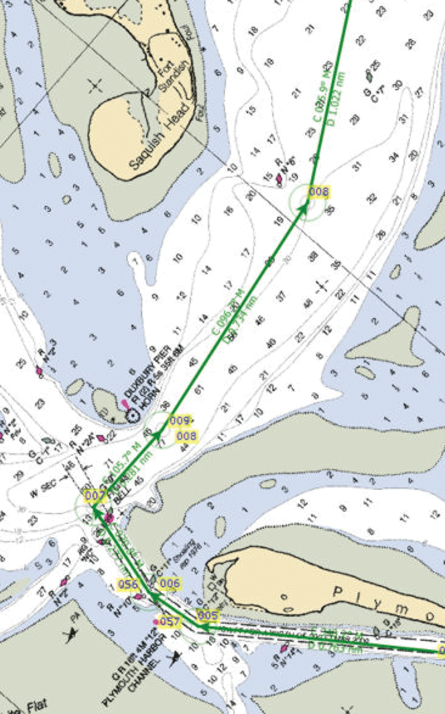
Waypoints and Routes (2/2)
Note route segments displaying course direction and distance
Fig. 16.3

Slide 14
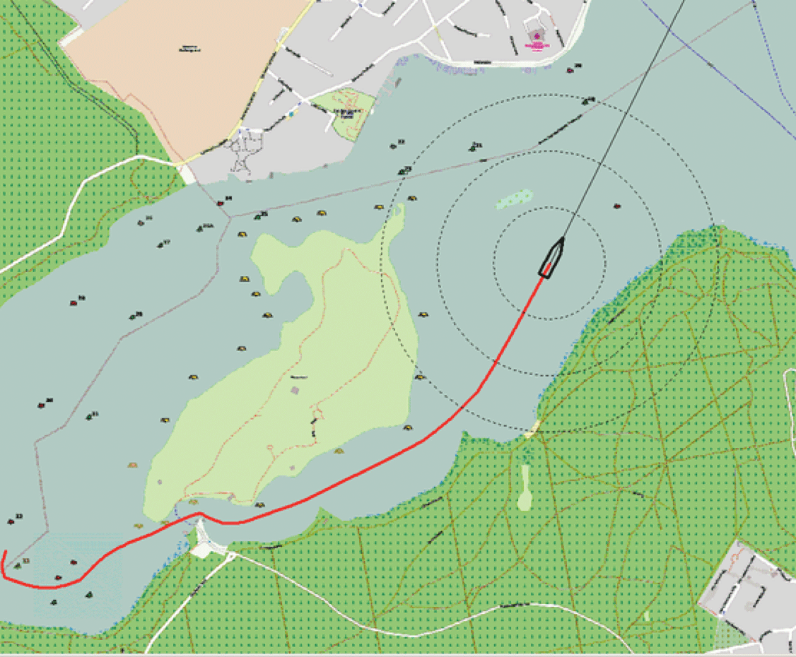
Tracks (1/2)
Continuous track
Fig. 16.4

Slide 15
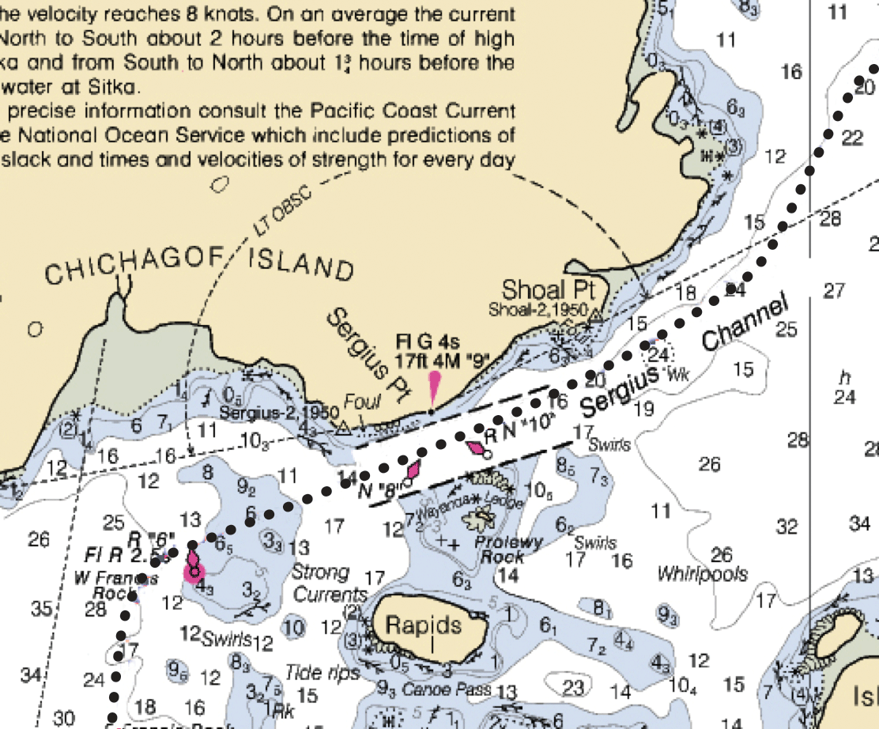
Tracks (2/2)
Tracks with dots at specific time intervals
Fig. 16.5

Slide 16
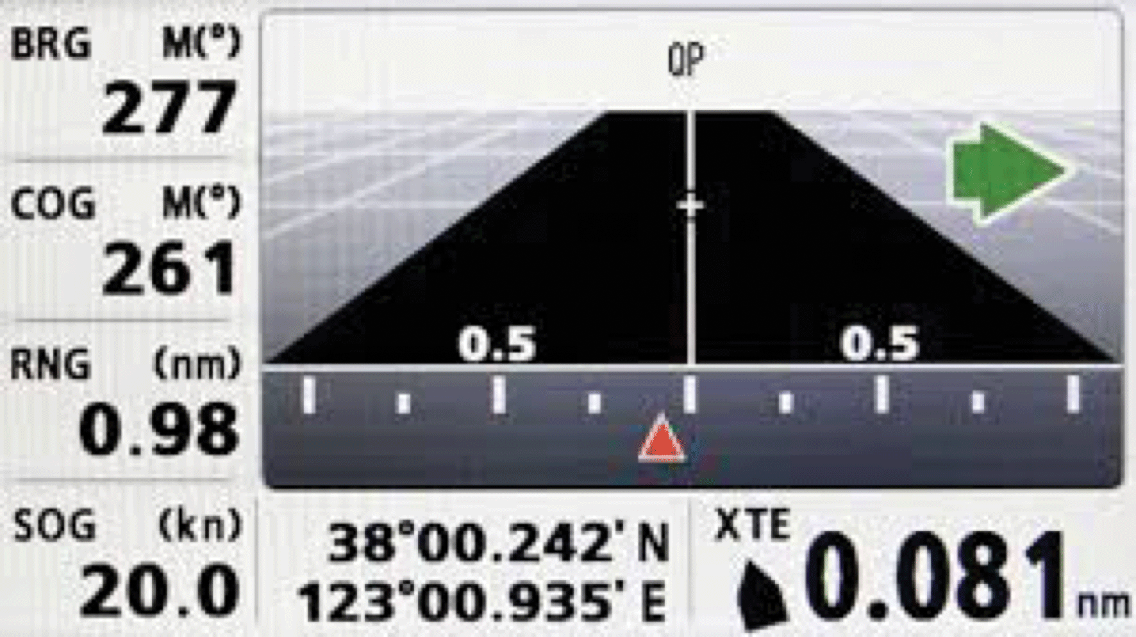
Cross Track Error (1/2)
Fig. 16.6
The intended track is vertical, at the center of the screen.
“Turn to starboard” to get back on track (green arrow), because:
The boat is a little to the left of the intended track (red arrow)
The boat 0.081 NM to the left of the intended track (bottom right window)
The course of the boat over ground (track) is 261˚M (left window), but the next waypoint is further to starboard, at a bearing of 277˚ M (top left window)

Slide 17
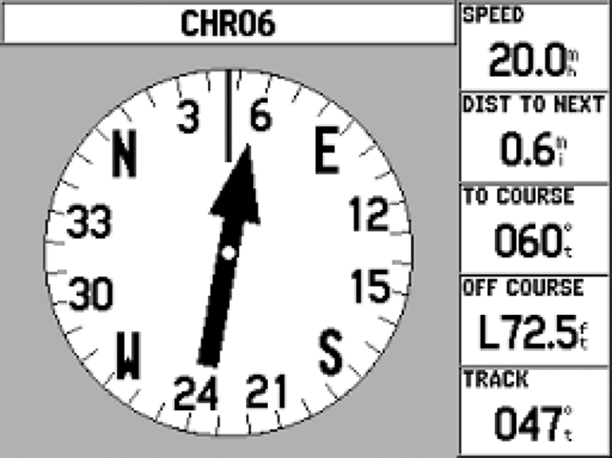
Cross Track Error (2/2)
Fig. 16.7
The boat track is oriented straight up (vertical line, top of dial)
The track over ground is 047˚ (T or M; reading on top of dial, and bottom window).
“Turn to starboard” to get back on track (big black arrow), because:
The boat is 72.5 feet Left (“L”) off the intended track (second window from bottom)
The next waypoint is slightly to starboard, at a bearing of 060˚ (T or M; middle window)

Slide 18
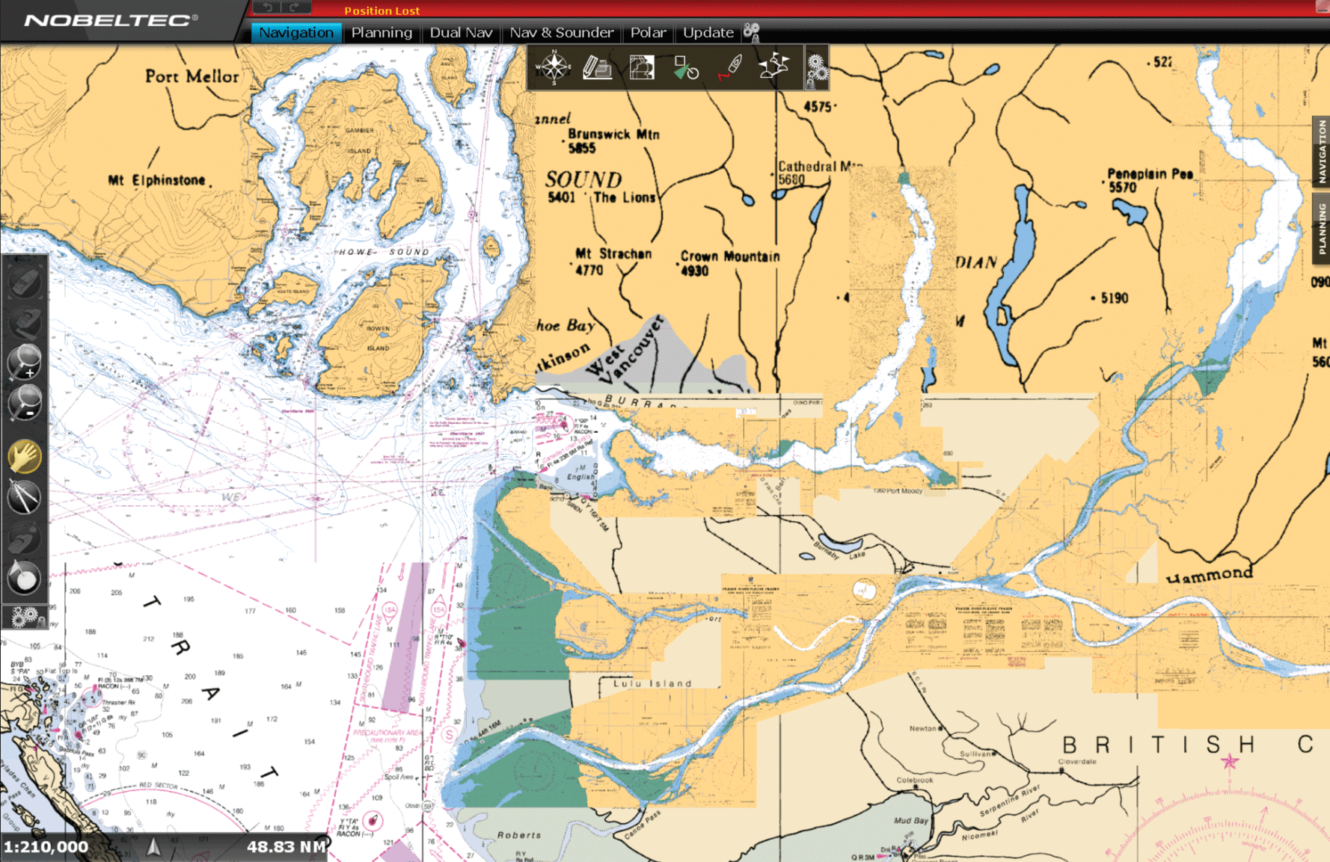
d. Electronic charts
Raster chart (1/3)
Fig. 16.8
The Vancouver area is on two different raster charts

Slide 19
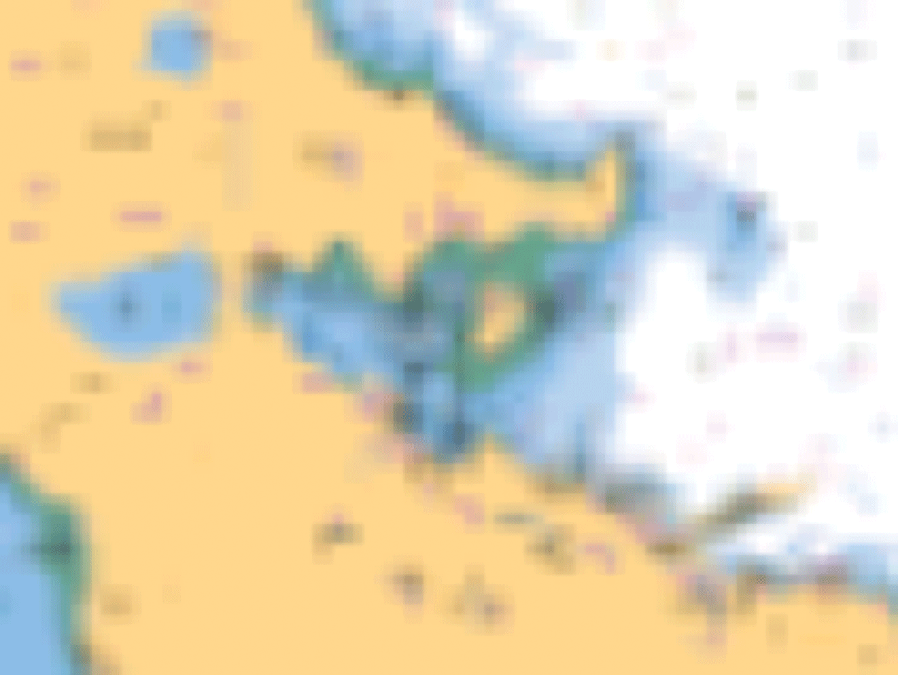
Raster chart (2/3)
Part of the previous raster chart blown up (by zooming) to show Vancouver harbour: no additional details are provided; very fuzzy image.
Fig. 16.9

Slide 20
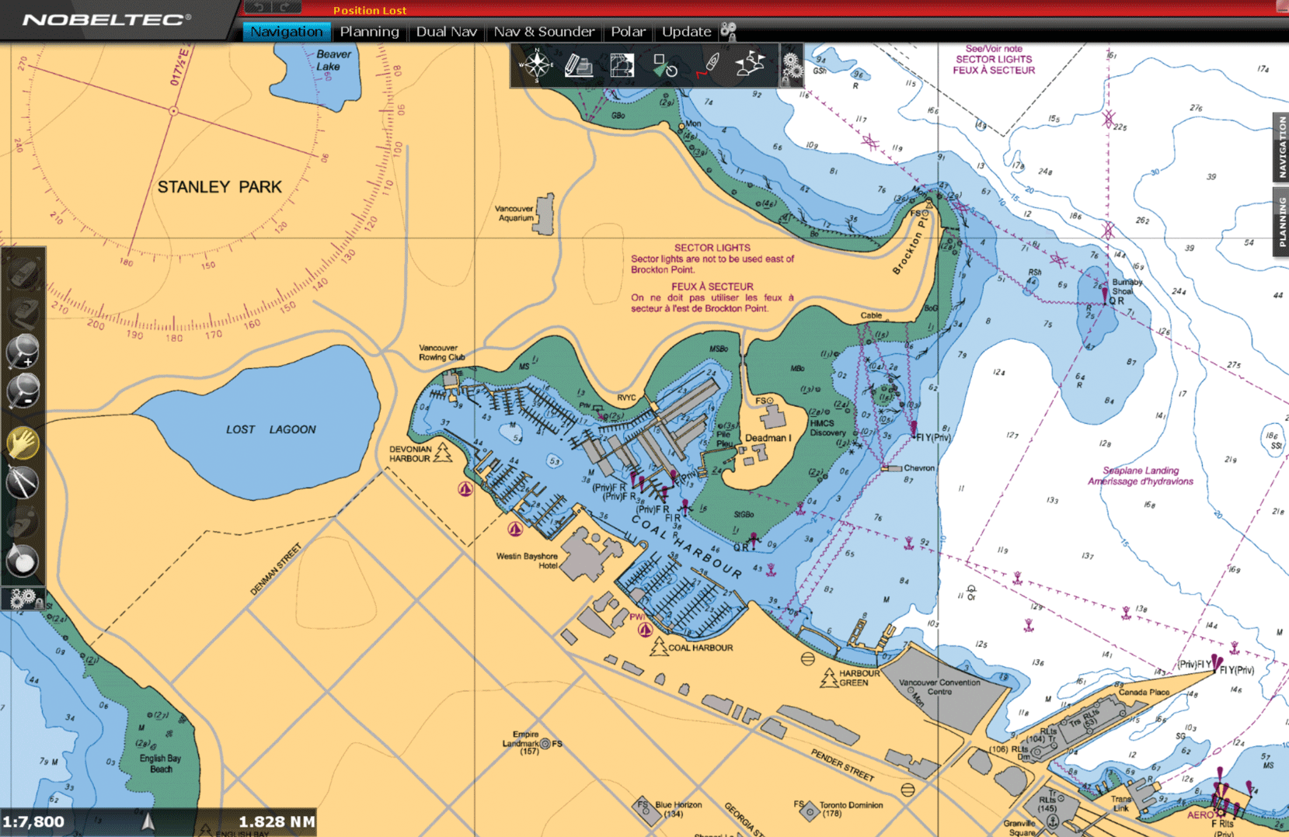
Raster chart (3/3)
Additional details can only be obtained from a different raster chart, with a much larger scale.
Fig. 16.10

Slide 21
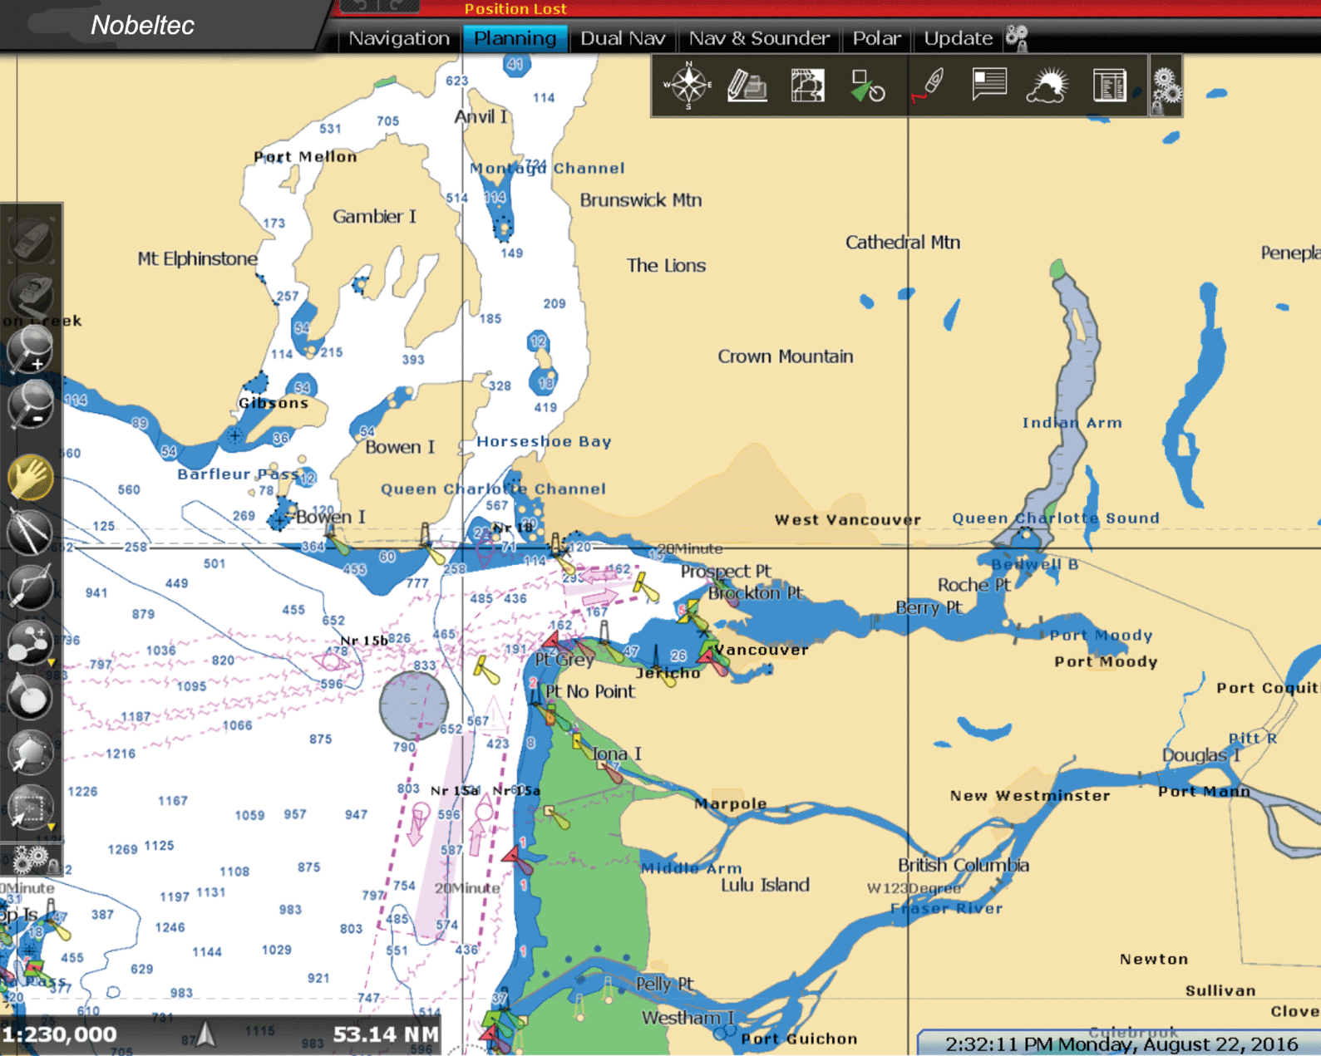
Vector charts (1/2)
Vector chart read on a laptop, with navigation software (top and left edges).
Fig. 16.11

Slide 22
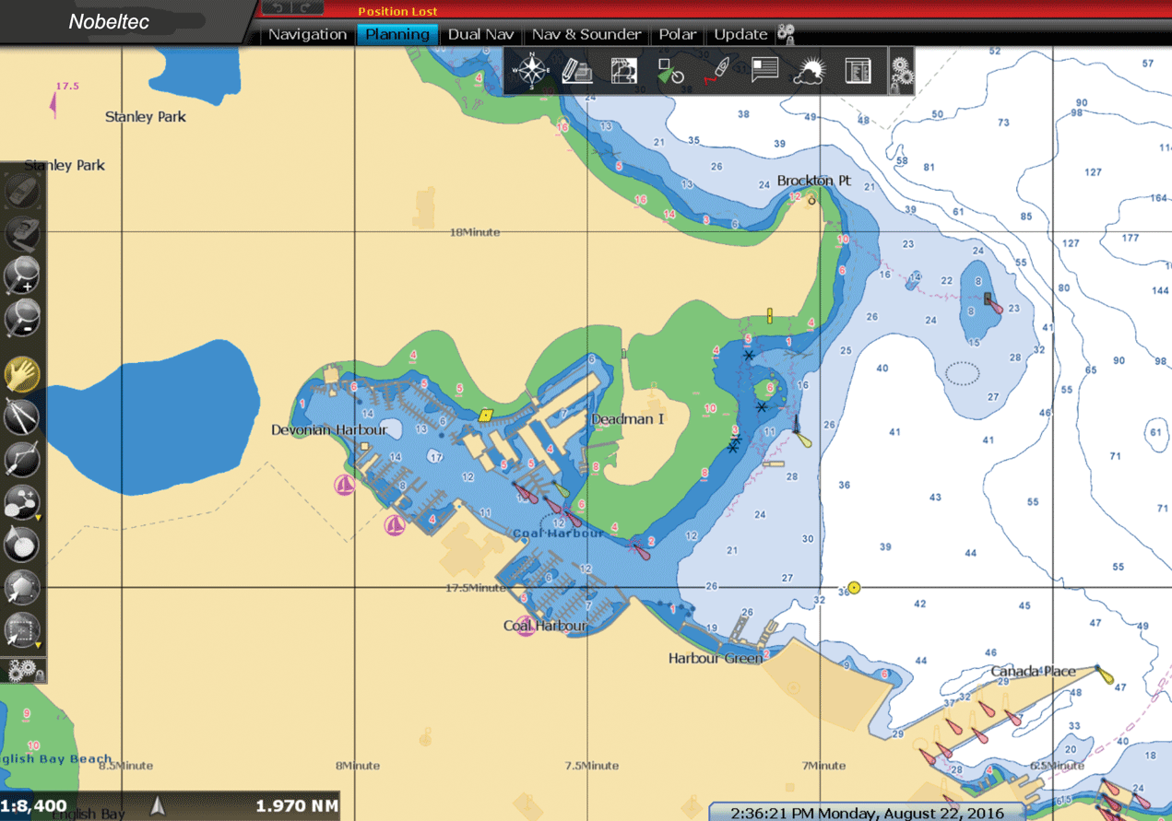
Vector charts (2/2)
Part of the previous vector chart blown up (by zooming) to show Vancouver harbour: all available details are provided. The writing remains perfectly readable, with the characters retaining the same size.
Fig. 16.12

Slide 23
End of Session 7

