Slide 1
Session 8
Review Exercises
Dominique Prinet www.MarineNavigationBooks.com 2017

Slide 2
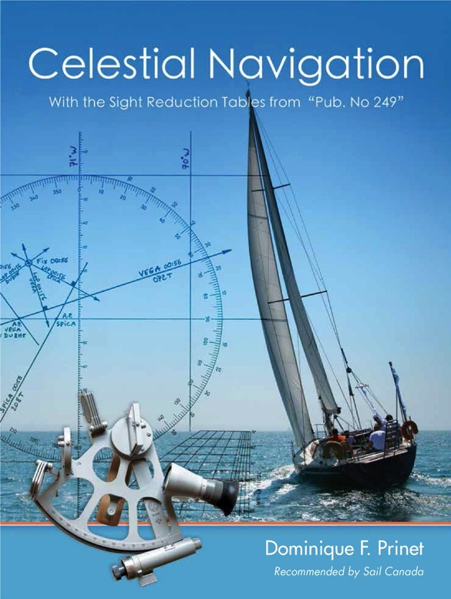
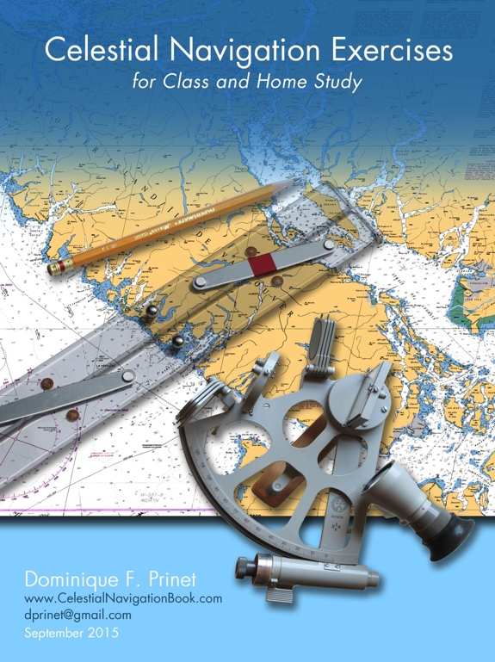
The exercises (questions and answers) are in the Exercise Manual
The class presentation follows the book:

Slide 3
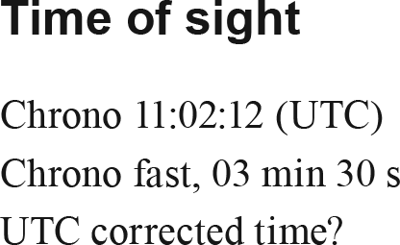
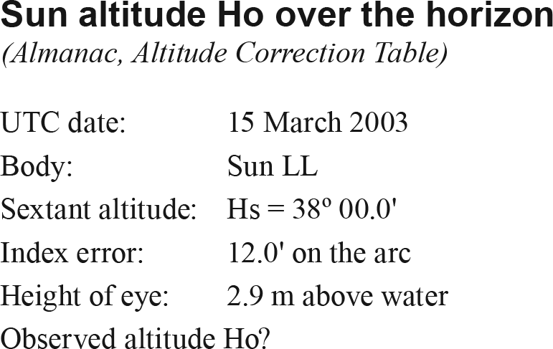
Exercise 41
Exercise 42

Slide 4
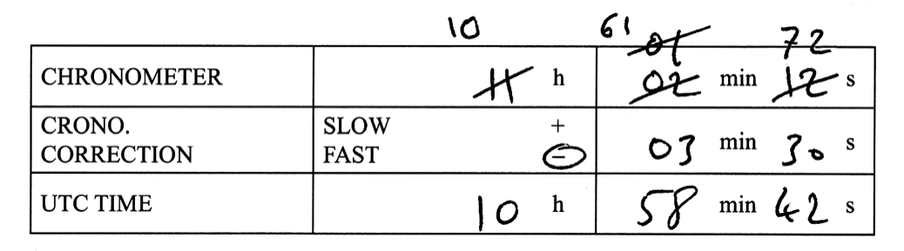
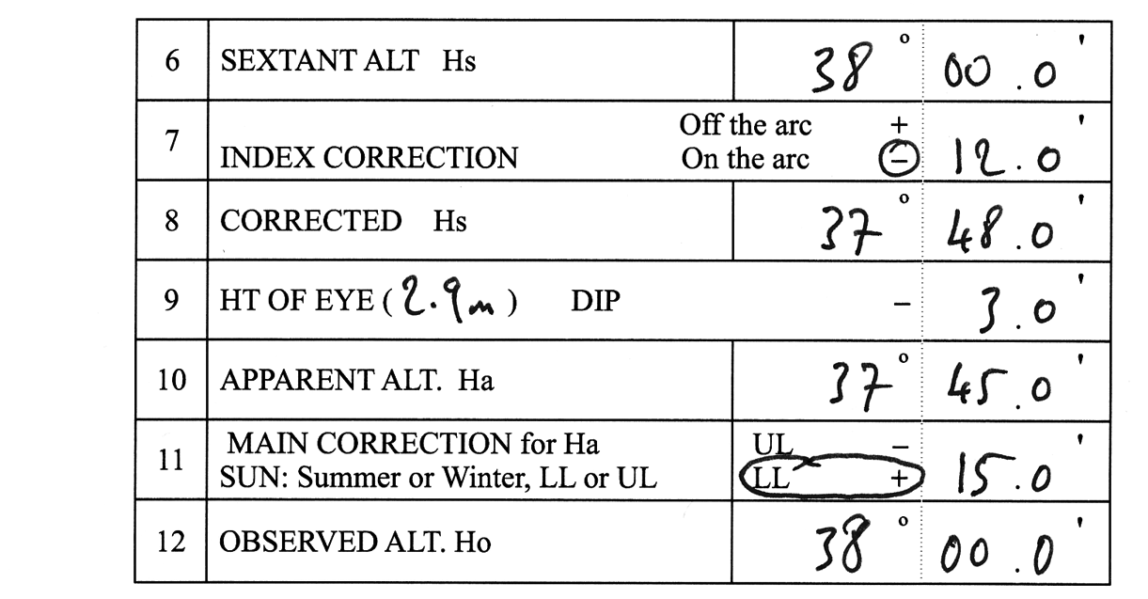
Exercise 41
Answer
Exercise 42
Answer

Slide 5
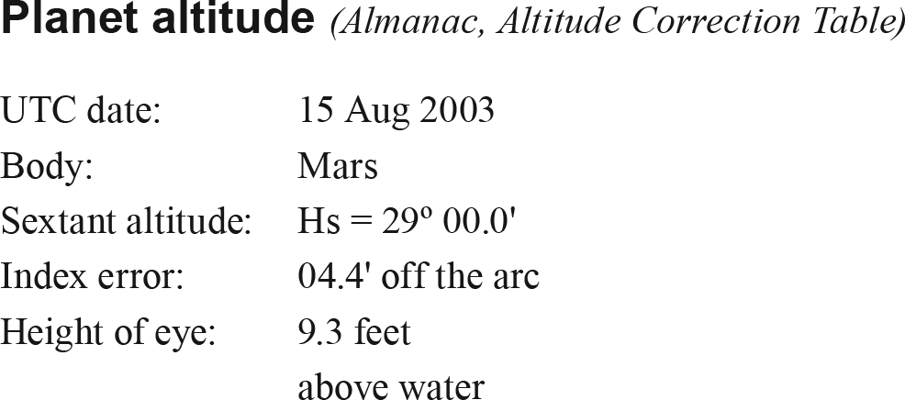
Exercise 43

Slide 6
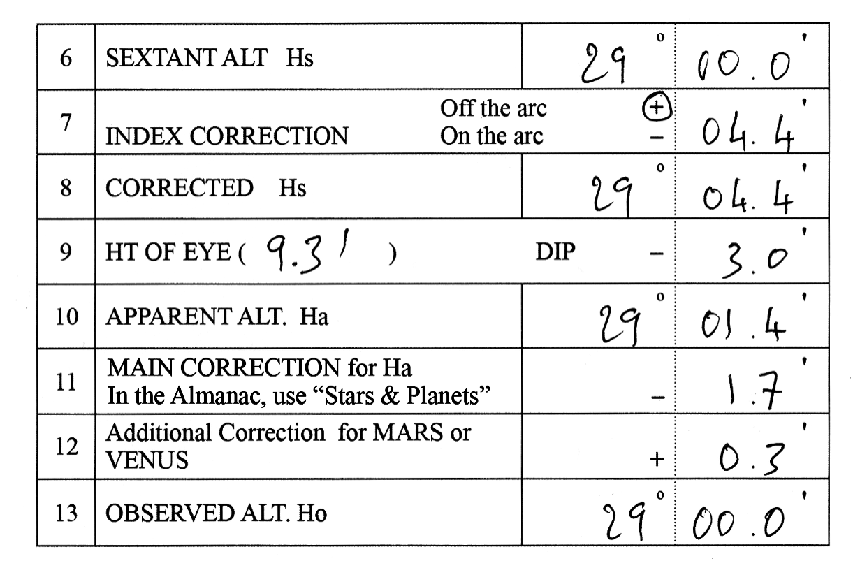
Exercise 43
Answer

Slide 7
Exercise 44

Slide 8
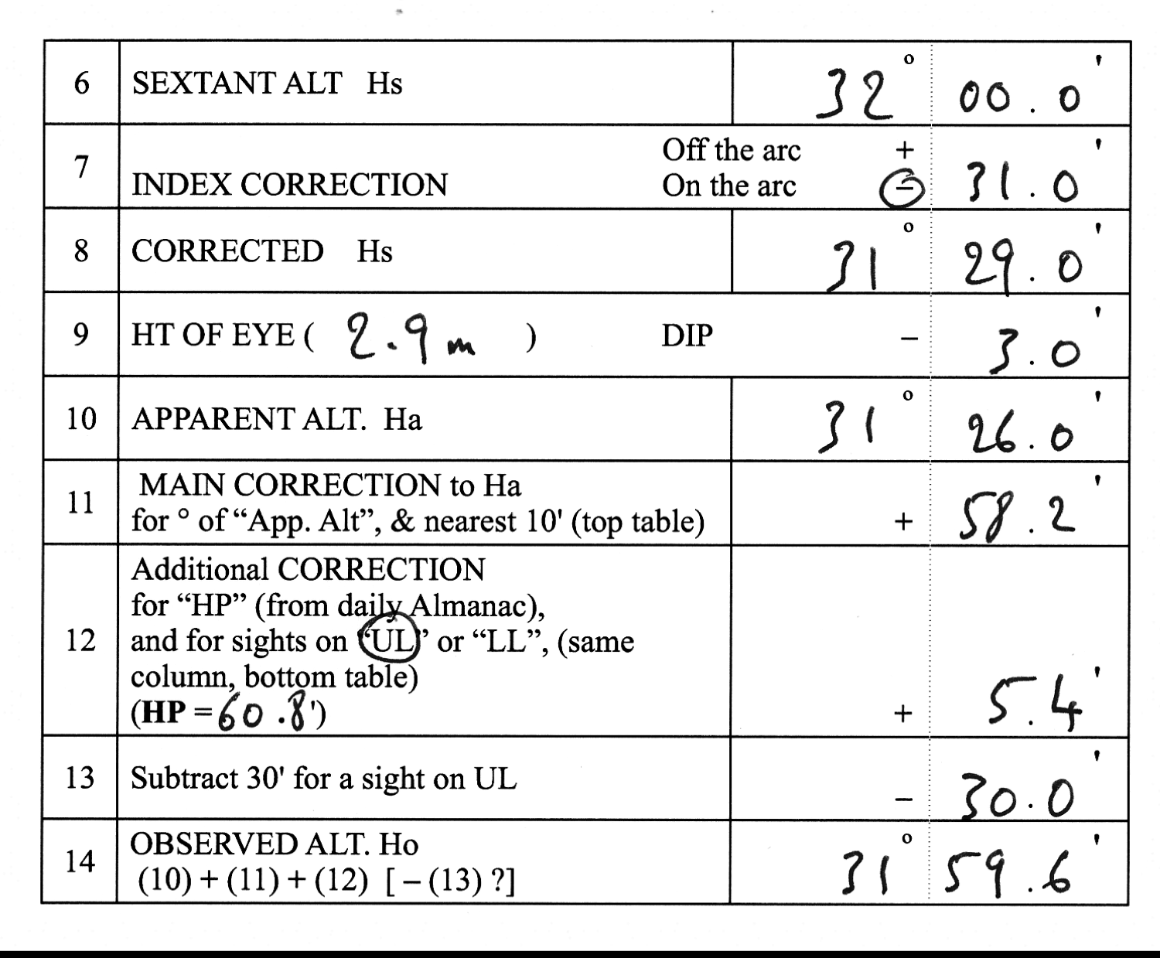
Exercise 44
Answer

Slide 9
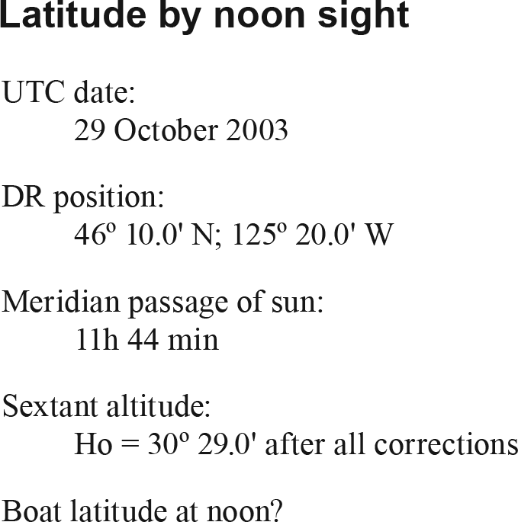
Exercise 45

Slide 10
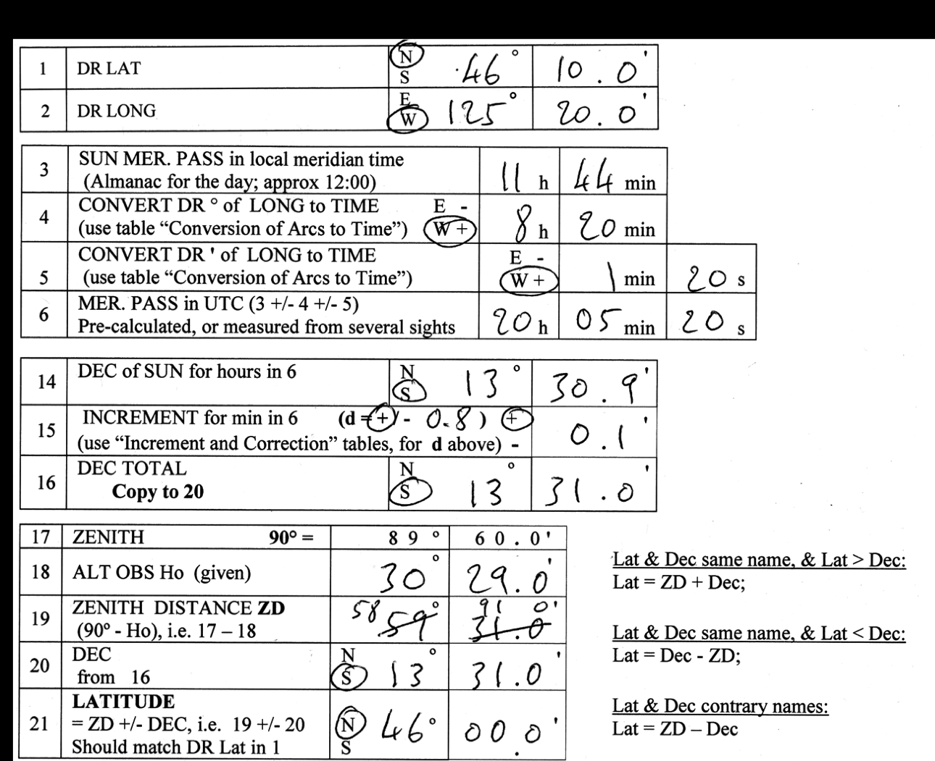
Exercise 45, Answer

Slide 11
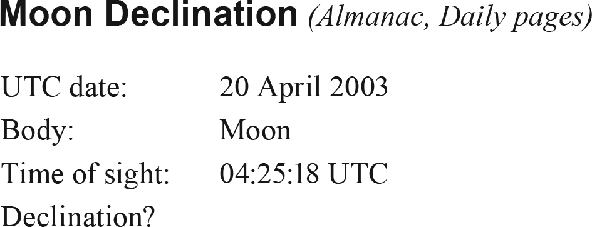
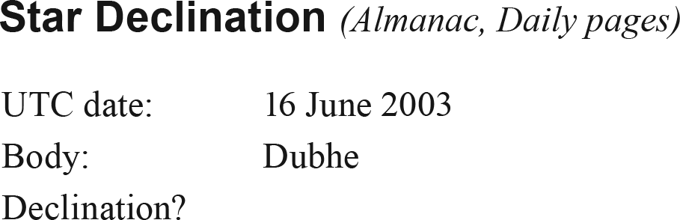
Exercise 46
Exercise 47

Slide 12
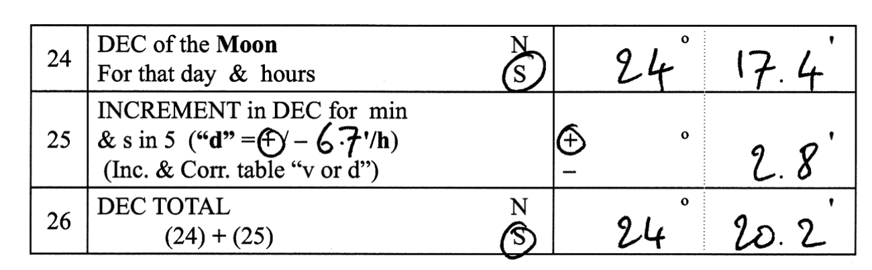
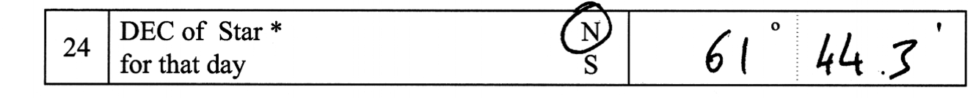
Exercise 46
Answer
Exercise 47
Answer

Slide 13
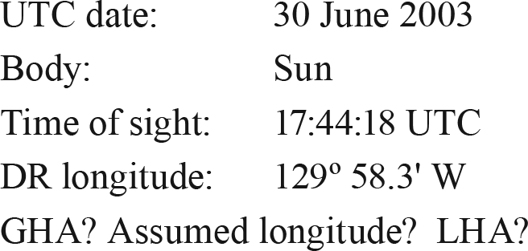
Exercise 48
Sun’s GHA; Assumed longitude; & LHA from the Boat to the Sun

Slide 14
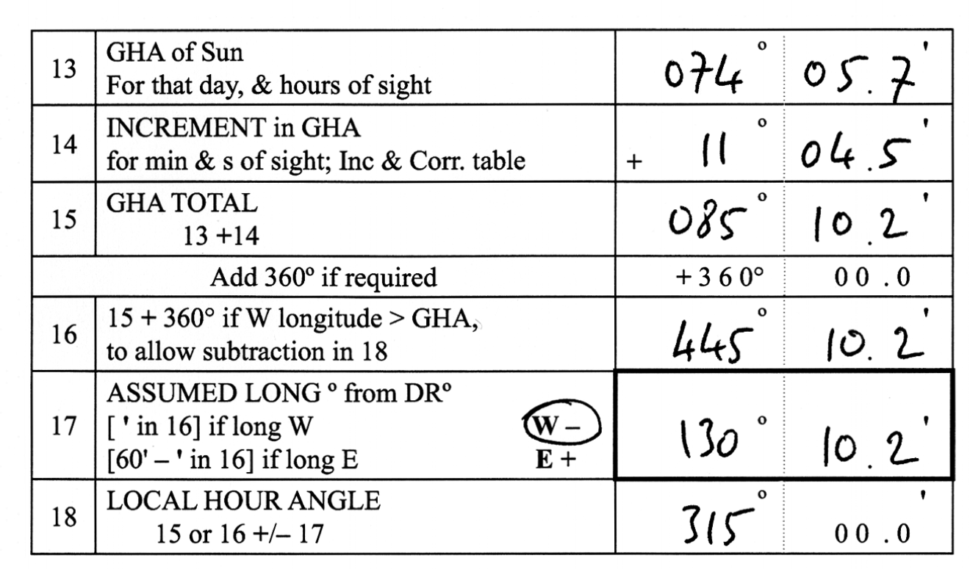
Exercise 48
Answer

Slide 15
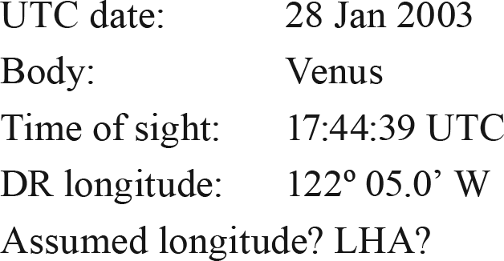
Exercise 49
Planet GHA; Assumed longitude; & LHA from the Boat to the planet

Slide 16
Exercise 49
Answer

Slide 17
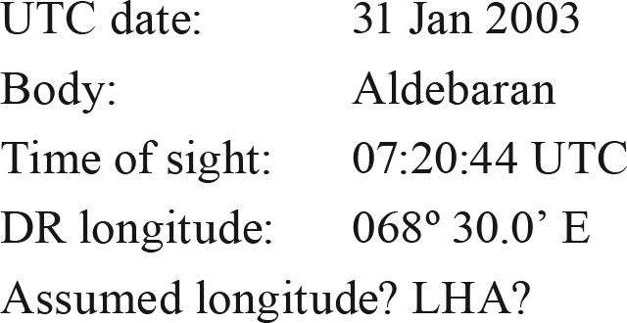
Exercise 50
Star GHA; Assumed longitude; & LHA from the Boat to the Star

Slide 18
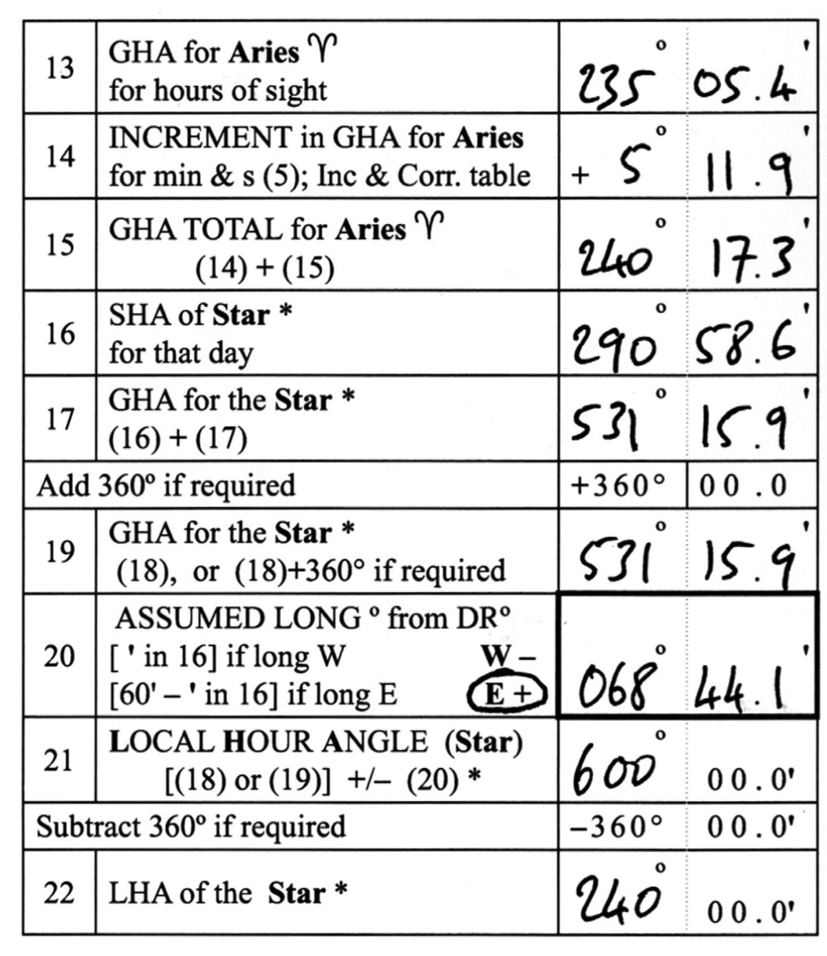
Exercise 50
Answer

Slide 19
Exercise 51

Slide 20
Exercise 51 Answer

Slide 21
Exercise 52

Slide 22
Exercise 52
Answer

Slide 23
Exercise 53
Twilights (Boat-meridian time)
July 01, 2003; Lat. 49º N
Sunset? Civil & Nautical EVENING twilights?
Use the Boat-meridian times

Slide 24
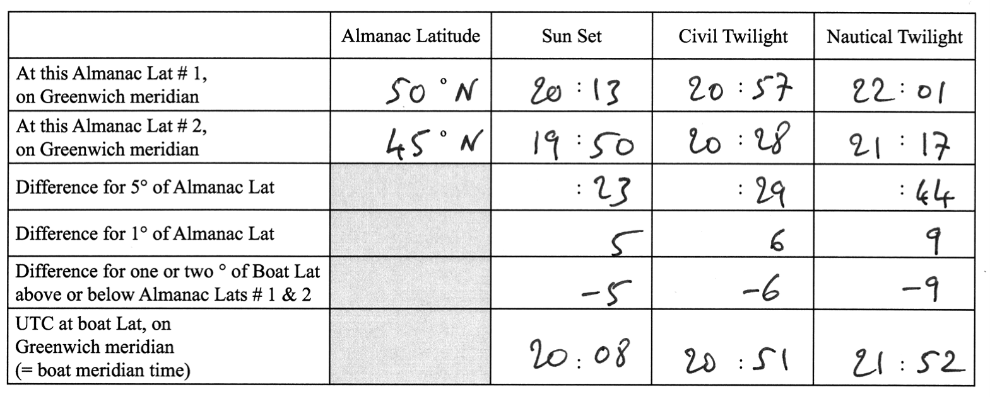
Exercise 53
Answer

Slide 25
Exercise 54
Twilights (Boat zone-time)
Nov. 18, 2003; Lat. 45º 00.0' N, Long. 123º 19.3' W
Express the Sunrise time, and DAWN twilights, in the zone-time of the zone within which the Boat is located

Slide 26
Exercise 54
Answer

Slide 27
Exercise 55
Zone time to UTC, and to Boat-meridian time
  Wrist-watch on the zone time,
  reading 04:25:37 (no watch error)
  Boat Long. = 148º 25.0' W
  UTC time?
  Boat-meridian time?
  no work form; use a blank sheet for calculations

Slide 28
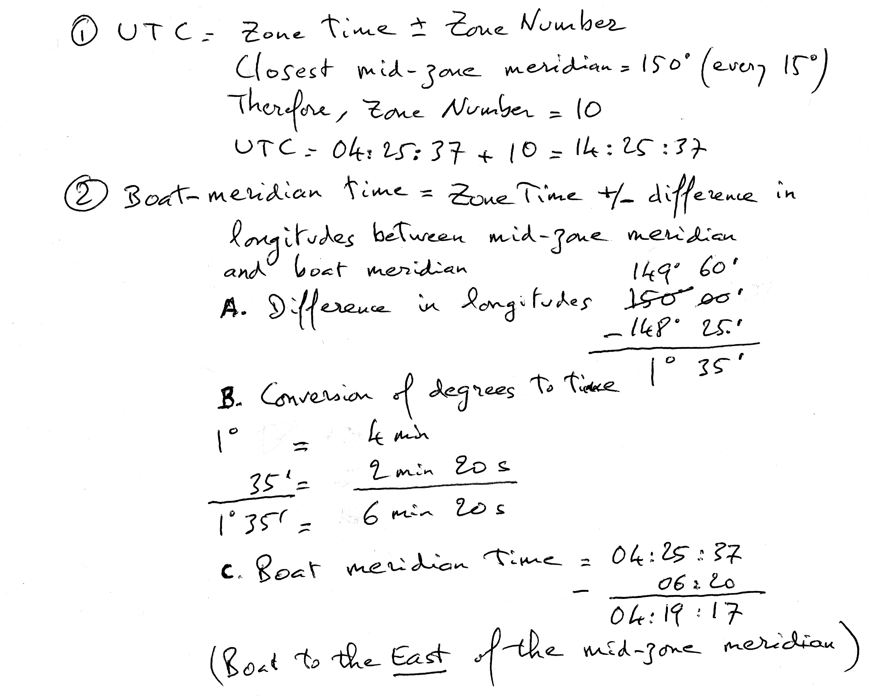
Exercise 55 Answer

Slide 29
Exercise 56

Slide 30
Exercise 56
Answer

Slide 31
Exercise 57
  Plotting a chart for the local ocean-area
  Prepare a plotting sheet to be used for Question 58. Its center should be at Lat. 47˚ N and Long. 130˚ W. Label the printed parallels of latitude one degree apart, and do the same for the meridians of longitude
Exercise 58
Plotting LOPs and Advanced LOPs on the chart (no calculations required)
  a) On the plotting sheet prepared for Exercise 57, plot the morning
  Sun bearings Zn, and the corresponding Lines of Position, after correcting for the intercept
  b) Advance the morning LOP to noon, and establish the noon fix
  c) Advance the noon LOP to the evening, and establish an
  evening fix

Slide 32
Exercise 58 Continued
Morning Sight
Assumed Position AP1: 48°N; 129° 10.0’W
Course: 230° T
Speed: 10 kn
Log: 2,350 NM
Time of sight: 05:30 (boat-meridian time)
True bearing of the sun: Zn = 100°
Intercept for AP1: A, 12’
Noon Sight
Course: 230° T
Speed: 10 kn
Log: 2,415 NM (65 NM travelled during the morning) Time of sight: 12:03 (boat-meridian time)
Calculated Lat.: 47° 35.0’ N
Evening Sight
Assumed Position AP3: 47°N; 131° 32.0’W
Course: 230° T
Speed: 10 kn
Log: 2,480 NM (65 NM travelled during the afternoon) Time of sight: 18:30 (boat-meridian time)
True bearing of the sun: Zn = 260°
Intercept for AP1: T, 08’

Slide 33
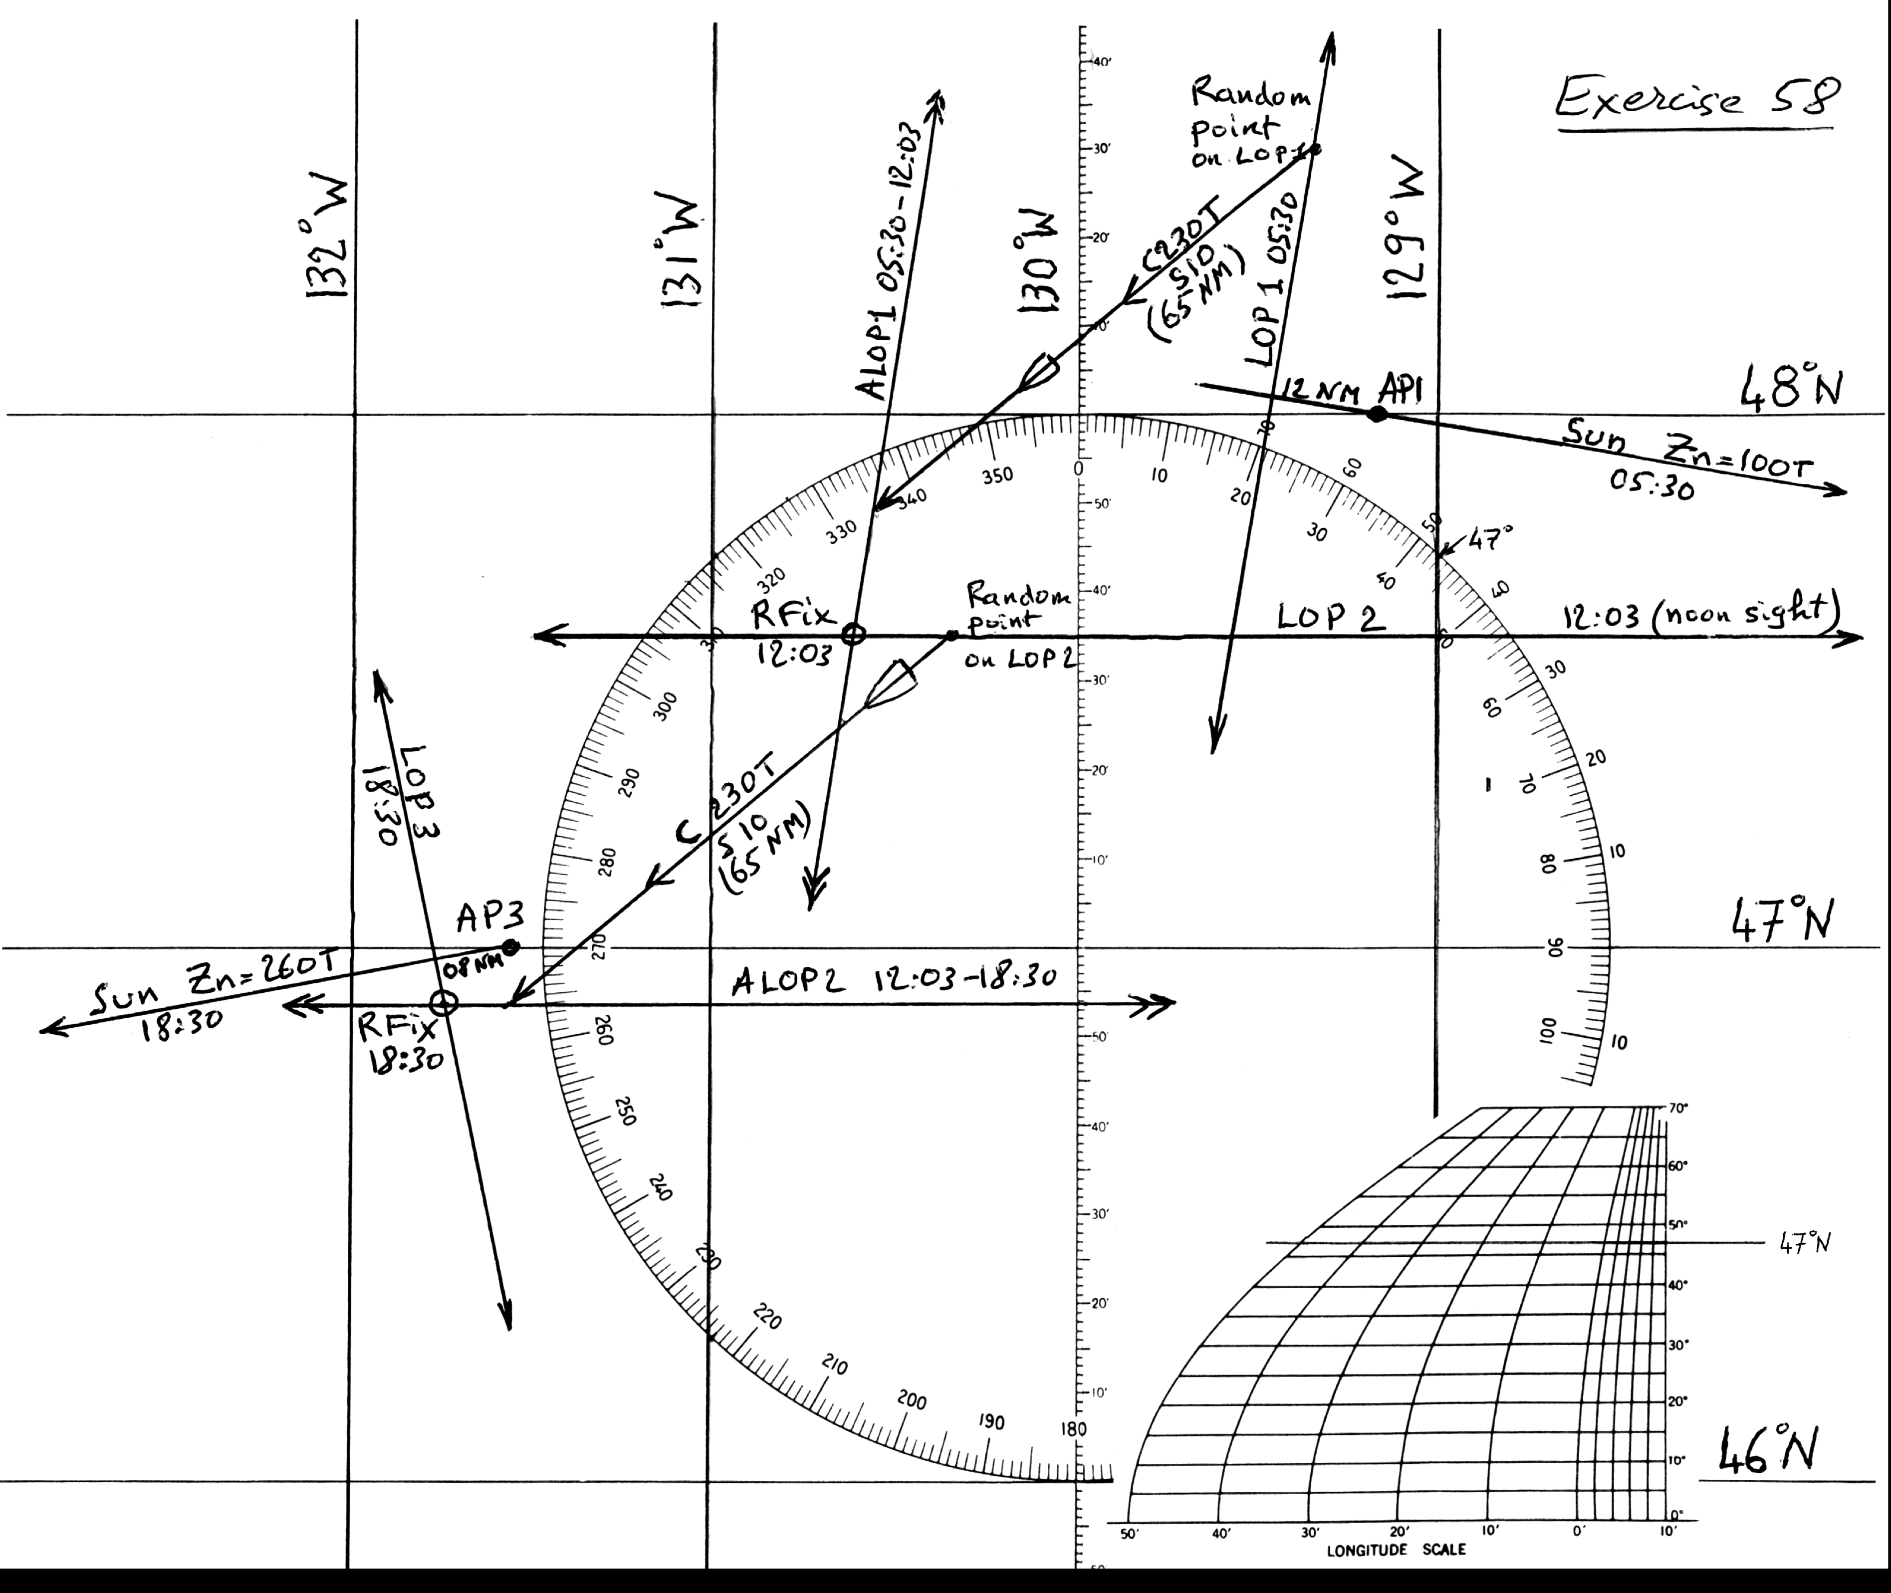
Exercise 57 & 58 Answer

Slide 34
End of Session 8
(Review Exercises)

