Slide 1
Ice Navigation
Ice is of direct concern to the navigator because
•
It restricts and sometimes controls his movements.
•
It affects his dead reckoning by forcing frequent changes
of course and speed.
•
It affects piloting by altering the appearance or obliterate
the features of landmarks.
•
It hinders the establishment and maintenance of aids to
navigation.
•
It
affects
the
use
of
electronic
equipment
by affecting
propagation of radio waves.
•
It
produces changes
in
surface features and
in
radar
returns from these features;
•
It
affects
celestial
navigation by
altering
the
refraction
and obscuring the horizon and celestial bodies

Slide 2
ICE
INFORMATION
SERVICES
•
General
ice
information
can
be
found
in
the mariner’s
hand book, sailing directions, ocean passage for the world
and routing charts.
•
Up
to
date
ice
report
and
forecasts
are
transmitted
by
coast radio through
Nav-tex, EGC, VHF, MF, HF,RT, FAX
and Facsimile for ling ranges.
•
Routine and tailored
ice products of the NIC (The USA
National Ice Center) can be separated into two categories:
a) Analyses which describe current ice conditions and
b)
Forecasts which
define
the
expected
changes in
the
existing ice cover over a specified time period.

Slide 3
ICE
INFORMATION
SERVICES
•
Sea ice forecasts are routinely separated into
four temporal classes: short-term (24–72 hour),
weekly (5– 7days), monthly (15–30 days) and
seasonal (60–90 days) forecasts.
•
Ice analyses are produced by blending relatively
small numbers
of
visual ice
observations from
ships, shore stations and fixed wing aircraft with
increasing amounts
of
remotely
sensed
data.
These data include aircraft and satellite imagery in
the visual, infrared, passive microwave and radar
bands.

Slide 4
INTERNATIONAL
ICE
PATROL
I NTE RNATI 0 NAL
ICE PATROL

Slide 5
International
Ice
Patrol
•
The
International
Ice
Patrol
was
established
in
1914
by the International
Convention
for
the
Safety of Life at Sea (SOLAS), held in 1913 as a
result of the sinking of the Titanic
in 1912.
•
The
International
Ice Patrol
is
conducted
by
the U.S.
Coast Guard,
which
is
responsible
for
the observation and dissemination of information
concerning ice conditions in the North Atlantic.

Slide 6

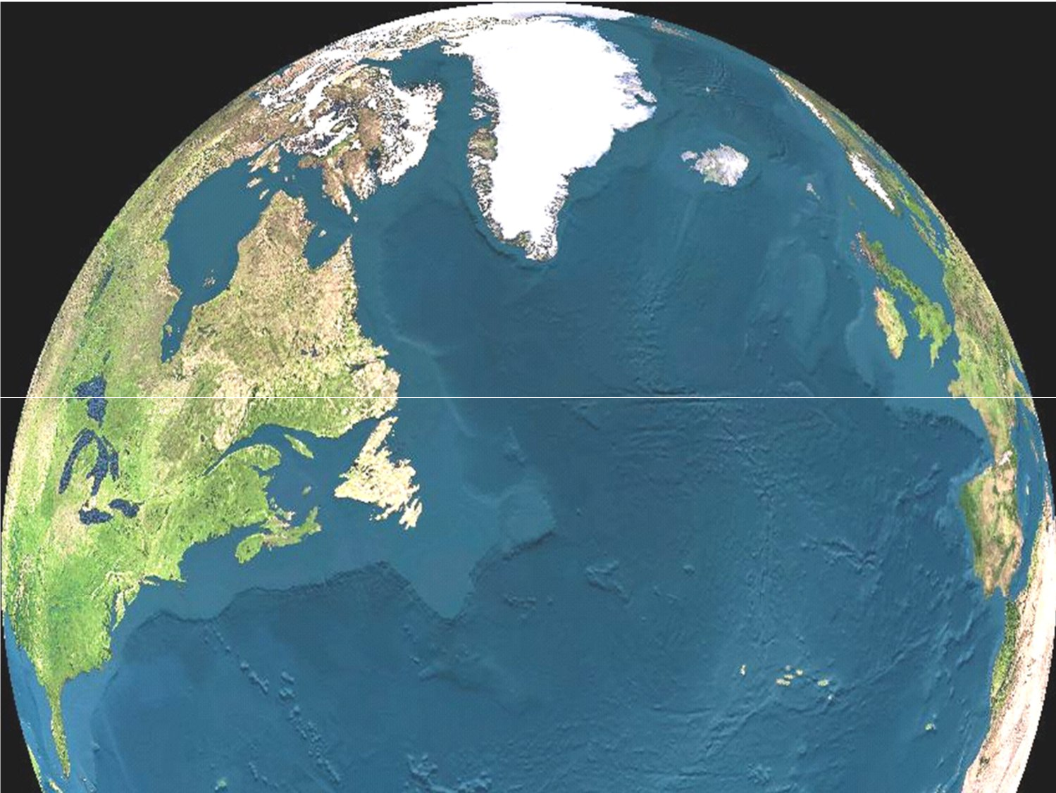
TITANIC
International Ice Patrol
Promote safe navigation in the
Northwest Atlantic Ocean when danger of iceberg collision exits.

Slide 7
International Ice Patrol
IIP
IIP Mission:
Monitor the iceberg danger near the Grand
Banks of Newfoundland and provide the limits
of
all known ice to the maritime community.
IIP Vision
Eliminate the risk of iceberg collision.

Slide 8
Icebergs
South
of
48N
MapP"o_inr'
Note
Few (or no) icebergs south of
48N does not mean there are
no icebergs anywhere!
How many
days are icebergs a threat south of 48N in a given year?
(When did IIP begin and stop issuing products?)
Feb To June
.st. John'.
Grand&nks
ATLANTIC OCEAN
40"
Where icebergs pose greatest threat to most ships

Slide 9
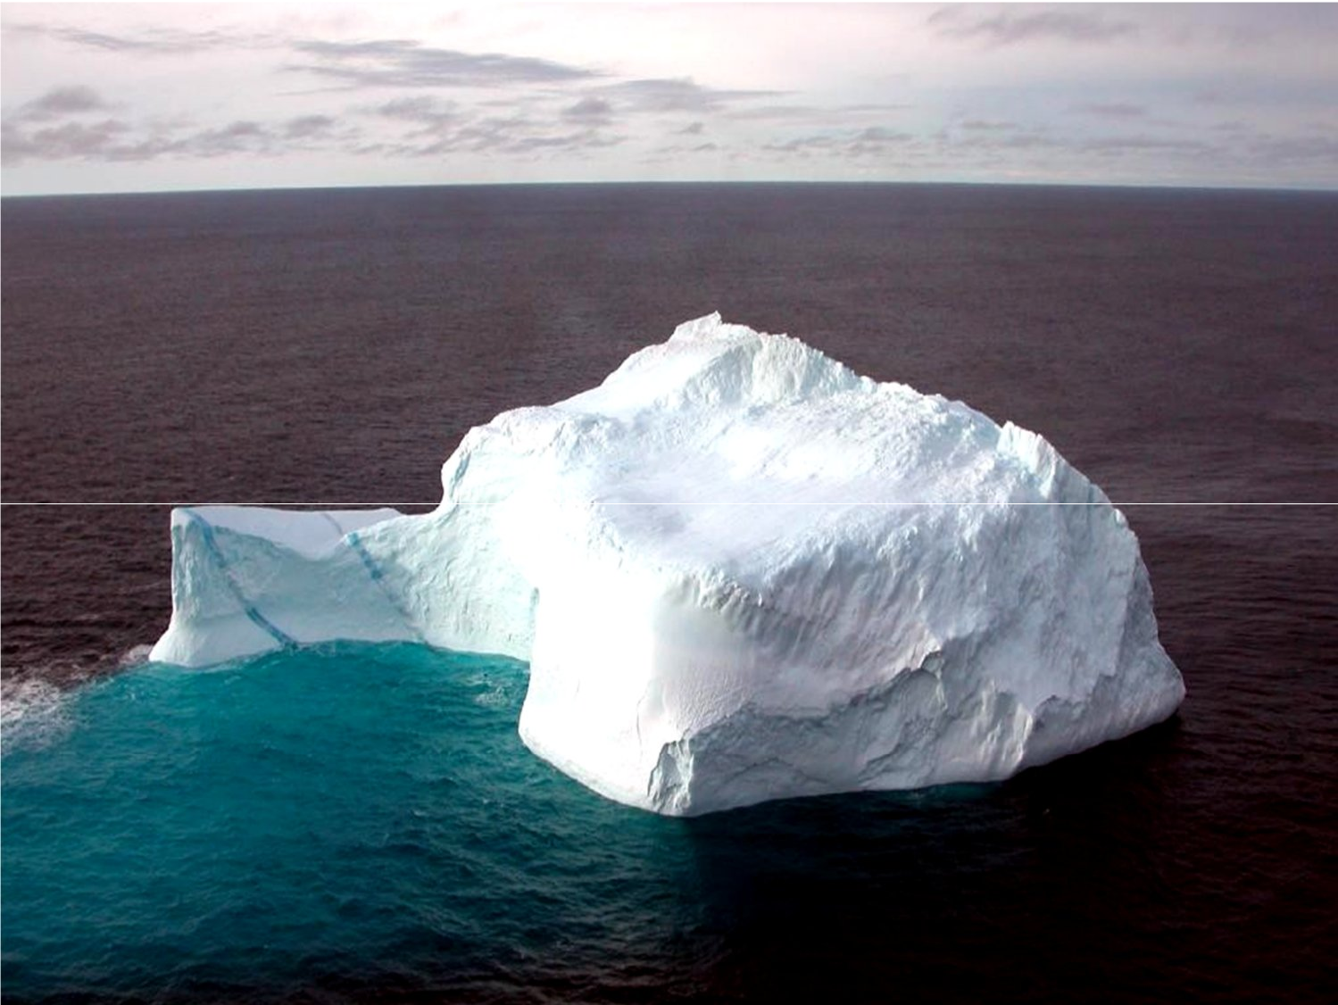
How does IIP monitor the iceberg danger near the
Grand Banks of
Newfoundland?
How does IIP provide the
maritime
limits of all known ice to the
community?

Slide 10
IIP use a Berg Analysis & Prediction
System
(BAPS)…and
issue
Daily Products
- - - - -
••••••••••
6.
~
SEA ICE UMIT
AREAOF MANY ICEBERGS
ICEBERG
GROWLER

Slide 11
Function
of
the
Ice
Patrol
•
The prime function of
the Ice Patrol is to warn shipping of the
extent of sea
ice and
icebergs which may affect vessels on the
main shipping routes.
•
Ice reports from shipping, together with weather reports from
shipping, assist the Ice Patrol to piece together any movement
of ice, and allow the construction of a facsimile chart of
conditions for general broadcast to all shipping within the area.
•
Reports are made by the Ice Patrol twice daily, together with
the dispatch of the facsimile chart. Additional reports of ice
sightings are broadcast whenever considered necessary.
Transmitting stations, together with frequencies and channels,
are as described in the A dmiralty List
of Radio Signals Vol 3, Part 2.!!!!!

Slide 12
Signs
of
icebergs
•
The observation of growlers or smaller pieces of detached ice is an
indication that an iceberg is in the vicinity, and probably to
windward; an iceberg may be detected in thick fog by this means.
•
There are two reliable signs of drift ice.
Ice Blink whose characteristic light effects in the sky once seen, can
never be mistaken, On clear days, with the sky mostly blue, ice blink
appears as a luminous yellow haze on the horizon in the direction of
the ice.
Abrupt smoothing of the sea and the gradual lessening of the
ordinary ocean swell is the other reliable sign, and a sure indication
of drift ice to windward.
•
Other likely signs include the presence of isolated fragments of ice
which often point to the proximity of larger quantities.
There is frequently a thick band of fog over the edge of drift ice. In
fog, white patches indicate the presence of ice at a short distance.

Slide 13
APPROACHING
ICE
•
The engines and steering gear of any ship intending to operate in
ice must be reliable and capable of quick response to
maneuvering orders.
•
The navigational and communications equipment must be equally
reliable and particular attention should be paid to maintaining
radar at peak performance.
•
Ships operating in ice should be ballasted and trimmed so that the
propeller is completely submerged and as deep as possible, but
without excessive stem trim which reduces maneuverability. If
the tips of the propeller are exposed above the surface or just
under the surface, the risk of damage due to the propeller striking
ice is greatly increased.
•
Ballast and fresh water tanks should be kept not more than 90 per
cent full to avoid risk of damage to them from expansion if the
water freezes. Good searchlights should be available for night
navigation with or without ice breaker escort.

Slide 14
OPERATING IN ICE
•
In ice concentrations three
basic
ship
handling rules apply:
1- Keep moving, even
if very
slowly;
2- Try to work with the
ice movement
and
not against it;
3-Excessive speed leads to ice damage .

Slide 15
OPERATING
IN
ICE
•
Vessels
without operational
radar
should
be
prepared
to
stop
during
the
hours
of
darkness if the concentration
of dangerous
ice warrants
such
action,
and
should
at
any time proceed only
at a safe speed.
•
Ice
reports should
be
continually
obtained
and charts updated in
accordance with the
vessel’s progress.

Slide 16
THE MASTER'S DUTY REGARDING ICE
•
Avoidance: The International Convention for the
safety of Life
at Sea (SOLAS), 1974, requires the Master of every ship, when
ice is reported on or near his track, to proceed at a moderate
speed at night or to alter course to pass well clear of the danger
zone .
•
Reports: He is also required to make the following reports:
On meeting dangerous ice:
•
Type of ice ,
•
Position of the ice, UTC (GMT) and date of observation.
On encountering air temperatures below freezing associated with
gale force winds causing severe ice accumulation on ships
•
Air and sea temperatures;
•
Force and direction of the wind;
•
Position of the ship,
•
UTC (GMT) and date of observations.

Slide 17
ICE
REPORTS
•
Extent: Ice reports are available when ice is prevalent for the
Arctic, Iceland, Baltic Sea, East coast of Canada, Gulf of Saint
Lawrence, Gulf of Alaska, Bering Sea, Sea of Okhotsk, Sea of
Japan and Antarctica. Some of these are Facsimile reports
.
Details of these reports and the radio stations transmitting them
are given in
ALRS Vol 3 .
•
International
Ice
Patrol:
The
United
States Coast
Guard
operates
the
International
Ice Patrol,
the
cost
being
met
by
Signatory Nations to the 1974 SOLAS Convention. Its prime
object is to warn ships of the extent and limits of icebergs and
sea
ice
in
the
North
Atlantic
near
the
Grand
Banks
of
Newfoundland. The service operates during the ice season from
late
February or
early March
to
about
the
end
of
June.
For
details, see ALRS Vol 3.

Slide 18
OET NORSKE METEOROlOGISKE
INSTlTlm
I~~lUoF.JC'UL
atAATIJf'NfIH! ~ :
\'E~II."~ NC;AFC~t-O~")'~O~C:=
Mft",,\w~r~
\
\

Slide 19
ICE ACCUMULATION ON SHIPS
•
Ice accumulation may occur from three causes :
1- Fog,
including
fog
formed
by evaporation
from a
relatively warm sea surface, combined with freezing
conditions;
2- Freezing drizzle, rain or wet snow
3- Spray or sea water breaking over the ship when the
air temperature is below the freezing point of sea water
(about -2° C)

Slide 20
ICE
ACCUMULATION
Avoiding ice accumulation:
The Mariner is advised to exercise all possible caution whenever
gales are expected in combination with air temperatures of -2°C
or below.
These conditions are most likely to occur with winds from polar
regions, but the direction may be any that will transport
sufficient cold air. If these conditions are expected, the prudent
course is to steer towards warmer conditions, or to seek shelter,
as soon as possible.
If unable to reach shelter or warmer conditions, it has been found
best to reduce spray to a minimum by heading into the wind and
sea at the slowest speed possible, or if weather conditions do not
permit that, to run before the wind at the least speed that will
maintain steerage way.

Slide 21
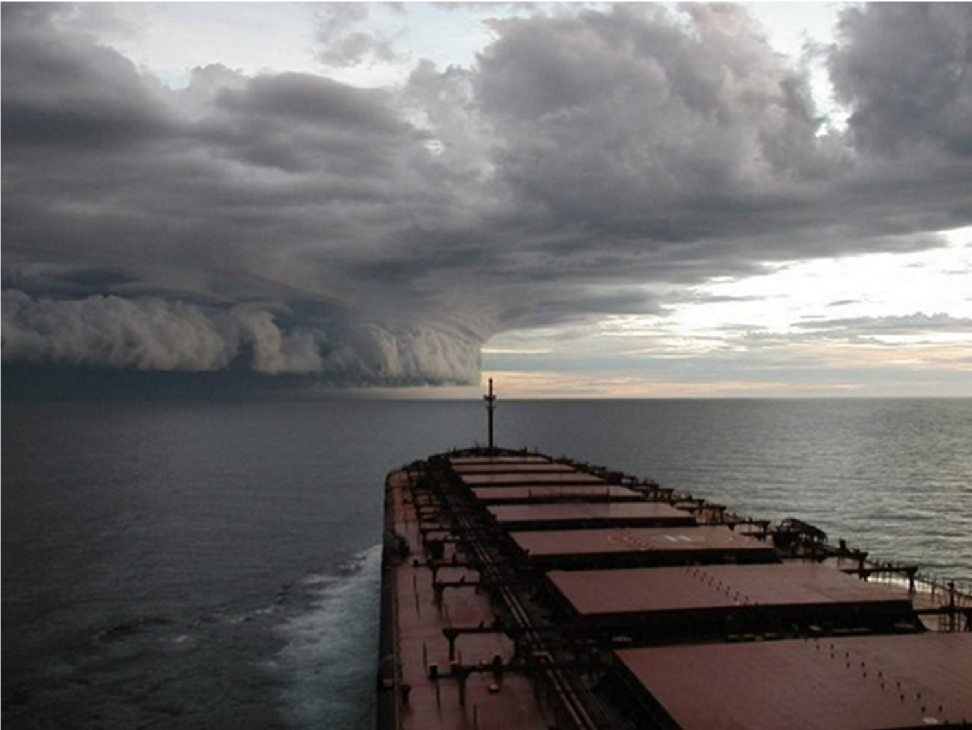
Capt. Rasoulzad

Slide 22
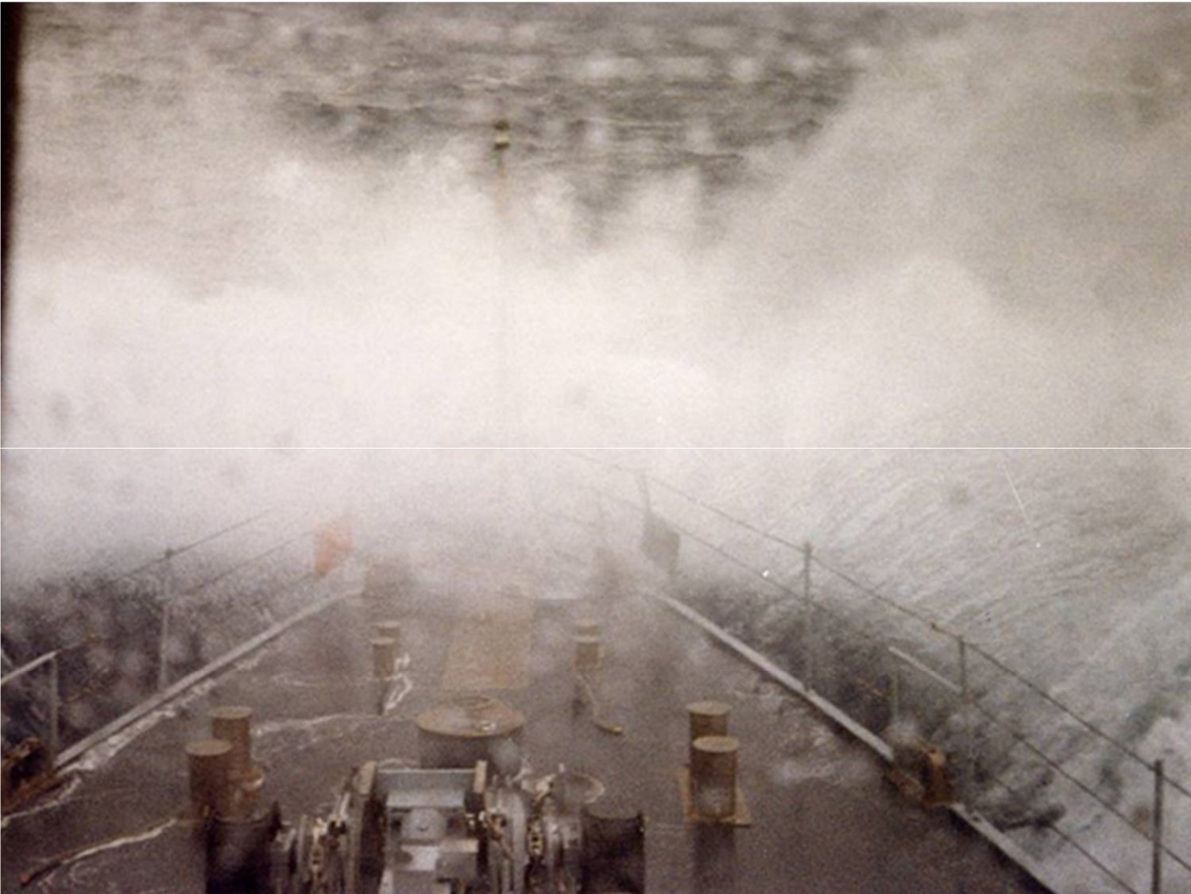
Capt. Rasoulzad

Slide 23
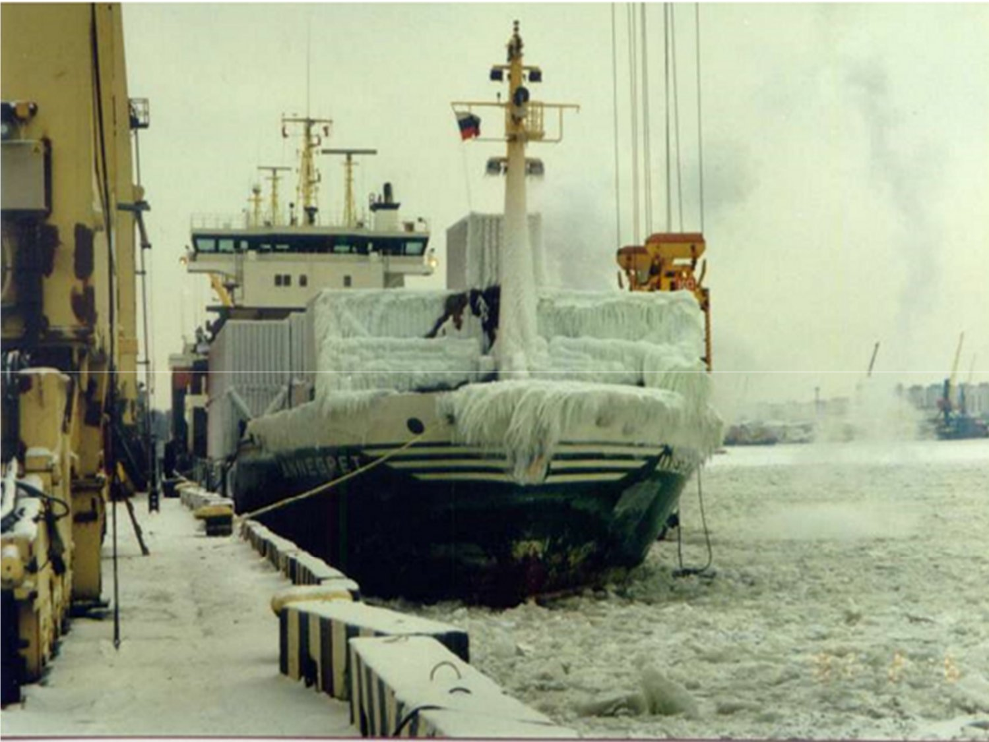
Capt. Rasoulzad

Slide 24
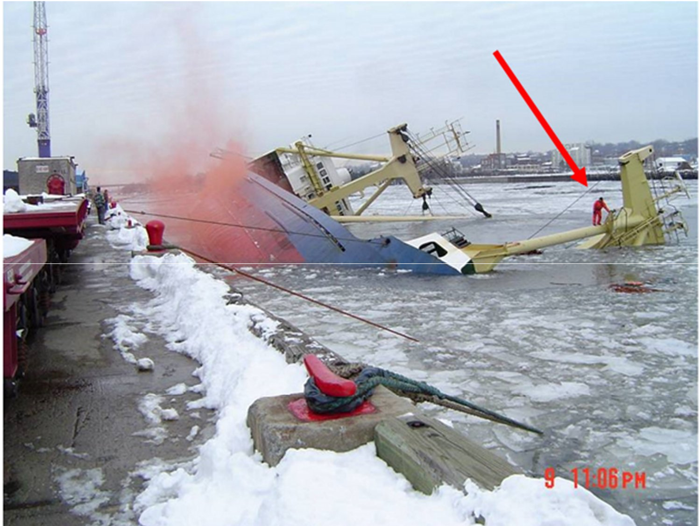
Capt. Rasoulzad

Slide 25
Obligations on
sighting
ice
 Under regulation 31 of chapter V of SOLAS-74,
master who meets dangerous ice is bound to
inform about this to ships near the vicinity and
the authorities.
 As per regulation 32, an ice danger message is
to be transmitted. It should contain:
 The
kind of ice observed
 The
position of ice when last observed
 The
time and UT when the ice last observed.

Slide 26
Factors
of
ice
accretion
 If wind force increases above force 6, the rate
of
ice accretion increases because:
 Wind chill factor increases.
 Air temperature falls below -2°C
 Sea temperature decreases
 Shipping seas and sprays increases
because of
Excessive ship's speed & Unsuitable ship's course
❖ Rate of ice accretion on a slow moving ship with
the wind ahead or on the beam, given wind and
sea temperature, can be estimated using "Icing
Nomograms" given in mariner's handbook

Slide 27
\/lind
20
speed
30
(m/s)
40
o
10
50
o
32
-4
24
DC
(OF)
16
-8
-12
8
-16
o
-20
o
20
40
Wind
60
speed
80
(Knots)
100
Sea temp erature
+ 1°C
ICING
NOMOGRAlVI

Slide 28
Precautions before proceeding to ice zone
Before proceeding to ice zone, check the following
items:

Article of agreement and the geographical limit,
expiry
of
article of agreement.

Class certificate, if ship has ice notation.

Check the charter party contract

Insurance coverage – premium may be high.
Engine department:
•
To check heating system for accommodation,
steering
gear,
bridge windows;
•
To check viscosity of hydraulic oil for all cranes, winches and
boat engines, if necessary, renew.

Slide 29
Deck department to check / indent
/ensure
availability of :
•
Warm clothing for full complement
•
Protective gloves
•
Extra blanket
•
Spare bulbs for navigation
light
•
Steam hoses
•
De-icing compounds
•
Axe, shovels.
•
Navigating officer to ensure that Navigational
equipment's in good working condition
•
Sufficient charts are available
•
Gather all information regarding the limits of ice,
ice
seasons, navigation in ice.

Slide 30
Cold weather
precautions

Inform all departments

Organize and brief bridge team
prior to entry into
the
ice
regarding:
•
Indications of presence of ice
•
Not to be overexposed to extreme cold
•
Look outs need to be rotated at short interval
•
Report to master on sighting ice
•
Regular radar watch in appropriate range
•
Second watch keeper

Obtain up to date ice reports and ensure that
ice limits are
entered in the chart, plot occasional icebergs.

Change over to manual steering until the vessel is clear of
ice
region. Helmsman to report D/O if loss of steering.

Slide 31
Followings to be checked regularly:
•
Steering gear
•
Heating arrangements of steering gears
•
viscosity of hydraulic oil for all cranes, winches and boat
engines, if necessary, renew.
•
Check all navigation equipment's are in satisfactory
conditions.
•
Check navigation lights, search light and sound signaling
appliances
•
The ship has sufficient stability
•
Ship should be sufficiently trimmed that propeller tips are
well
submerged.
•
Ballast tanks, FW tanks, life boat FW tanks not to press up
full, keep allowance for expansion. Especially above water
line tanks. Calculate free surface effect.

Slide 32
•
Drain fire lines on deck.
•
All deck scuppers to be cleared to prevent water
trapping on deck.
•
Cover deck machinery and controls with canvas.
•
If steam windlass, run slowly.
•
Cranes/ derricks to be freeze, to prevent this, they
should be topped/slewed at regular intervals.
•
Hawse pipes/ sparling pipe covers are in position.
•
Rig life lines on deck as may become slippery
•
All LSA/FFA in satisfactory condition and ready
for immediate use.

Slide 33
Actions when
navigating
in the
vicinity of
ice
Ensure the followings, when navigating in the vicinity of
ice:

Additional look out have been posted, they know their
duties.

Continuous radar watch

Obtain as much information possible about sighting ice
and other navigational warnings.

Monitor temperature of air and sea, especially at night.

Make obligatory reports of ice sighting
as per
MSA/SOLAS.

Adjust the speed of the ship if passing
through the ice,
according to the type and thickness of
ice.

Slide 34

Inform engineers when temperature drops to
about 0 to 1°C.

Information received from ice patrol, coastal
stations, shipping broadcast and meteorological
observations may result in an alteration of course
to avoid ice.

Make the fullest use of navigation equipment and
aids to ascertain accurate navigation.

Ensure the deck is safe for
crews to go about their
normal duties. Remove ice
by chipping or by
sweeping.

Do not use normal window
washers. Use window
heaters instead.

